Slide 1
4.8 Workshop:
The reality of married clergy in our Church today
DEACON TONY AND ANNETTE HOBAN

Slide 2
PRAYER
FOR THIS WORKSHOP

Slide 3
Agenda
Who you are and why you are here
Something about us
Some learnings from our journey,
including ministry as a couple
Some learnings for the broader church

Slide 4
Who are you and what brings you to this workshop
Name
Ministry/Vocation
What brought you to this workshop

Slide 5
Who we are and what we’re doing now

Slide 6
“Now after this the Lord appointed seventy others, and sent them in pairs ahead of Him to every city and place where He Himself was going to come.” - Luke 10:1.

Slide 7

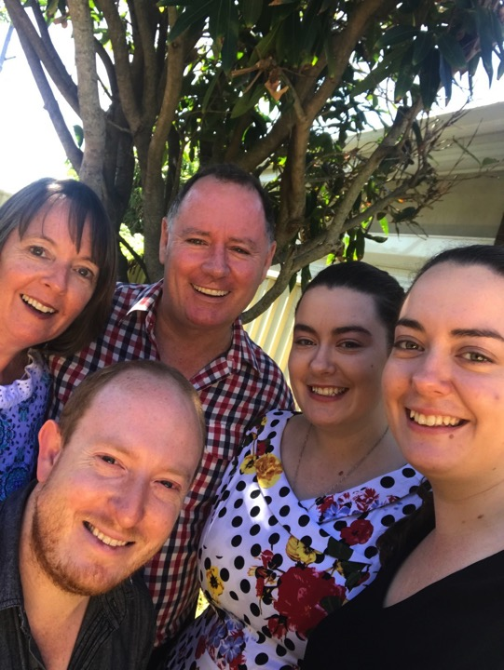

Slide 8
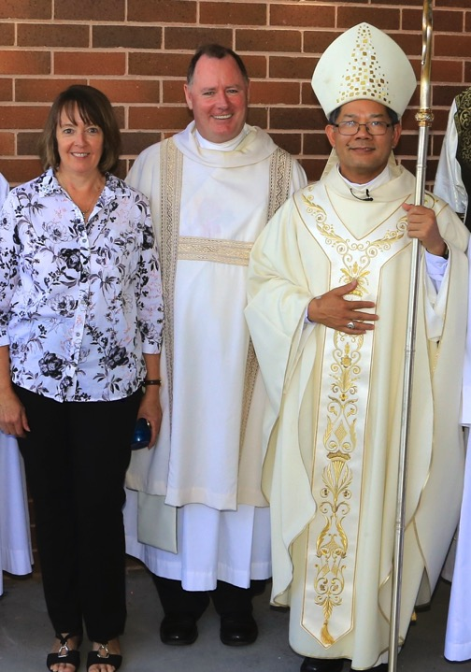

Slide 9
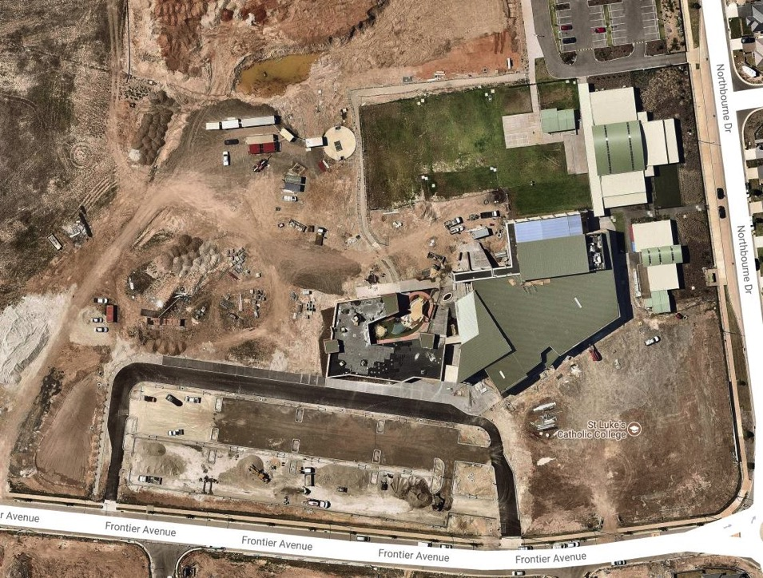

Slide 10
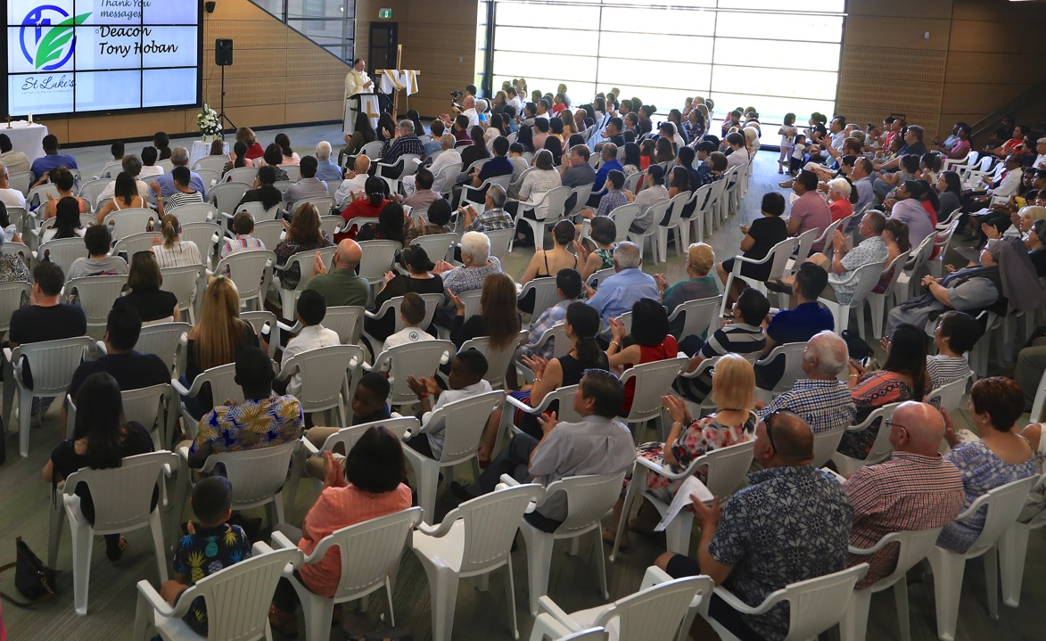

Slide 11
Some learnings from our journey

Slide 12
Can. 517 §2. If, because of a lack of priests, the diocesan bishop has decided that participation in the exercise of the pastoral care of a parish is to be entrusted to a deacon, to another person who is not a priest, or to a community of persons, he is to appoint some priest who, provided with the powers and faculties of a pastor, is to direct the pastoral care.

Slide 13
The Pope’s vision of parish (Evangelii gaUdium)
28. “The parish is not an outdated institution; precisely because it possesses great flexibility, it can assume quite different contours depending on the openness and missionary creativity of the pastor and the community.”

Slide 14
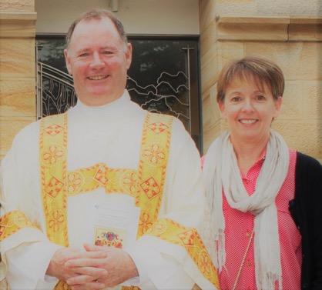
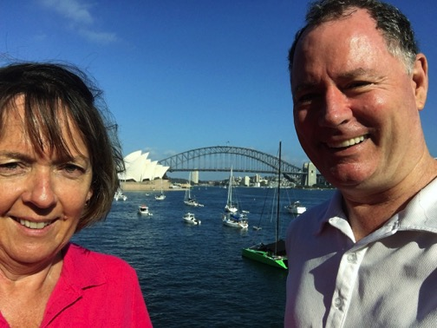
Ministry as a Couple

Slide 15
Some learnings for the broader church
Do you think there should be more use
of Canon 517 S2? Why/ Why not?

Slide 16
Some learningS for the broader church
Should priests continue to be the leaders of:
sacramental life
pastoral care
outreach
administration?
OR, should they be responsible only for leadership of the sacramental life of the community?

Slide 17
ACCOUNTABILITY IN THE CHURCH
How can the Church follow the example of corporates, charities and its own social and health arms with accountability and support measures for regular meetings with ‘supervisor’, expected outcomes to achieve, professional supervision/accompaniment etc?

Slide 18
Some further learnings
- a team leadership approach - advisory group from day one
Support from Diocesan pastoral planning team
Learning from others – Oran Park Parish; Toronto Parish
- Divine Renovation/Alpha model

Slide 19
Some further learnings
- Vision formed by our advisory group: “WE ARE CONTINUALLY ATTRACTING PEOPLE TO ST LUKE’S AND EVERYONE WHO COMMITS TO BEING A MEMBER OF OUR COMMUNITY IS TRANSFORMED IN EVERY AREA OF THEIR LIFE BY HAVING A DEEPER RELATIONSHIP WITH JESUS.”
- Great relationship with St Luke’s Catholic College
-Excitement of ‘Firsts’ - video from first anniversary Mass

Slide 20
Film
https://www.facebook.com/parracatholic/videos/st-lukes-catholic-faith-community-an-answer-to-prayer/1450227838422976/

Slide 21
Some further learnings
- some Celebrant rostering challenges
including a ‘no show’
- the engagement of children –
blessing and interviews
- Outreach – more to do, but so far, Hawkesbury Helping Hand, Vinnies, Muslim Community, Kairos
- Challenges of ministry with busy, young families

Slide 22
PRAYER
MAY THE CONVERSATION CONTINUE

