Slide 1
Stephanie Lorenzo
Founder, PROJECT FUTURES
Communications Director, Voices of Faith

Slide 4
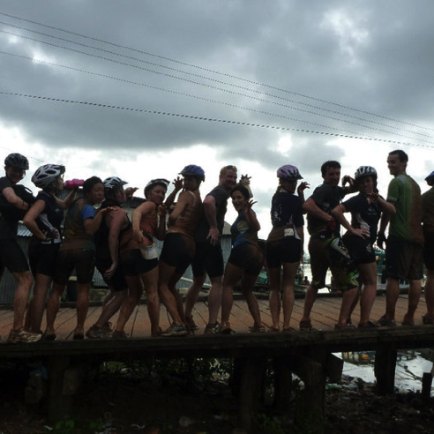

Slide 6
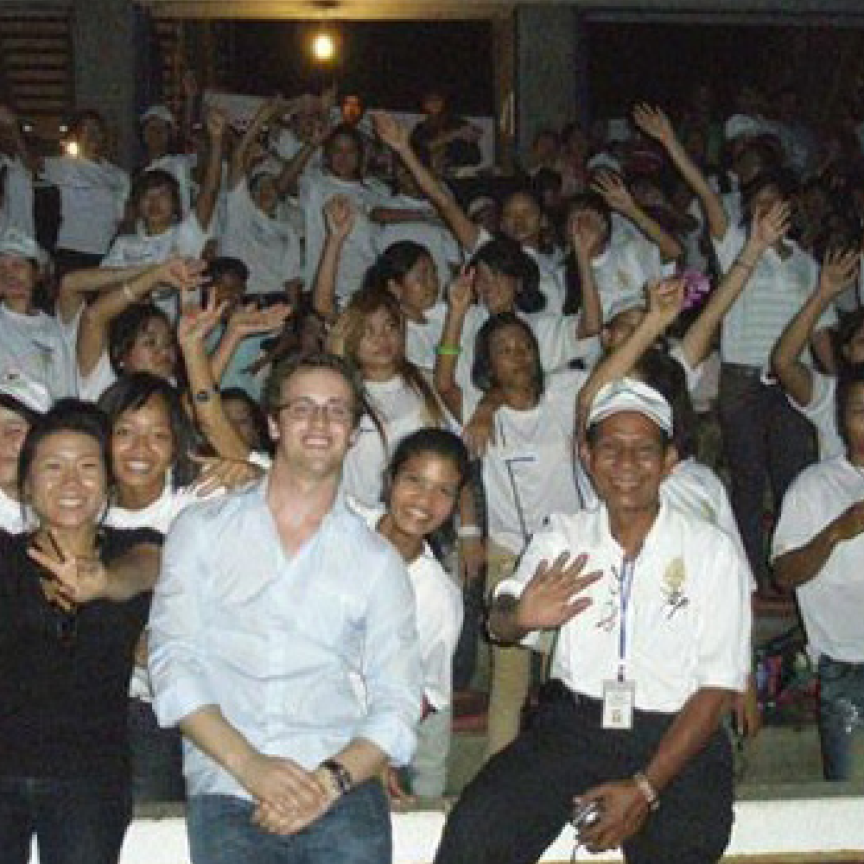
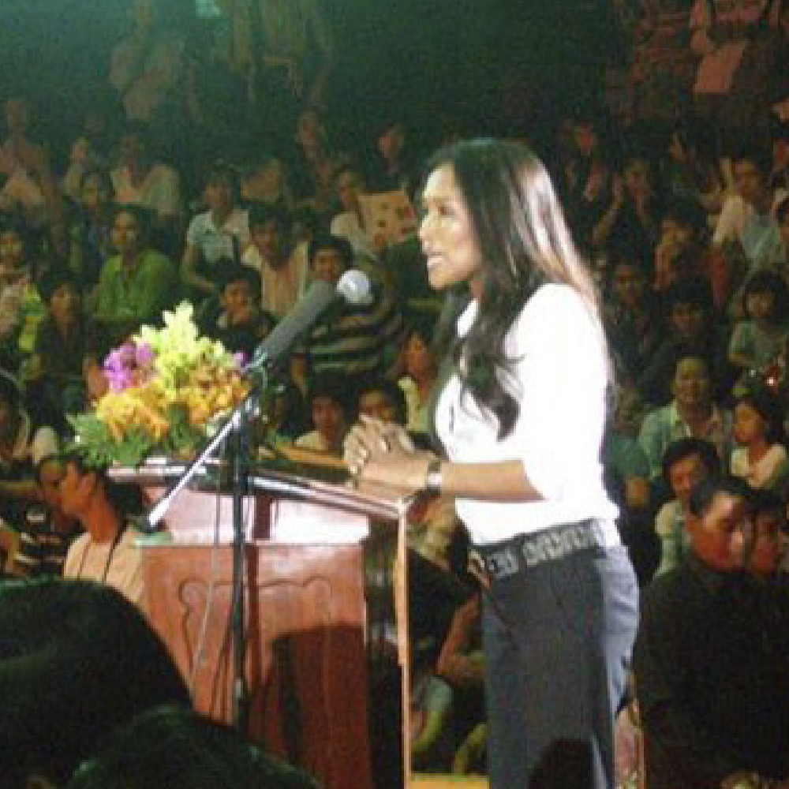

Slide 9
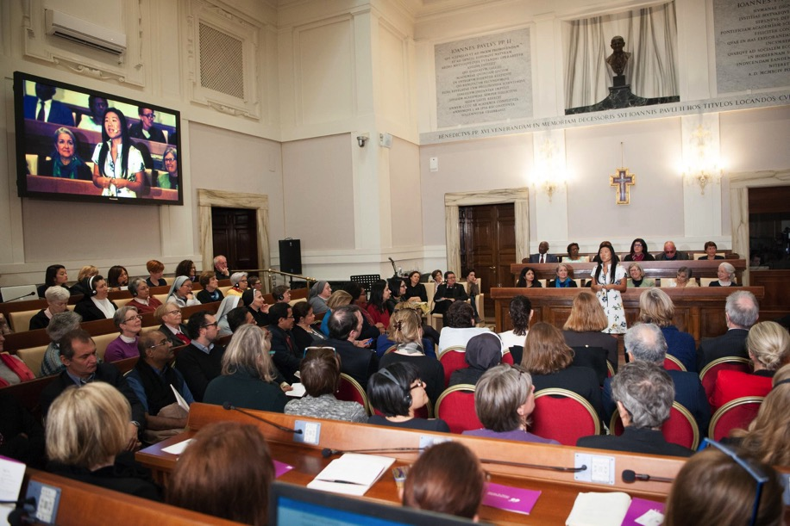

Slide 11
