Slide 1
Valuing LGBTIQA+ people. How can we include all?
Steff Fenton, Co-chair, Equal Voices, Sydney. Ecumenical advocacy for LGBT people.
Peter Maher, Sydney Catholic priest, 25 years LGBT Pastoral care , member of Equal Voices.

Slide 2
Being Christian and Gay can be difficult. But why should it be?

Slide 3
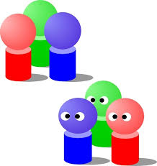
Why did you come to this workshop?
Chat in two’s or three’s for a few minutes
Feedback
Notes:
Maybe their stories
Maybe a story or two about being LG in church Steff and Peter

Slide 4
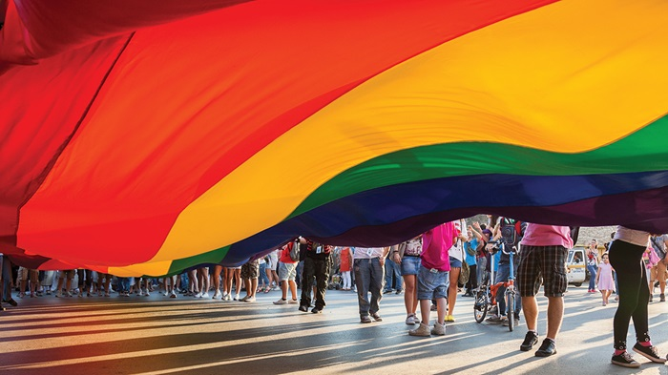
Who are we talking about?
Chat to the person next to you on what each letter means:
L
G
B
T
I
Q
A
+

Slide 5
Who are LGBTIQA+ people?
Lesbian
Gay
Bisexual
Transgender
Intersex
Queer/questioning
Asexual
and many other terms (such as non-binary and pansexual)

Slide 6
LGBTIQA+ What do they mean?
Lesbian: A term used to describe women attracted romantically, erotically, and/or emotionally to other women.
Gay: A term used to describe individuals who are primarily emotionally, physically, and/or sexually attracted to members of the same sex. More commonly used when referring to males, but can be applied to females as well.
Bisexual: A person emotionally, physically and/or sexually attracted to male/men and females/women. This attraction does not have to be equally split between genders and there may be a preference for one gender over others.

Slide 7
Pansexual: A person who experiences sexual, romantic, physical, and/or spiritual attraction for members of all gender identities/expressions.
Asexual: Having a lack of (or low level of) sexual interest or desire for sex or sexual partners. Exists on a spectrum from people who experience no sexual attraction or have no desire for sex to those who experience low levels and only after significant amounts of time.

Slide 8
Trans/Transgender: Transgender: The word "trans" is Latin for "cross". Transgender people are people whose gender identities are different to the gender they were assigned at birth. In our medical system, most babies born are categorised as male or female based on their physical characteristics (genitals, hormones, etc.). For many people, however, the gender they were assigned is not the identity that actually exists within them. Or it could be a person who transcends the binary gender systems altogether, so that they identify as neither male or female gender.
Transition: can describe a process that transgender people undergo in order to live their lives more fully as themselves. Transition does not necessarily have an end point, and there are many reasons why transgender people choose to include hormones or surgical procedures in the process, or not choose those things.

Slide 9
Cis (cis-gendered): A description for a person whose gender identity, gender expression, and biological sex all align. Opposite would be trans.
Queer: An umbrella term to refer to all LGBTIQA+ people. A political statement, as well as a sexual orientation which advocates breaking binary thinking and seeing both sexual orientation and gender identity as fluid. Can also be a simple label to explain a complex set of sexual behaviours and desires. For example, a person who is attracted to multiple genders may identify as this.

Slide 10
Why should we care?
For decades many but not all LGBTIQA+ people have been treated as:
An issue to ignore
A problem to solve
A threat to fight
A danger to exclude
A person to preach at
Embarrassment to hide
Treating LGBTIQA+ people or anyone else in these denigrating ways does not honour one's humanity and does not reflect God’s love.

Slide 11
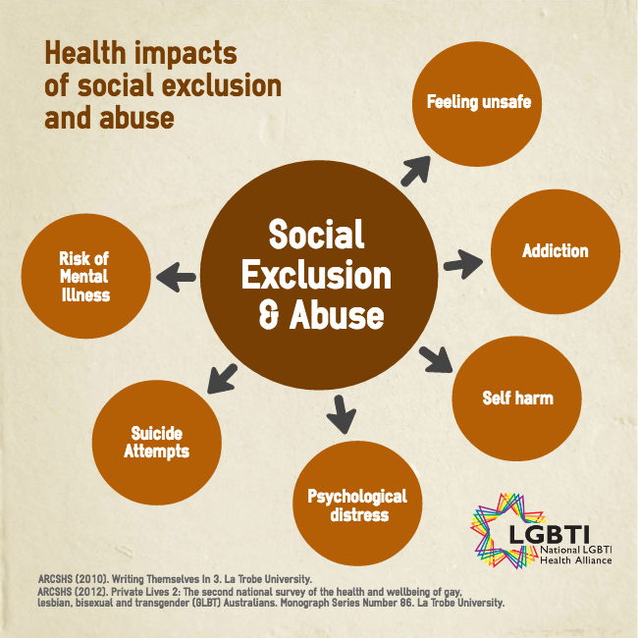
Spiritual and Psychological Damage
There has been much emotional and spiritual harm caused to LGBTIQA people by bullying and discrimination.
Many have left the church.

Slide 15
Are we compromising the Gospel through Acceptance?
Biblical truth and unconditional love
1 Corinthians 13:4-8.
Love is patient; love is kind; love is not envious or boastful or arrogant or rude. It does not insist on its own way; it is not irritable or resentful; it does not rejoice in wrongdoing, but rejoices in the truth. It bears all things, believes all things, hopes all things, endures all things.
Love never ends.

Slide 16
Conversion Therapy
There is clear evidence that conversion therapy does not work, and some significant evidence that it is also harmful to LGBTQ people.
Conversion to heterosexuality vs. Christ
Causation vs. Compassion: We cannot “fix” people, we can love them.
“You have to reach people where they are because you can’t reach them where they’re not.”

Slide 17
How to welcome LGBTI people into our faith communities? Ideas from Fr James Martin SJ talk at the World Meeting of Families in Dublin on August 23, 2018
1) LGBTI parishioners are baptised. They are as much as part of the church as anyone baptised. The most important thing we can do for LGBT people is to welcome them to what is already their church. To remain in the church LGBT people have often endured years of rejection.
2) LGBTI people do not choose their orientation. People don’t choose their orientation or gender identity any more than you choose to be left-handed. It is not a sin and it is not something to ‘blame’ on someone, like parents.

Slide 18
3) LGBTI people have often been treated like lepers by the church. Never underestimate the pain that LGBTI people have experienced in church and society. The highest rate of youth suicide and homelessness is among LGBTI youth from religious backgrounds. Some Church leaders have insisted on retaining the right to discriminate against LGBT employees based on sexual orientation, gender or relationship status. Some ministers and priests have refused LGBTI Catholics the Sacraments and Baptism for their children. Some preachers offend LGBTI people from the pulpit and the term (LGBTI) by which they name themselves is hardly ever heard in church. Why would they feel included or welcomed? Parents of LGBT children face similar rejection and even blame for their children’s sexual identity.

Slide 19
4) LGBTI people bring gifts to the church. Church leaders often refer to LGBTI people as ‘in need of our help’. This makes them clients of the church. In fact they are members of the church by baptism with gifts to share like every baptised member.
5) LGBTI people and church teaching. LGBTI people are the only people in church teaching to be called ‘intrinsically disordered’ and ‘objectively evil’ because they are created different to most. All other minorities and people born with minority characteristics are honoured in church teaching for their gifts and/or their courage.

Slide 20
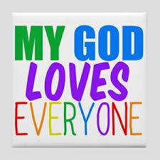
6) LGBTI people are loved by God and seek God as all Christians do. God loves them - so should we. And what does real love mean: knowing them in the complexity of their lives, celebrating with them when life is sweet and suffering with them when life is bitter. Love them as Jesus loved people on the margins: extravagantly. How can a parish treat LGBT people with the virtues that our faith recommends: respect and compassion?

Slide 21
1) Examine your own attitudes towards LGBT people and their families.
2) Listen to LGBTI people and learn who they are. Listen to the experiences of LGBT Catholics and their parents and families.
3) Acknowledge LGBTI people at events. Begin each event/ceremony in the church and in newsletters and websites like this: We acknowledge the [Aboriginal tribal name] people as the traditional custodians of the land on which [parish name] stands. We aim to provide a safe place for all people to pray regardless of age, race, creed, gender, cultural background or sexual orientation.

Slide 22
4) Prepare and have an Apology ceremony. It doesn’t solve everything, but it’s a start.
5) Don’t reduce gays and lesbians to the call to chastity we all share as Christians. LGBT people are more than their sexual lives.
6) Include LGBTI people in ministries.
7) Acknowledge LGBTI people’s individual gifts.
8) Invite everyone on the parish staff to welcome them. Develop training for all ministers and staff. Does the person answering the phone know what to say to a lesbian couple who wants to have their child baptized? At funerals, are the gay adult children of the deceased treated with the same respect as other children? What about the teacher in a parish school who has two fathers coming to a parent-teacher conference? How does a deacon treat the father of a gay man who just died and who wants a funeral for his son? Is your parish staff educated in the full range of church teaching on non-discrimination and pastoral outreach?

Slide 23
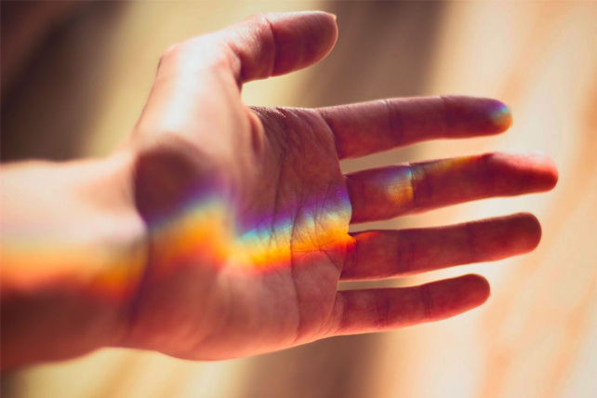
9) Sponsor special events or develop an outreach program.
10) Advocate for LGBTI people. Be prophetic.
11) Supply information for families of LGBTI Catholics: PFLAG http://pflagaustralia.org.au/
12) Provide a flyer at the back of the church for LGBTI Catholics, their families and allies.

Slide 24
What does the bible say?
Sodom and Gomorrah (Genesis 19) condemns male homosexual sex but it is actually about gang-rape. The men of Sodom seek to rape two visitors (angels), but Lot offers them protection and his daughters to be raped in their place.
What is clear is that sexual violence and rape is harshly condemned, and so God destroys the town with sulphur and fire.
Despite the linguistic history of the word “sodomite”, Genesis 19 has nothing to say about homosexuality or mutually consenting adults of the same gender expressing their desire and love.

Slide 25
Laws of Leviticus (18:22 and 20:13)
It describes a married man (heterosexual) having sex with a male an “abomination”. It is not describing what we would understand to be a sexual orientation.
The verse clearly condemns adulterous homosexual sex in calling it an “abomination”, but here some of the other things also called an “abomination” in the Bible:
Egyptians eating with Hebrews;
having an image of another god in your house;
sacrificing your child to the god Molech;
having sex with your wife when she is menstruating;
eating pork;
wearing mixed-fabric clothing, and
trimming your beard.
To claim one set as timeless truths while ignoring the others is patently hypocritical and goes against the grain of the text itself.

Slide 26
New Testament texts
1 Corinthians 6:9-10 and 1 Timothy 1:10
Lists a wide group of people
who will not “inherit the
Kingdom” without changing.
But words used actually mean ‘effeminate’ , ‘male prostitute’
or ‘adulterer’ not homosexual as it is sometimes translated. Paul had no concept of sexual orientation and he was certainly not describing a committed adult relationship.

Slide 27
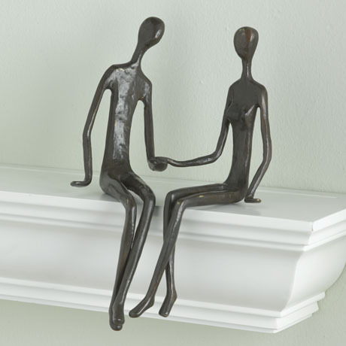
Romans 1:26-27 Paul condemns people swapping out their usual partner for one of the same gender. Paul shares a stereotypical Jewish distrust of Graeco-Roman same sex activity, but is not talking about loving partnerships between people with same sex orientation.

Slide 28
QUESTIONS
THANK YOU

