Slide 1
Cross-cultural Competency for Mission
Patrick Fox & Bernadette Sullivan
Catholic Mission Cultural Consulting
Notes:
Welcome
V Practical session
Mission is ‘going out’ encounter inclusion and dialogue, without judgement, and with humble curiosity.
There may be time at the end to theologise a little on ‘interculturality’
But first some very practical skills and understandings
Via
Two sessions:
1st Berni Sullivan case study, real life, to understand model of Culture
Berni to introduce herself
Debrief on her Cultural Orientations Indicator profile
3 dimensions, 10 – 15 min each, break for observations, comments, clarifications
BREAK
2nd Some applications
Finally cross-cultural, multicultural, intercultural
Professor, Catholic Theological Union, Chicago
Dr of Anthropolgy Anthony Gittins CSSp – Holy Spirit Father,

Slide 2
Introduction
Case Study – Cultural Orientations Profile Debrief
Applications in Mission – International Assignment, Multicultural Parish
Catholic Mission Cultural Consulting

Slide 3
Cultural Orientations Model
Catholic Mission Cultural Consulting
Notes:
Mission – sent out, go out
Diversity – how to cross the frontiers/borders
This practical day-day face-face understanding/skills
Language, key to heart, to values, to understanding
Same language – different backgrounds
Different languages – no time to become fluent
A model, a framework, a skeleton
A lens to view people’s interactions,
an approach to understanding
Skeleton – all have the same framework, but the expressions are unique.
All groups of 2 or more persons have a culture
Each individual has a set of cultural preferences according to which groups they belong to
Without ‘knowing’ or having had significant interaction with that person,
How can I know them more quickly, see under the surface – x-ray vision, into their cultural skeleton
to their values and beliefs and their identity?

Slide 4
Values Drive Behavior
Observable Behaviors
Beliefs
Unobservable
(Underlying Values)
* The Iceberg Model* Edgar Schein, MIT
Catholic Mission Cultural Consulting
Notes:
Manual Page(s):
Key Notes:
Without ‘knowing’ or having had significant interaction with that person,
How can I know them more quickly, see under the surface
to their values and beliefs and their identity
Example: direct eye contact above the surface. Below the surface, some interpret as engaging others confrontational and negative
The visible portion language, food, dress, rituals, customs, art and music.
The invisible values, customs, beliefs and attitudes.
iceberg is much thicker below the surface.
Below the surface - the ways of thinking and feeling, our values and thoughts are the drivers of the surface behaviors.
We may not even be conscious of the thoughts and values that guide these behaviors (e.g. eye contact).
water level symbolizes our daily awareness.
Behaviors that meet our expectations are readily accepted, perhaps even unconsciously. However, those behaviors that violate our expectations are often judged or evaluated in a negative way. We evaluate these behaviors using values, beliefs and attitudes that are below the surface of the water. Like the iceberg,
80-85% of what drives behavior remains out of our immediate awareness.
Our behaviors are directly related to our values and are connected to a variety of emotional responses. We reward those behaviors that meet our expectations (a positive emotion) and negatively evaluate or judge those that do not. These negative emotions may result in our inability or reluctance to work with others who are different than us.
Every culture crafts linkages between behaviors, values and emotions. Values directly impact behavior. In cross-cultural situations, behavior patterns may collide, yet the values may be similar. Where behaviors come into conflict, e.g. eye contact example, the conflict may be a result of a difference in assumptions or expectations in a given business or social context.

Slide 5
Definition & Characteristics of Culture
Definition:
The complex pattern of
ideas, emotions and observable manifestations “behaviors and/or symbols”
that tend to be expected, reinforced and rewarded
by and within a particular group. –TMC/Berlitz
Behavior
Norms
Beliefs and Assumptions
Values
Culture is:
Collective
Learned
Dynamic
Situational
Complex
Contradictory
Emotions
Context/Situation
Catholic Mission Cultural Consulting
Notes:
Manual Page(s):
Key Notes:
There are many valid definitions of culture. One definition is that “Culture is to a group what personality is to an individual”.
culture as the linkages made between behaviors, values and emotions that are expected, reinforced and rewarded by and within a particular group.
reinforcement and reward are not only overt, obvious way, e.g. financial reward.
Often it is subtle encouragement / discouragement

Slide 6
Aligned with our definition of culture
Context/Situation
Interaction Style Orientations that impact how we communicate and engage others.
Behavior
Norms
Thinking Style Orientations that impact how we process information.
Cognition
(Beliefs and Assumptions)
Values
Sense of Self Orientations that define how we view our “self” and are motivated.
Emotions
The connection between behaviors, beliefs, and emotions that are
expected, reinforced and rewarded by and within a particular group.
Catholic Mission Cultural Consulting
Notes:
Manual Page(s):
Key Notes:

Slide 7
Interaction Style
Cultural orientations that impact how we communicate and engage others; i.e., the way we connect and approach relationships.
Interaction Style:
Fluid - Fixed
Being - Doing
Indirect - Direct
Instrumental - Expressive
Informal - Formal
Particularistic - Universalistic
Catholic Mission Cultural Consulting
Notes:
Manual Page(s):
Key Notes:

Slide 8
Thinking Style
Cultural orientations that impact how we process information; i.e. the way you think, perceive, remember and relate to information.
Thinking Style:
Multi-Focus - Single-Focus
Past - Future
Low Context - High Context
Inductive - Deductive
Linear - Systemic
Catholic Mission Cultural Consulting
Notes:
Manual Page(s):
Key Notes:

Slide 9
Sense of Self
Cultural orientations that impact how we see and experience our “self”; i.e., our identity and core motivation.
Sense of Self:
Control - Constraint
Private - Public
Hierarchy - Equality
Collectivistic - Individualistic
Cooperative - Competitive
Flexibility - Order
Catholic Mission Cultural Consulting
Notes:
Manual Page(s):
Key Notes:

Slide 10
Understanding the COI®
Assessment tool that maps one’s personal cultural preferences on the basis of three dimensions
Is descriptive rather than prescriptive,
Uses non-judgmental neutral language enabling the discovery of other’s riches – promoting diversity & inclusion
Describes general preferences, not skills, abilities or particular behaviors
Is restricted to work/ministry-related situations
Is subject to self-validation, as is any assessment instrument
The Cultural Orientations Indicator® is a Trademark and the intellectual property of Training Management Corporation, a Berlitz company.
Catholic Mission Cultural Consulting
Notes:
The COI descriptive rather than prescriptive. Focuses on general orientations
Describes preferences, not skills or abilities. Is related to work-related behaviors
Leaders often have to have difficult conversations.
We often hear ‘it’s cultural’ or ‘it’s their culture’ and no one can say anything to challenge that.
This model provides a safe non judgmental language to describe behaviours and preferences. But without upholding one over the other.
There is no “good” or “bad” orientation. There are no “wrong” or “right” answers on the assessment. They both value something.
Therefore it recognises the positive contributions and riches from both sides – which is diversity and inclusion in practice.
You’re late - or you arrived 15 minutes after the meeting.
You have your head in the clouds – or your beginning from the theory. Now lets talk about the practical.
I hear your excited about this prospect, now what are the facts.
If we look at the way it was in the past, it seems it can’t be done. But if we look at future possibilities, there may be a way.
Or it was possible in the past, we know that. Now looking at the future reality, we can see it is no longer the best way forward.

Slide 11
The Four Key Cultural Skills
Cultural Due Diligence
I assess the possible impact of cultural difference and prepare for it. In advance, case by case
Style-Switching
I change my behaviour to accomplish a goal, when I can’t expect the other to change. In the moment, case by case
YES
NO
Cultural Dialogue
We explore cultural differences and mutually adapt, dealing with issues.
Over time, first having built trust
Cultural Mentoring
I lead others, modelling behaviours, language, skills,
helping with cultural adaptation and integration.
Long-term strategic planning & modeling
Catholic Mission Cultural Consulting
Notes:
Manual Page(s):
Key Notes:

Slide 12
International Assignment
Foreign Born Priests -Kerala, India
to Queensland
Catholic Mission Cultural Consulting

Slide 13
Agenda
Adaptation Process
Introduction to culture
Cultural Orientations Model
Personal COI and Cultural Gaps with Australia
Cultural Skills – Due Diligence, Style Switching
Australian National Culture and Lifestyle
Catholic Mission Cultural Consulting
Notes:
Adaptation Process – Culture Shock - Attitudes - Journey

Slide 14
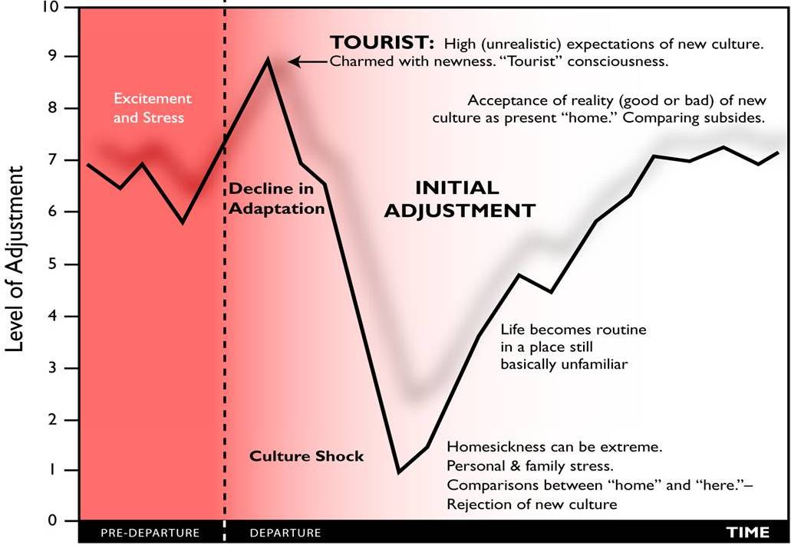
Cultural Adjustment Curve
Catholic Mission Cultural Consulting

Slide 15
Overcoming Culture Shock
Realize that this is NORMAL
Stay active
Go out even if you don’t want to
Take a vacation to a third culture, but DON’T go home!
Join clubs, activities, go to school, take language lessons etc.
Catholic Mission Cultural Consulting
Notes:
15
Immerse yourself, throw yourself in, go out of your comfort zone, you have to sooner or later.
Make the decision/commitment, now that you’re here.
Don’t go home – physically, and psychologically

Slide 16
To be successful from a personal standpoint, interviewees having had expatriation experience cited first and foremost the importance of flexibility and adaptability (90%), open-mindedness (82%) and motivation (72%).
O
Flexibility, adaptability
90%
Open mind
82%
Motivation
72%
Curiosity
58%
Tolerance for differences
50%
Autonomy
42%
Source: Expatriate Observatory 2012
Catholic Mission Cultural Consulting
Notes:
When experienced expats were asked what were the characteristics that were most important in order to have a successful mission,
they citied Flexibility and Adaptability as being crucial,
followed by having an open mind, being motivated, being curious, and tolerating differences.

Slide 17
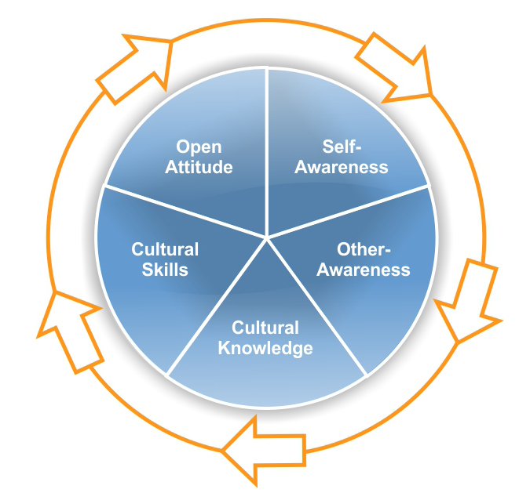
Developing Cultural Competence
An open attitude is the prerequisite for engaging in the continuous learning process of developing cross-cultural effectiveness.
Self-awareness facilitates our other-awareness.
Cultural knowledge, in turn must be translated into cross-cultural skills to achieve cross-cultural effectiveness.
To become useful self- and other-awareness must be grounded in cross-cultural knowledge.
Notes:
Manual Page(s):
Where do you think this cycle starts.
Becoming culturally competent is a journey – evolving and emerging
Open Attitude:
Humble Curiosity. Let go of ego, non-judgemental. Mercy over Judgement. Love over fear.
Pause and introspect.
Look closely at your own assumptions about how/why people behave.
Start with generalisations i.e. helpful and respectful ideas about a social group.
Be open to information through on-going observation. Refrain from quick judgments.
Self Awareness: Focus on developing self awareness and knowledge of your own cultural preferences and how it reflects in your behavior.
Leadership skills: awareness of self – attitudes values,
Other Awareness: Understanding and Ability to recognize attitudes, values and behavior preferences of others.
Cultural Knowledge: Developing knowledge about a culture. Grounding our awareness in other social and business cultures. The COM™ and its 3 dimensions have immense practical value in this context.
Cross-cultural Skills: Translate awareness and knowledge into skills, building your confidence and ability to integrate cultural differences into new and more rewarding ways of doing business.
On the assumption of all participants having an open attitude, the remainder of the program is dedicated to the four aspects of self-awareness, other-awareness, cultural knowledge and adapting skills.
COM frame differences in a non threatening manner,

Slide 18
Developing Cultural Competence
Source: Bennett
Catholic Mission Cultural Consulting
Notes:
Denial - Lacks any Cultural awareness
Defense – Sees all others as negative and own culture as superior
Minimisation – differences are not important,
Acceptance – recognises and accepts different Cultures, and actively interests self in learning
Adaptation – daily effort, sacrificing one’s own securities/world view, to discover, appreciate cultural differences, Understands own Culture and the effect Culture has in relating
Integration – comfortable in another Culture, moving between, possibly not feeling solely of one Culture
Cultural competency is the ability to effectively navigate – communicate, interrelate, and effectively function in diverse cultural settings.

Slide 19
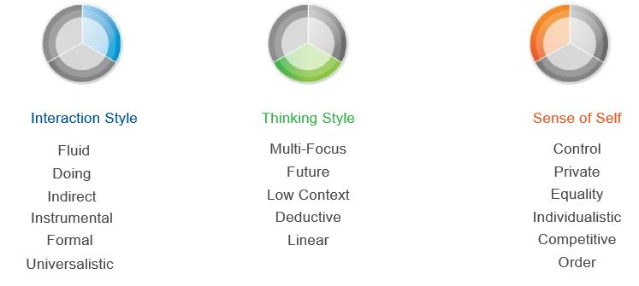
Australian Cultural Norms
Catholic Mission Cultural Consulting

Slide 20
Due Diligence – Comparing Countries
Catholic Mission Cultural Consulting

Slide 21
Fixed / Fluid – Homily length, Punctuality events Private / Public – Personal space, Taboo topics & Q’s, Sport Direct / Indirect – Eye contact, Criticism & evaluation Equality / Hierarchy – All equal, women & professions, titles Universalistic / Particularistic – Rules & consequences, Secular vs Canon Law
Australian Culture
Catholic Mission Cultural Consulting
Notes:
Homily length, arrive before Mass, end on time, meetings start on time and end on time
Don’t touch, wait to be presented the hand before shaking, greeting women,
Personal space, especially in the more rural towns
Taboos Qs- $ rent/income/housing cost, marriage, religion,
Work – Life separation,
Maintain eye contact, otherwise suspicion of disinterest, ignoring or disrespect,
Criticism is invited and valued, be constructive, sign of goodwill and interest
All people and all Women are equal – secretary, administrator, catechist, receptionist – all trades and professions,
even PM, no special privileges (caste system)
Titles, first names,
Decision making more democratic or consensus/participatory
Road rules, ask for the rules, secular law trumps canon law,
lining up – don’t jump queue
no one is above the law,

Slide 22
Interpersonal and Cross-cultural Competency for Mission
Parramatta Diocese
Permanent Deacon Formation
Catholic Mission Cultural Consulting

Slide 23
Objectives
Establish a common understanding and language about culture and its impact in ministry
Apply a model of culture to describe and address cultural issues that impact effectiveness and communications
Explore individual cultural profile and its implications in communication, interpersonal effectiveness, building trust & leadership style …
Develop cross-cultural competency skills to cross gaps and to bridge cultural differences
Identify key actions for further development as individuals, units and teams

Slide 24
Agenda
Introduction to culture
Cultural Orientations Model – COI, Country Profiles
Cultural Competency Skills
Due Diligence, Style Switching, Cultural Dialogue,
Cultural Mentoring
4. Application & Practise
Catholic Mission Cultural Consulting
Notes:
4 Skills

Slide 25
Style Switching – Exploring Gaps with Country Profiles Patrick Fox - India

Slide 26
Cultural Due Diligence - Comparing Country Profiles

Slide 27
Style-Switching – Instrumental Sermon
In the Bible the word listen appears over 1200 times.
The word ‘hear’ 400 about times. And the word ‘obey’ about 270 times.
We are asked to listen so much more.
Why are we asked so many more times to listen than to hear?
Maybe it’s because we’re not good at listening.
We need to be reminded of something so central,
to hear the quiet voice of God within.
And to hear the quiet voice of God within, if we don’t stop to listen,
we will never hear what God is asking of us or how he is guiding us.
Then if we don’t hear the voice of God,
how will we be able to act and obey?
Catholic Mission Cultural Consulting
Notes:
Manual Page(s):
Key Notes:

Slide 28
Style-Switching – Expressive Sermon
We live such frantic lives. We feel stressed and anxious.
We feel we don’t have enough time to do all we are pressured to do.
Perhaps in our busy times we’re not good at listening.
Life would be calmer and we’d feel happier
if we would stop and listen to the quiet voice of God within,
to hear what God is asking of us or how God is guiding us.
If we don’t hear the voice of God, how will we be able to act and obey?
Catholic Mission Cultural Consulting
Notes:
Manual Page(s):
Key Notes:

Slide 29
Style-Switching – Instrumental + Expressive Sermon
We live such frantic lives. We feel stressed and anxious.
We feel we don’t have enough time to do all we are pressured to do.
Maybe that’s why in the Bible the word listen appears over 1200 times,
and the word ‘hear’ only 400 about times.
We are asked to listen so much more.
Perhaps in our busy times we’re not good at listening.
We need to be reminded of something so central,
to hear the quiet voice of God within.
If we don’t stop to listen, we will never hear what God is asking of us
or how God is guiding us.
If we don’t hear the voice of God, how will we be able to act and obey?
Life would be calmer and we’d feel happier
if we would stop and listen to the quiet voice of God within,
to hear what God is asking of us or how God is guiding us.
Catholic Mission Cultural Consulting
Notes:
Manual Page(s):
Key Notes:

Slide 30
Style-Switching – Instrumental + Expressive Sermon
We live such frantic lives. We feel stressed and anxious.
We feel we don’t have enough time to do all we are pressured to do.
Maybe that’s why in the Bible the word listen appears over 1200 times,
and the word ‘hear’ only 400 about times.
We are asked to listen so much more.
Perhaps in our busy times we’re not good at listening.
We need to be reminded of something so central,
to hear the quiet voice of God within.
If we don’t stop to listen, we will never hear what God is asking of us
or how God is guiding us.
If we don’t hear the voice of God, how will we be able to act and obey?
Life would be calmer and we’d feel happier
if we would stop and listen to the quiet voice of God within,
to hear what God is asking of us or how God is guiding us.
Catholic Mission Cultural Consulting
Notes:
Manual Page(s):
Key Notes:

Slide 31
Challenges - Diocese of Parramatta
1. Dress styles, codes of dress in churches. Australians tend to dress more informally
2. Gender and equality,
the presence of women in leadership,
gender issues arising from originating country – how women are viewed there and how they are viewed differently in Australia
3. Ethnic chaplaincies, 5 different chaplaincies operating within 1 parish
4. Different rites within one parish, plus the Latin Mass
5. Racism within the parish, exclusion or lack of welcome based on ethnicity and/or skin colour
6. Tokenism, allowing or inviting the presence of a group for a ‘narrow/limited’ reason
Catholic Mission Cultural Consulting
31
Notes:
Manual Page(s):
Key Notes:

Slide 32
Challenges – Diocese of Parramatta
7. Cultural expectations around liturgy/Mass,
in length of time, manner in which celebrated, to what degree a social event
8. Roman Liturgy, local variations across the diocese, forms or prayer and rosary,
9. Language barriers,
level of competency in English, being made to feel one doesn’t belong,
developing trust
10. Relevance of religion to the young, across all generations, how to be more welcoming
11. Royal Commission, how a culture of institutional sexual abuse came about and was allowed to persist
12. Engagement with people, community, parents, individuals, groups
Catholic Mission Cultural Consulting
32
Notes:
Manual Page(s):
Key Notes:

Slide 33
Style-Switching: Issues & Preferences at play
Issue: Dress styles in church. Australians’ informality
Preferences:
Issue: Cultural expectations around Mass/liturgies; time, manner, as a social event. Roman liturgy variations, cultural expectations of liturgy
Preferences:
Formal / Informal
Fixed / Fluid
Formal / Informal
Doing / Being
Universalistic / Particularistic
Catholic Mission Cultural Consulting
Notes:
Manual Page(s):
Key Notes:

Slide 34
Style-Switching: Issues & Preferences at play
Issue:
Different rites, different chaplaincies, exclusion of groups, engagement and relevance with groups, royal commission, engagement
Preferences: Being / Doing
Instrumental / Expressive
Deductive theology / Inductive theology
Direct / Indirect.
Public / Private
Catholic Mission Cultural Consulting
Notes:
Manual Page(s):
Key Notes:

Slide 35
Style-Switching
or Cultural Dialogue?
Issue:
Tensions in parish/pastoral council meetings, planning, negotiating, decision making
Preferences:
Past / Future
Hierarchy / Equality
Direct / Indirect
Universalistic / Particularistic
Formal / Informal
Catholic Mission Cultural Consulting
Notes:
Manual Page(s):
Key Notes:
One may have to use Style Switching in some instances, but where the issue/challenge keeps repeating with the same person or group, then we need to move to Cultural Dialogue.
This can only occur where a sense of trust has been developed.
An excellent way to have developed trust is to have done a lot, possibly months, of Style Switching, as you have tried and demonstrated your genuine attempt to enter into the mindset/worldview of the other.

Slide 36
Cultural Dialogue - Liturgy
Phase I
Initiate
Frame: What ‘type’ of liturgy? Opportunity to …..
Issues: Length of celebration, In/Formality
Extend an invitation to affected parties
Fixed / Fluid – Formal / Informal – Hierarchy / Equality –
Particularistic / Universalistic
What do each of us understand by liturgy?
One understanding is …. Another is ……
What outcomes do we want
Phase II
Create Shared Understanding
Realistically we can do …… but not ….
We can try for more ……
Jointly visualize success. Would this be acceptable?
Set guiding principles.
With future requests let’s keep this in mind
Phase III
Problem Solve Jointly
Catholic Mission Cultural Consulting
Notes:
Manual Page(s):
Key Notes:
Refer to the COG – Pages 127-134
Highlight the importance of the first phase i.e. if ones analysis and opening of the conversation is done in a manner that generates rejection or resistance more damage than good will be done.
Highlight that this process does not necessary occur in a seamless process but to be prepared for perhaps a number of interactions.
Initiation : During this phase, you initiate the dialogue framing it as a learning conversation.
The recommended approach for conducting this phase is to:
Frame the conversation as a learning Alliance for the parties involved – rally behind a statement of purpose that acknowledges and invites different perspectives
Articulate critical issues – use the neutral, nonjudgmental vocabulary of the Cultural Orientations Model™
Extend an invitation – use non-threatening, constructive language to “invite” the parties involved to a joint exploration and problem-solving meeting
You know you have successfully accomplished this phase when you:
Take a facilitator’s (third party’s) perspective on the issue
Become conversant in the vocabulary provided by the Cultural Orientations Model
Prepare is when you create Alignment and Shared Understanding. In this phase you create alignment between all parties involved as well as a shared understanding of the critical issues, interests, and perspectives involved. When creating a shared understanding.
When creating a shared understanding:
Listen and paraphrase – pay attention to the articulated and unarticulated messages; verify and clarify by articulating your interpretation and understanding
Inquire and probe – ask non-leading, open-ended questions and lead counterpart to make general statements concrete and specific
Share your perspective and/or experiences – differentiate between behavior, intent/cultural drivers and emotional impact
Acknowledge the perspectives involved-remember that acknowledgement does not mean agreement
You will know that you have achieved this phase when you can:
Be specific
Talk concrete examples
Implement is Joint Problem Solving. In this phase, you participate in shared problem solving to identify the possible ways in which to harmonize interests, bridge gaps and address resulting issues.
When solving problems jointly:
Identify options – be creative in outlining possible solutions and approaches; make sure that these options address the interests and needs of each party
Jointly visualize success – create and articulate both a general and a specific image of success
Set guiding principles – articulate principles that will guide actions and behaviors all parties recognize as constructive
You will know that you have achieved this phase when you can:
Be specific
Talk concrete examples
You will know that you have successfully achieved this phase when you
Have genuine curiosity in others’ perspectives, circumstances and viewpoints
Are open, authentic and persistent
Refrain from problem solving and focusing on understanding and clarifying
Clearly understanding the cultural underpinnings of your perspectives and experiences; in other words, distinct linkage between behaviors, intent and emotional impact

Slide 37
Cultural Dialogue – Women in Leadership
Phase I
Initiate
Frame: What is the context / needs / opportunities?
Issues: Clericalism, people’s expectations
Extend an invitation to affected parties
Past / Future – Hierarchy / Equality –
Particularistic / Universalistic – Deductive / Inductive
What do each of us understand by leadership / authority / service?
One understanding is …. Another is ……
What outcomes do we want ?
Phase II
Create Shared Understanding
Realistically we can do …… but not ….
We can try for more ……
Jointly visualize success. Would this be acceptable?
Set guiding principles.
We will keep this in mind in the future when …..
Phase III
Problem Solve Jointly
Catholic Mission Cultural Consulting
Notes:
Manual Page(s):
Key Notes:

Slide 38
Cultural Mentoring
The ability to promote and model cultural adaptation and integration
Ongoing process assisting an individual or group
to develop skills to adapt to new and different cultural environments
facilitating cultural understanding and integration
Catholic Mission Cultural Consulting
Notes:
Leadership
Seeing with a lens of cultural preferences
Way of recognising and speaking about
Including across all spectra, inviting
Way of acting, modelling the awareness and sensitivity and inclusion
Creating a ‘culture of cultural competence’
Key Notes:
Cultural Mentoring is the ability to move an individual and/or group through cultural understanding to successful integration in a different cultural environment. While cultural dialogue is an important part of cultural mentoring, it goes a step beyond with its sustained focus on assisting an individual or group to develop adaptive approaches in a new and different cultural environment.
This skill takes many different forms and may entail:
Assisting a new colleague in decoding the cultural norms of a new organization or team
Helping an international assignee manage the difficulties of culture shock
Assisting a group calibrate its communication and work practices to increase effectiveness; for example, within a differing, dominant organizational culture or with a client’s organizational culture
Like cultural dialogue, it’s an ongoing process of learning and development to be better tomorrow than you are today.
Is a two-way process—not just helping others, but learning from those who have more experience/knowledge than you do

Slide 39
Cultural Mentoring – Cross Cutting theme
Promote & model cultural awareness, adaptation & integration
Value, leverage & celebrate differences
What would a ‘culturally competent’ parish/community do differently?
How would the leader act differently?
Catholic Mission Cultural Consulting
Notes:
As a Leader, awareness and practise in
Dealing with conflict,
Preparing well in advance,
Employing different channels for expressing/venting,
Experimenting with different styles of meeting, and negotiating styles
Committing to various methods of follow up afterwards
in employment, in recruitment – looking for diversity
Annual planning process, not only listen to all, but consider different ways of analyzing, critiquing and evaluating, making decisions
Use of different modes of communication - inductive and deductive, systemic and linear, expressive and instrumental
at least employ some translations for the most important points,
more face-face for some or pick up the phone, especially for high context and being cultures, don’t rely only on emails and newsletters
Cultural Competency becomes part of the DNA of the organization, lived and explicitly modelled by the leaders

Slide 40
Final Reflection Why?
Catholic Mission Cultural Consulting
Notes:
3rd cross-cultural, multicultural, intercultural
Professor, Catholic Theological Union, Chicago
Dr of Anthropolgy Anthony Gittins CSSp – Holy Spirit Father,

Slide 41
Final Reflection Why?
Multi-cultural
Cross-cultural
Inter-cultural
Catholic Mission Cultural Consulting
Notes:
3rd cross-cultural, multicultural, intercultural
Professor, Catholic Theological Union, Chicago
Dr of Anthropolgy Anthony Gittins CSSp – Holy Spirit Father,
Multi-c presence of different cultural groups – live and let live, tolerance and acceptance, but no real interaction or communication
Cross-cultural – a person or group who genuinely moves into a new cultural environment and does their due diligence and at least style switching.
Intercultural is a faith filled theological reality where we create, through cross-cultural skills, a previously unimagined new reality where the contributions and riches of all persons and groups is recognised and valued, including the strongly contrasting, and together we create a totally new way of being, that is not mostly of the previous two or more cultures, but is something of God, the Kingdom

Slide 42
Final Reflection Why?
Then I saw “a new heaven and a new earth,” for the first heaven and the first earth had passed away.
I saw the Holy City, the new Jerusalem, coming down out of heaven from God.
God’s dwelling place is now among the people, and he will dwell with them.
He who was seated on the throne said, “I am making everything new!”
Rev. 21
Catholic Mission Cultural Consulting
Notes:
The church of Australia will not be the church that the Holy Spirit wants it to be, until she has joyfully received the contribution of the original Australian people.
JP II Alice Springs.
The Church of Au will not be …..
Until she has joyfully received the contribution of all the peoples of earth who have come to dwell in her.
Inclusion and Diversity, Encounter
“A million dreams for the World we’re gonna make – a vision for the world”
An evolving and emerging society, Kingdom of God

Slide 43
Cross-cultural Competency for Mission
Patrick Fox patrick@catholicmission.org.au
Catholic Mission Cultural Consulting

