Slide 1
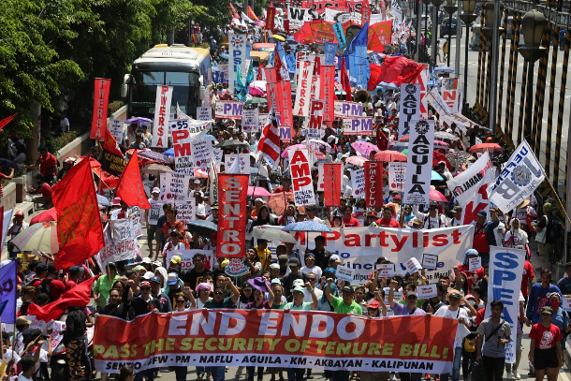
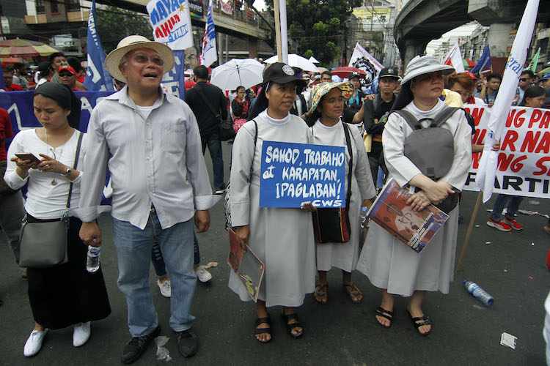
Wake up the world I prefer a church which is bruised, hurting and dirty because it has been out on the streets, rather that a church which is unhealthy from being confined and from clinging to its own security (Pope Francis May 3 2018)

Slide 2
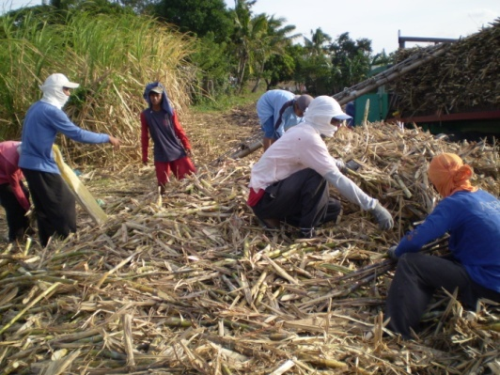
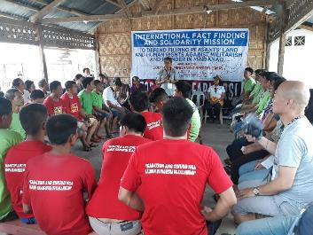
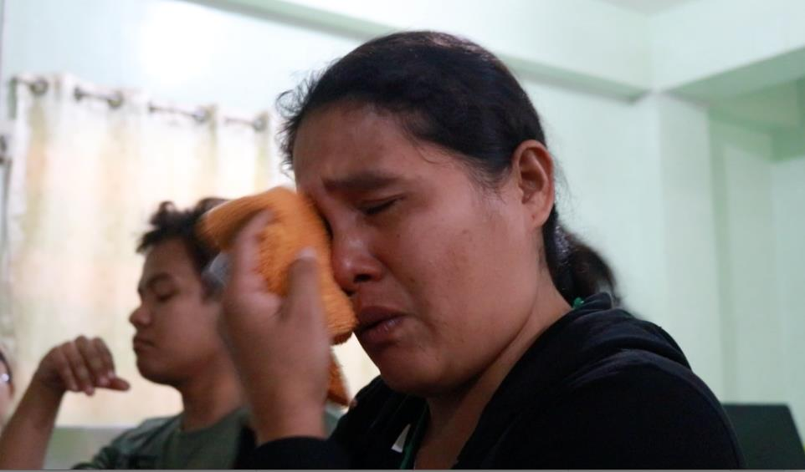
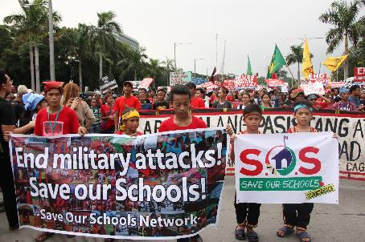
My “Crimes”

Slide 3
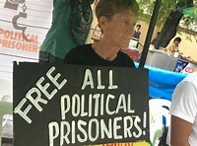
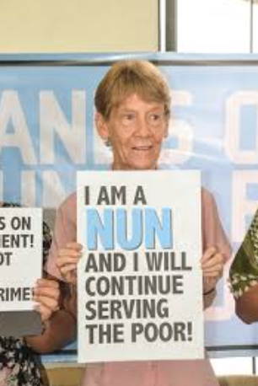

Slide 4
Missionary - A person who has been sent to a foreign country to teach their religion to the people who live there: (Cambridge.com) - A person whose mission is to go somewhere to help others. In many cases, the goal of a missionary is to teach about a religion so that the people can convert to that faith: (Vocabulary.com)
According to the Bureau of Immigration!
Apostolate
An association of persons dedicated to the propagation of religion or a doctrine: (Merriam-webster.com)
A christian organization directed to serving and evangelizing the world, most often associated with the Anglican Communion or the Catholic Church: (Wikipedia)

Slide 5
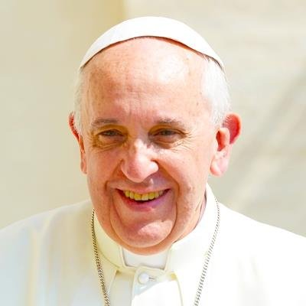
Evangelii Gaudium
Francis tells us: “no one can demand that religion should be relegated to the inner sanctum of personal life, without influence on societal and national life, without concern for the soundness of civil institutions, without a right to offer an opinion on events affecting society” (No.183).
If indeed “the just ordering of society and of the state is a central responsibility of politics”, the Church “cannot and must not remain on the sidelines in the fight for justice” (No.150).

Slide 6
Compendium on the Social Doctrine of the Church, #66
Nothing that concerns the community of men and women – situations and problems regarding justice, freedom, development, relations between peoples, peace – is foreign to evangelization, and evangelization would be incomplete if it did not take into account the mutual demands continually made by the gospel and by the concrete, personal and social life of man and woman. Profound links exist between evangelization and human promotion.

Slide 7
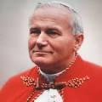
St John Paul 11
The teaching and spreading of her social doctrine are part of the Church’s evangelizing mission. And since it is a doctrine aimed at guiding people's behavior, it consequently gives rise to a "commitment to justice," according to each individual's role, vocation and circumstances. (Soliitudo Rei Socialis No.41)
To teach and to spread the social doctrine pertains to the church’s evangelizing mission and is an essential part of the Christian message, since this doctrine points out the direct consequences of that message in the life of society and situates daily work and struggles for justice in the context of bearing witness to Christ the savior (Centessimus Annus)

Slide 8
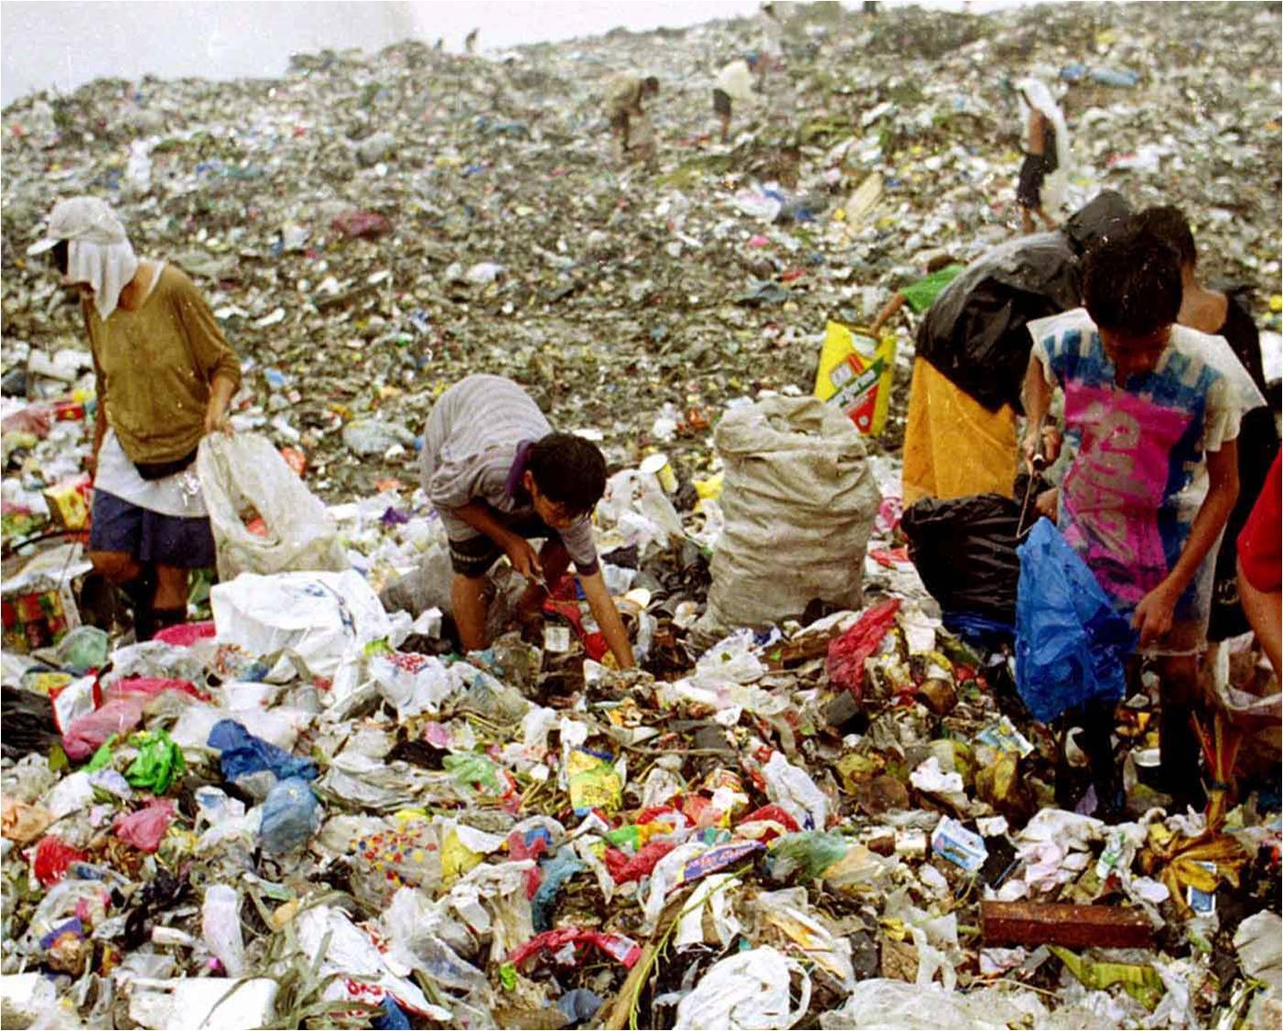
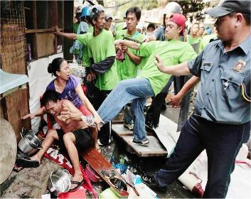
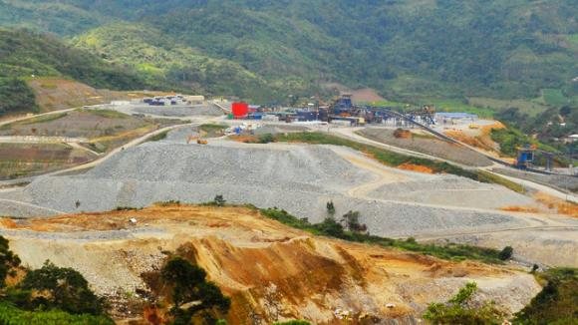
Our missionary task is a struggle with those who are victims, to eliminate the structural causes of poverty and to promote integral development. Guided by the Gospel of mercy and by love for humankind, we must hear the cry for justice and respond to it with all our might (EG188).
Peace, justice and preservation of creation are three absolutely interconnected themes which cannot be separated and treated individually without falling into reductionism (Laudato Si 92). Concern for the environment thus needs to be joined to a sincere love for our fellow human beings and an unwavering commitment to resolving the problems of society.

Slide 9
Greatest Commandment
Mark 12:29-30
Shema Deut. 6:4ff
Lev. 19:18

Slide 10
Our challenge then as church people is to live the Shema, acknowledging God our creator and liberator, hearing with our hearts the cries of the poor and acting.
Common Good
Pope Francis calls us to go to the peripheries, and makes it clear that we are called to solidarity with the poor, to listen to their cries, as not to do so is to oppose the plan of God (EG 187).
An authentic faith..always involves a deep desire to change the world, to transmit values, to leave this earth somehow better than we found it (EG 183)

Slide 11
Mosheh Lichtenstein, a Jewish author, in his book, Moses: Envoy of God, Envoy of His People writes that “if God took notice of the affliction of the Israelites, then Moses born of human flesh had no excuse not to hear the sufferings of his people. If I, the King of Kings, the Most high, can descend into the impurity of Egypt; If I, who dwell in the highest heavens, listen and pay heed to the groaning of the Israelites; If I, the absolute and transcendent Other, am concerned with the fate of people—even those who are unwilling to fight for themselves—then you, Moshe, born of a woman, have no right to close your ears and ignore their sufferings”. Mosheh Lichtenstein, Moses: Envoy of God, Envoy of His People (New Jersey: KTAV Publishing House, Inc., 2008),30.
“”

Slide 12
Francis reiterates Vatican 11’s call of “option for the poor” but says that it is urgent that we see this option “in a new light” (No.202). This option he says is “primarily a theological category rather than a cultural, sociological, political or philosophical one. God shows the poor “his first mercy’ (No.163). He exhorts “The need to resolve the structural causes of poverty cannot be delayed, not only for the pragmatic reason of its urgency for the good order of society, but because society needs to be cured of a sickness which is weakening and frustrating it, and which can only lead to new crises. Welfare projects, which meet certain urgent needs, should be considered merely temporary responses. As long as the problems of the poor are not radically resolved by rejecting the absolute autonomy of markets and financial speculation and by attacking the structural causes of inequality no solution will be found for the world’s problems or, for that matter, to any problems. Inequality is the root of social ills” (No.202).

Slide 13
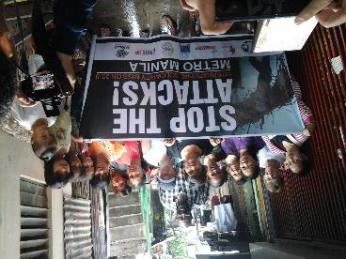
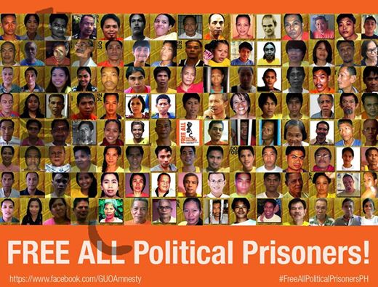
The Church is missionary by its very nature (Vat 11).
Before todays forms of exploitation of the poor, the Church cannot remain silent (131)
We are called to solidarity with the poor, to listen to their cries, as not to do so is to oppose the plan of God (187)
I invite everyone to be bold and creative in this task of rethinking the goals, structures, style and methods of evangelization in their respective communities” (No.33).

Slide 14
Some Possible Questions
What are my experiences?
What are the calls today?
How do I define missionary work today in light of the call to “wake up the world”?
What is the role of the church today?
What is our way forward?

