Slide 1
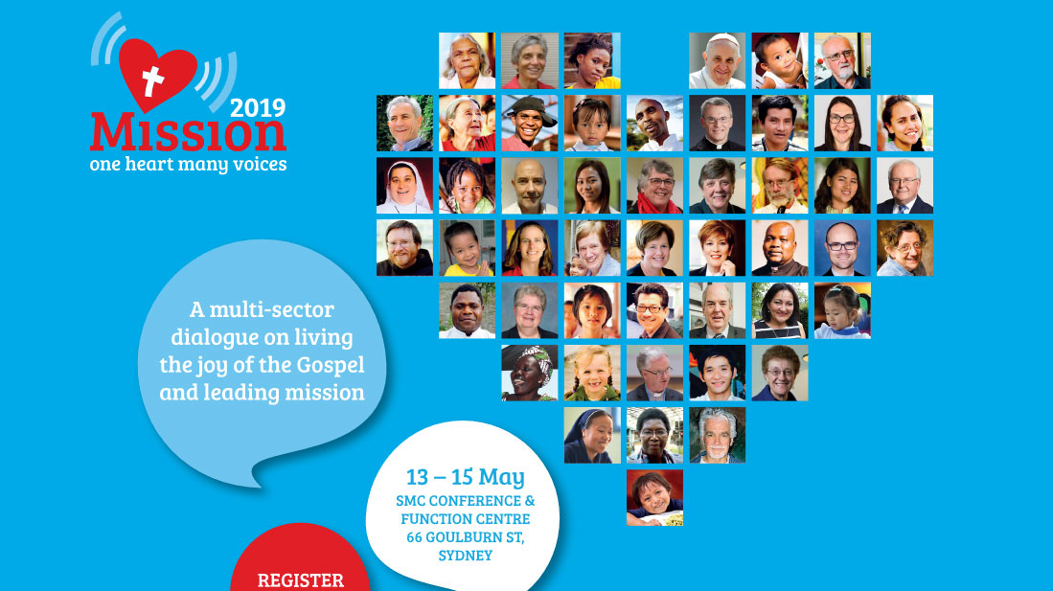

Slide 2
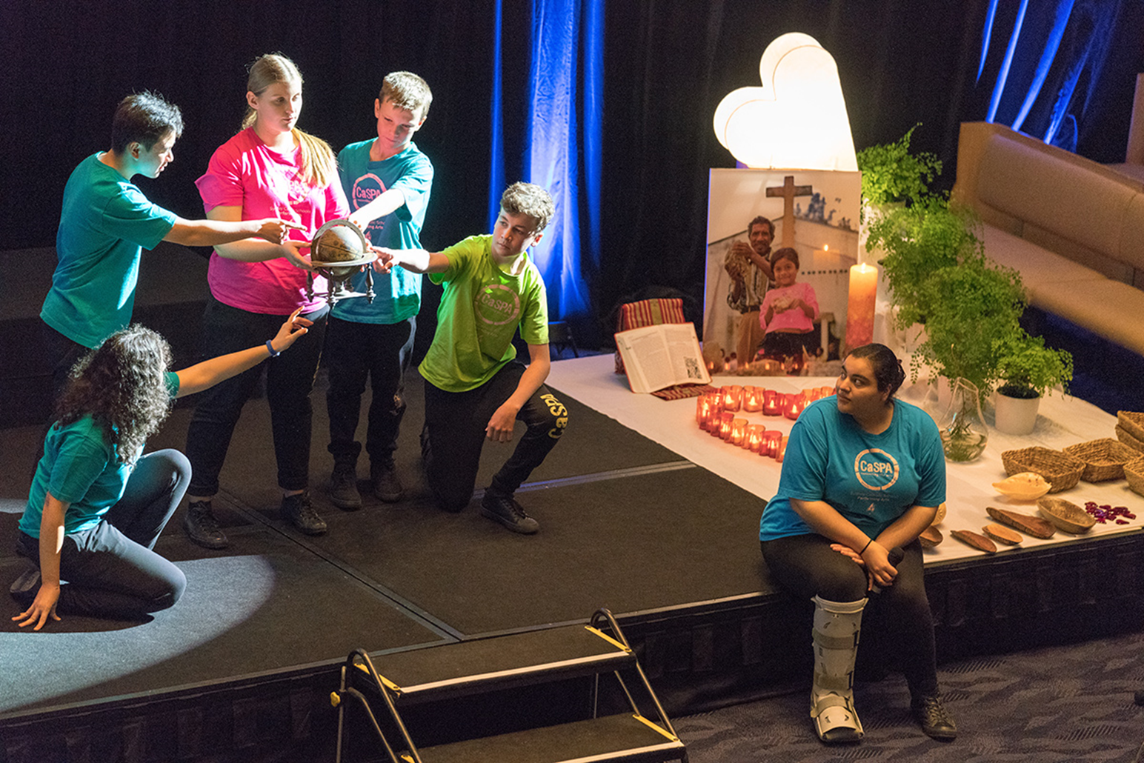
Opening Ritual
Energy
Enthusiasm
Passion
Excitement
Colour
Inclusion
Dialogue
Encounter

Slide 3

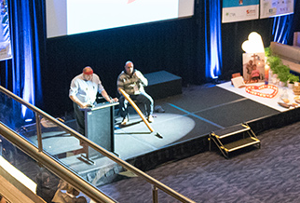

Slide 4
Sr Carol Zinn
False
Evidence
Appearing
Real
Looking at
Others with the
Very
Eyes of God

Slide 5
Bishop Paul Tighe
Digital communication is changing our culture
How are we going to be meaningful in the new culture, the digital world?

Slide 6
Conference mass
Music
Singing
Music
Singing
Music
Singing
A Real Celebration

Slide 7
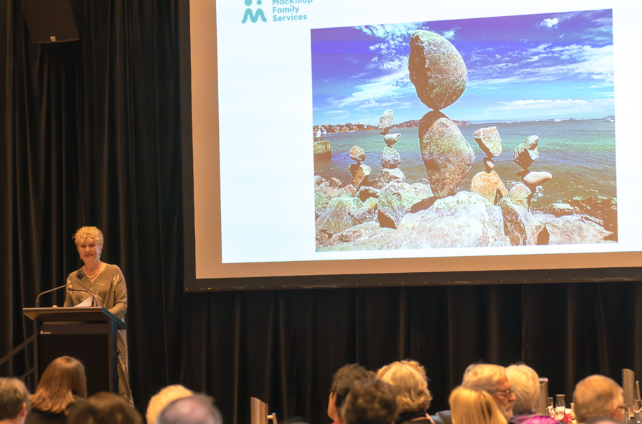
Breakfast: Dr Robyn
Miller
“We must hold our nerve and be faithful to the gospel”

Slide 8
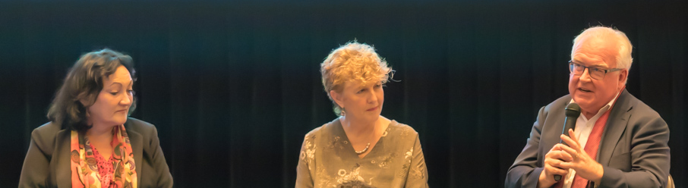
Facilitated Dialogue:
Robyn Miller, Ravina Waldren, Robert Fitzgerald, Phil Glendenning
60,000 years of knowledge, culture wisdom (Ravina)
Legitimacy, Integrity, Governance (Robert)
“We DARE to work in this field” (Robyn)

Slide 9
The lament

Slide 10
Sharing The Conversations
Engaging the Heart

Slide 11
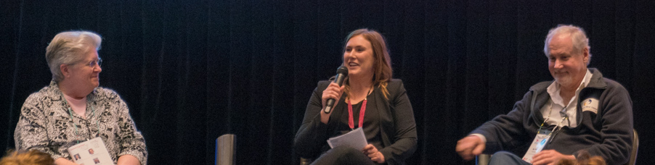
Becoming a Church beyond 2020
Sr Carol Zinn
Charlene Robson
Phil Glendenning

