Slide 1
WORKSHOP 4.7 Leadership: A way of being and a way of doing
15 may 2019
11.00am - 12.15pm
Mary Leahy

Slide 2
Purpose of today…….
Identify and apply leadership processes and practices that give witness to Jesus’ mission.
knowing self: knowing others
Align theory and practice
Implications for me as leader
Notes:
knowing self
knowing others
and appreciating the value of diversity
sharing something of oneself
having the courage to question
critically self-reflecting
modeling and encouraging others

Slide 3
Way
of doing
Way
of being
Notes:
NOT SURE IF IT GOES HERE!

Slide 4
Leadership
Theory
Way
of being
Way
of doing
Notes:
NOT SURE IF IT GOES HERE!

Slide 5
Leadership
Theory
Context
Way
of being
Way
of doing
Notes:
NOT SURE IF IT GOES HERE!

Slide 6
Leadership
Theory
Context
Way
of being
Beliefs&
Values
Way
of doing
Notes:
NOT SURE IF IT GOES HERE!

Slide 7
Leadership
Theory
Context
Way
of being
Beliefs&
Values
Experience &
Wisdom
Way
of doing
Notes:
NOT SURE IF IT GOES HERE!

Slide 8
Leadership
Theory
Context
Way
of being
Expectations &
Assumptions
Beliefs&
Values
Experience &
Wisdom
Way
of doing
So what for me as leader?
Notes:
NOT SURE IF IT GOES HERE!

Slide 9
Leadership Theories- Potential Overload!
Multiple theories, frameworks, capabilities, competencies, styles & practices exist regarding leadership and what makes a good leader.
Although they are in the main grounded in sound research; are aspirational and potentially transformational, they can be at risk of remaining in one’s head space or the subject of an assignment if not pulled into the reality space, critically reflected upon and applied.
Notes:
Theories on butchers paper:
Kouzes and Posner,
Michael Fullan,
Practices, Goleman’s leadership styles etc

Slide 10
Leadership- A way of being & a way of doing.
What attracted you to this workshop?
Notes:
Record responses on butchers paper- Expectations (acknowledging we have 1 hr- to start the conversation)

Slide 11
Leadership- A way of being & a way of doing.
What attracted you to this workshop?
What do you bring to this session from the past day and a half:
insights
learnings
challenges
questions?
Notes:
Record responses on butchers paper- Expectations (acknowledging we have 1 hr- to start the conversation)

Slide 12
Leadership-
What words, phrases, images come to mind?
Notes:
Record responses on butchers paper-

Slide 13
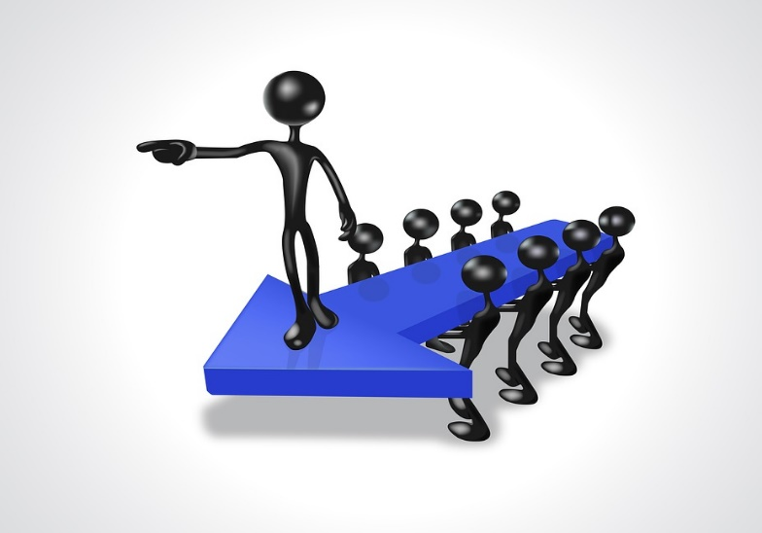
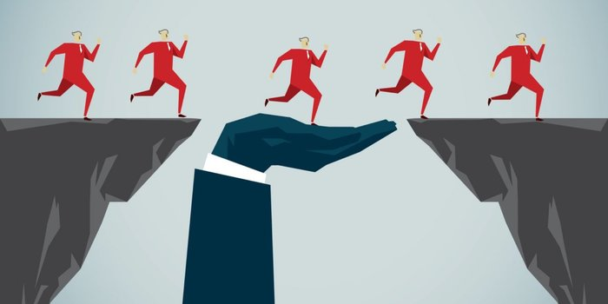
Leadership Images

Slide 14
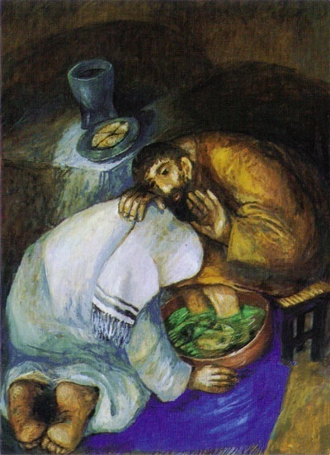
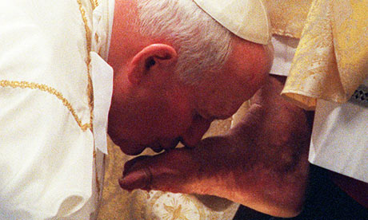
Leadership Images
Sieger Koder
Pope Francis Easter 2013

Slide 15
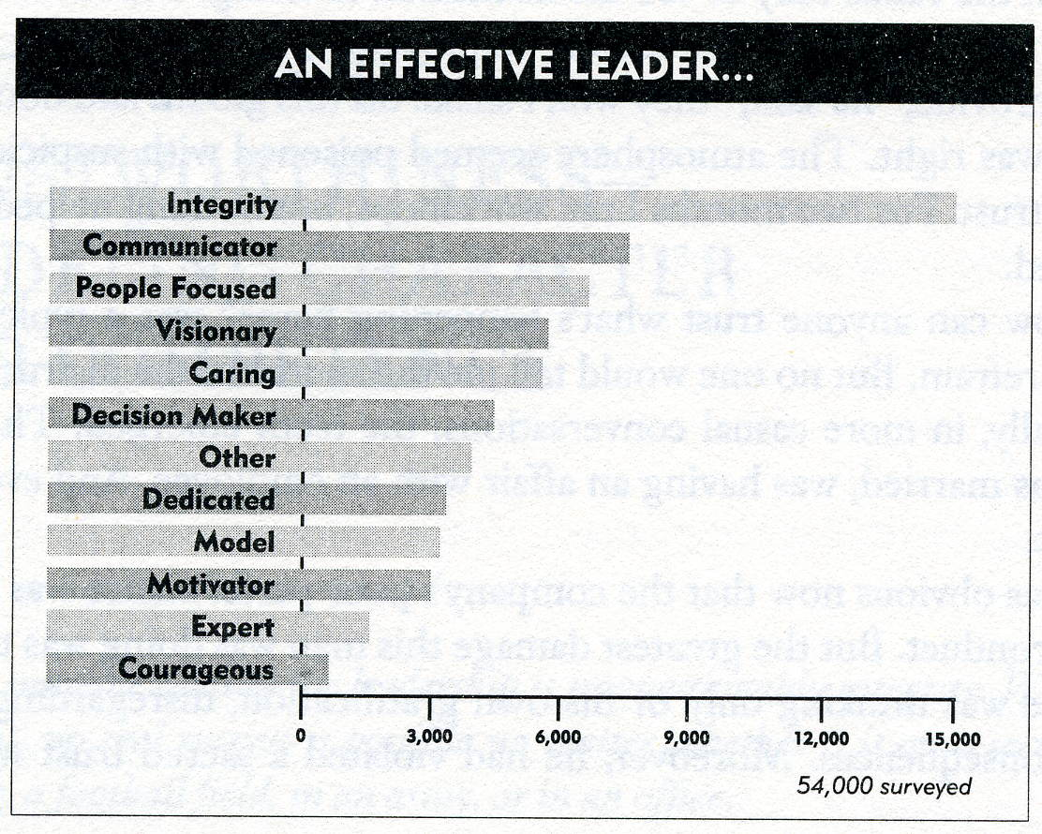
Stephen Covey
Stephen Covey
Notes:
Roz Zander’s statement about leadership from An Art of Possibility

Slide 16
“….we lead people and manage things.”
(Stephen R. Covey)
“When leadership is defined not as a position you hold but as a way of ‘being’, you can lead from wherever you are.”
(Zander & Zander)
Notes:
Butchers Paper

Slide 17
Leading Self: Knowing Self
Quote
“leaders ….bring themselves, including their deepest convictions, beliefs and values to their work.”
Robert Starratt. Ethical Leadership p.65

Slide 18
Your ‘way of being’ is unique… (booklet)
WHO ARE YOU……..?
What are your deepest convictions?
What do you believe?
What values shape who you are and how you strive to live your life personally and professionally?

Slide 19
Impact of Culture, Background and Experience on your way of being & your way of doing
VISIBLE DIFFERENCES
Communication
Decision making
Dealing with conflict
Disclosure
Knowledge
INVISIBLE ROOTS
Beliefs & Attitudes
Values
Perceptions
Expectations
Assumptions
http://www.1000ventures.com/business_guide/crosscuttings/cross-cultural_differences.html
Notes:
All the visible behaviours above the line are informed by what’s below the line.

Slide 20
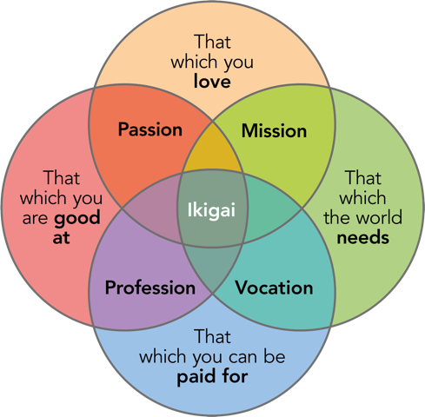
Ikigai
Notes:
Ikigai (生き甲斐, pronounced [ikiɡai]) is a Japanese concept that means "a reason for being." The word "ikigai" is usually used to indicate the source of value in one's life or the things that make one's life worthwhile. The word translated to English roughly means "thing that you live for" or "the reason for which you wake up in the morning." Each individual's ikigai is personal to them and specific to their lives, values and beliefs. It reflects the inner self of an individual and expresses that faithfully, while simultaneously creating a mental state in which the individual feels at ease. Activities that allow one to feel ikigai are never forced on an individual; they are often spontaneous, and always undertaken willingly, giving the individual satisfaction and a sense of meaning to life.

Slide 21
Ikigai- a reason for being
Indicate the source of value in life or the things that make life worthwhile.
English translation:
"thing that you live for"
"the reason for which you wake up in the morning."
Each individual's ikigai is personal to them.

Slide 22
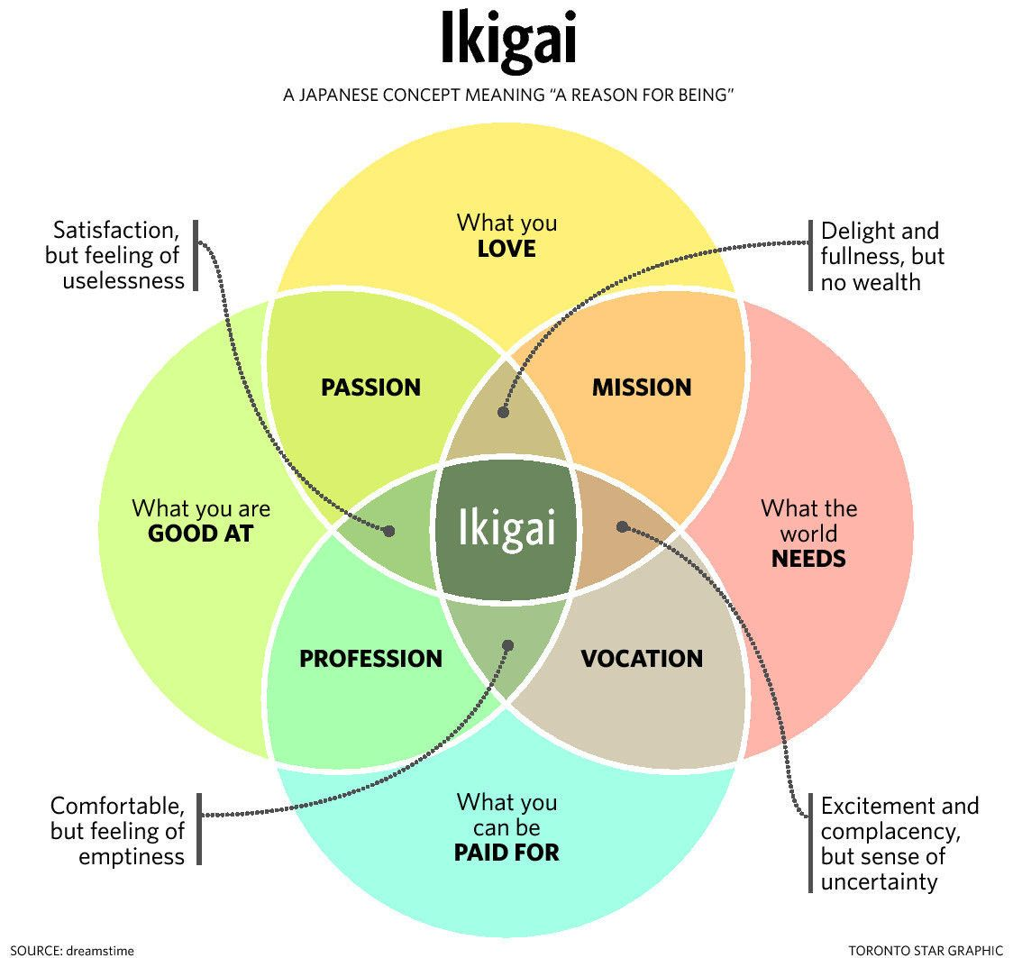
Notes:
Ikigai- “A reason for being”

Slide 23
Leadership (booklet)
What does leadership mean to you?
What are the 3 most important things to you in leadership? (relationships, authenticity)
What do you find most challenging?
What gets in the way?
There will be things you can’t change, but what can you do…….?
Notes:
Booklet – add to butchers paper

Slide 24
Challenges?
Barriers?
What’s most important?
Leadership
Head and
Heart
YOU:
Self Awareness
Self Management
OTHERS:
Social Awareness
Relationship
Management
Notes:
Record on table groups- A3 paper

Slide 25
Better Knowing Self…… Way of Being and Way of Doing
1976 - HBDI developed by physicist, Ned Herrmann
Intrigued by how the brain could help explain the:
‘clever/dumb’ issue- absent minded genius;
big picture thinker who doesn’t notice detail.
Using brain research, Hermann discovered that there were four patterns that emerged in terms of how the brain perceives and processes information.
The Whole Brain® Model emerged
Notes:
BACKGROUND:
In 1976, while researching the brain as the source of creativity, Ned Herrmann learned of the pioneering brain research of Roger Sperry, Paul MacLean, Joseph Bogen and Michael Gazzanaga. From their work it is clear that the brain has four distinct and specialized structures.
Inspired by this research, Herrmann worked with EEG scans and, later, paper-and-pencil questionnaires to identify four distinct types of thinking, each roughly corresponding to one of the brain structures

Slide 26
See Booklet p 4
Handout

Slide 27
How I put my Whole Brain to Work
BLUE
YELLOW
Being Challenged
Analyzing & Diagnosing
Logical Processing
Finance & Numbers
Making Things Work
Solving Tough Problems
Clarifying Issues
Explaining Things
Dealing with the Future
Seeing the Big Picture
Inventing Solutions
Developing New Things
Providing Vision
Taking Risks
Integrating Ideas
Bringing About Change
GREEN
RED
Administering
Attending to Detail
Being in Control
Building Things
Establishing Order
Timely Implementation
Planning Things Out
Providing Support
Coaching
Working with People
Communicating
Building Relationships
Expressing Ideas
Teaching/Training
Persuading People
Being part of a Team
Notes:
Model with 1 person
Strongest Preference 4; Weakest Preference 1 (4,3,2,1) or (4,4,2,1)

Slide 28
“What’s the Theory of the case?”
Define goals & objectives
Logically solving problems
Critical analysis & theory
Efficiency, cost & data
Working toward quantifiable
outcomes
GETTING DOWN TO BUSINESS
“Challenge the Status Quo”
Strategize & visualize the future
Risk taking & experimenting
Combining & connecting concepts
Brainstorming new ideas & solutions
“Big picture” perspective
BREAKTHROUGH THINKING
Team Approaches
“Being part of the team”
Mediating & facilitating
Sharing, listening & expressing
Collaborating & building
relationships
Intuitive sensing of underlying
issues
Being sensitive to other people
KINDLING COMMUNITY SPIRIT
“How can we make this happen?”
Attention to detail & procedures
Moving from point A to point B
Task allocation, organization& planning
Follow-up & scheduling with time lines
Making sure everything is in
order & in control.
MOVING TOWARD A RESULT
Notes:
Strongest Preference 4; Weakest Preference 1 (4,3,2,1) or (4,4,2,1)

Slide 29
Facts, no Fluff
Technical Accuracy
Articulated ideas
Brief, Clear, Precise
Critical Analysis
Straight forward
Metaphors
Big Picture Overview
Imaginative
Conceptual framework
Exploration
Visual
Communication Preferences
Details
Thoroughness
Rules & Procedures
Action Plans
Explanations
Stay on topic
Feelings & values
Open discussion
Expression
Personal touch
Empathy & consideration
Stories & examples
Notes:
Strongest Preference 4; Weakest Preference 1 (4,3,2,1) or (4,4,2,1)

Slide 30
Leadership Styles
BLUE
YELLOW
Authoritative
Directive
All-business
Analytical
Factual
Adventurous
Visionary
Entrepreneurial
Idealistic
Holistic
GREEN
RED
Traditional
Conservative
Organized
Accountable
Safe-Keeping
Team-Oriented
Supportive
Personable
Intuitive
Communicator
Notes:
Strongest Preference 4; Weakest Preference 1 (4,3,2,1) or (4,4,2,1)

Slide 31
40
32
24
16
$8
8
Notes:
Statistical studies of HBDI® profiles have identified typical profiles for different careers, fields and job descriptions. A study of hospital personnel revealed preference differences among the varying jobs:
Specialists (A quadrant);
Administrators (B quadrant);
Nurses (C quadrant);
Psychiatrists (D quadrant).
Is it any wonder that sometimes there might be tension in the hospital environment?

Slide 32
Awareness and appreciation of diversity leads to more creative outcomes.
One heart many voices
Research using the HBDI® Team profile has shown that team effectiveness can be up to 66% greater in diverse teams.

Slide 33
Insights?
Challenges?
Barriers?
What’s most important?
Leadership
Head and
Heart
YOU:
Self Awareness
Self Management
OTHERS:
Social Awareness
Relationship
Management
Notes:
Record on table groups- A3 paper

Slide 34
It’s Complex!
Knowing your preferred way of operating and the preference of others is helpful but there’s more…….
Becoming an authentic leader is a journey:
self awareness & self-management .
commitment to ongoing learning & growth
nourishment
energy, joy and conviction
develop others

Slide 35
Emotional Intelligence
Emotional intelligence is the ability to understand one’s emotional make-up and the emotional make-up of others , and to use insight from this knowledge to effectively manage and regulate one’s own emotions to make good decisions and to act effectively in relation to others.
Daniel Goleman

Slide 36
Emotional Intelligence- Daniel Goleman
Knowing self
Self Awareness | Social Awareness
Emotional Self Awareness Accurate Self Assessment Self Confidence | Empathy Organisational Awareness Service
Self Management | Relationship Management
Self Control Transparency Adaptability Achievement Initiative Optimism | Inspiration Influence Developing Others Change Catalyst Conflict Management Team Work and Collaboration
Knowing others
Managing Relationships
Managing self

Slide 37
Emotional Intelligence
What presses your buttons?
What strategies do you find assist you in managing and monitoring your emotional responses?
How have you worked with people who are not self-aware?
What strategies, approaches have you found effective?

Slide 38
Benefits of developing EI Skills
to quickly reduce stress
to recognize and manage your emotions
to connect with others using non verbal communication
to use humour and play to deal with challenges
to resolve conflicts positively and with confidence.

Slide 39
Leadership
Theory
Context
Way
of being
Expectations &
Assumptions
Beliefs&
Values
Experience &
Wisdom
Way
of doing
So what for me as leader?
Notes:
NOT SURE IF IT GOES HERE!

Slide 40
Reflections
Leadership: A way of being & a way of doing
What have you learnt about yourself as a leader?
What has been affirmed?
What leadership challenges are you prepared to tackle in the pursuit of Jesus’ mission?

Slide 41
Thank you!

