Slide 1
Welcome!

Slide 2
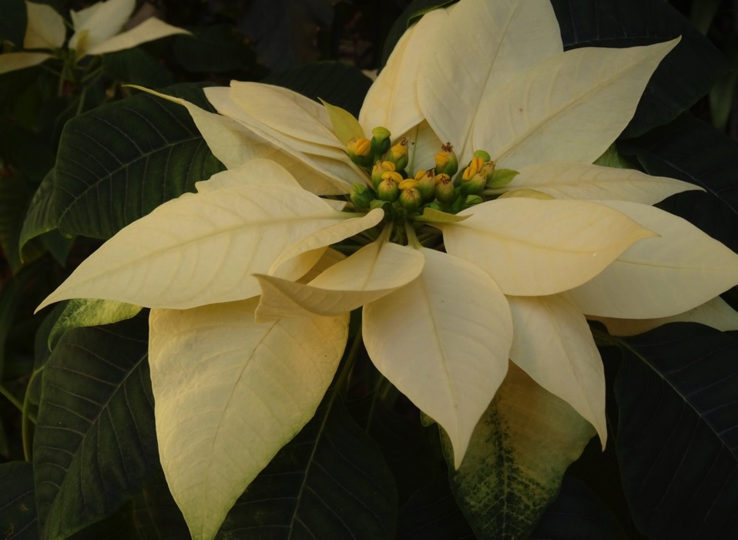

Slide 3
Overview
Process:
Session One:
Brief Understanding of Evolutionary Consciousness
Exploring the Art of Listening Contemplatively
Appreciating the steps involved in a Contemplative Dialogue Process
Practice… Modelling the Process with a small group
Review of the Process

Slide 4
Session Two:
Setting up Groups and assigning question for the practice of Contemplative Dialogue.
Facilitating the Process with Large Group.
Reflection on the Process:
Learnings – Challenges
Conclusion

Slide 5
Evolutionary Consciousness

Slide 6
‘Our role is no longer to merely
ease the suffering,
bind up the wounds,
and feed the hungry,
but through every form and effort to
‘raise the power of love upward’
to the next stage of
consciousness.’
Teilhard de Chardin

Slide 7
First Tier Consciousness…
Believe that their values, perceptions and judgments are the only correct ones.
Second Tier Consciousness…
Desire for and vision of interconnectedness, a willingness to discriminate through dialogue and can allow room for other ways of perceiving and acting.

Slide 8
A New Stage of Consciousness
– Integral Consciousness
A cosmological awareness of the evolutionary
significance of the 14 billion year Universe Story.
A deepening capacity for
contemplative consciousness
that transcends and includes the rational
An ongoing integration of science and spirituality.

Slide 9
A movement from individualism to communion – from I to We.
A vision of a global economy and governance that care about
the common good of all, especially those most in need.
Liz Sweeney SSJ

Slide 10
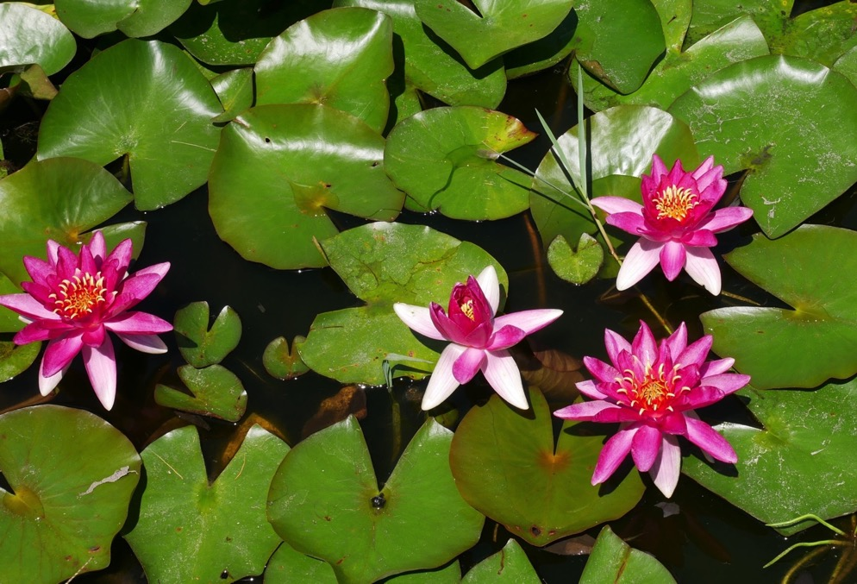
How can we bring about
this shift in consciousness?
What seems to be emerging in our culture and our Church today?

Slide 11
The Invitation to live the Mystery of Christ more consciously.
2. The invitation to become more intentional about our engagement in individual and communal contemplation.
The invitation to create ways of coming together that deepen the bonds
of relationships.

Slide 12
1.The Invitation to live
the
Mystery of Christ
more
Consciously.

Slide 13
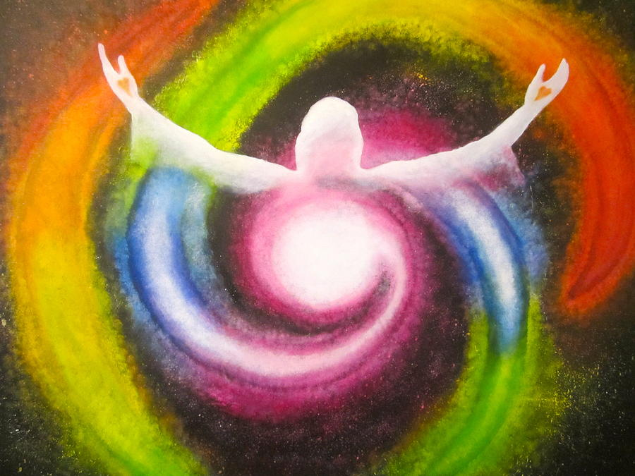
Cosmic Christ

Slide 14
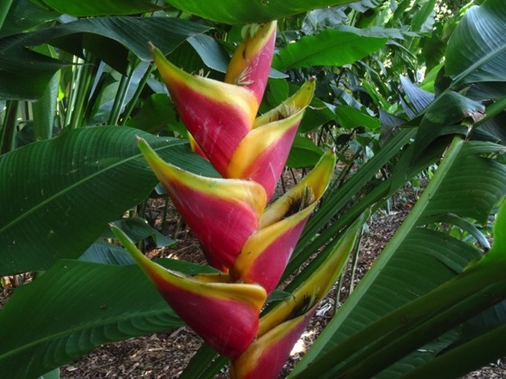
The Christ who
‘ fills the universe in all its parts’
Ephesians 1:2
‘God already began
the mysterious
process of becoming flesh
by first
becoming Creation itself.’
Daniel O’Leary

Slide 15
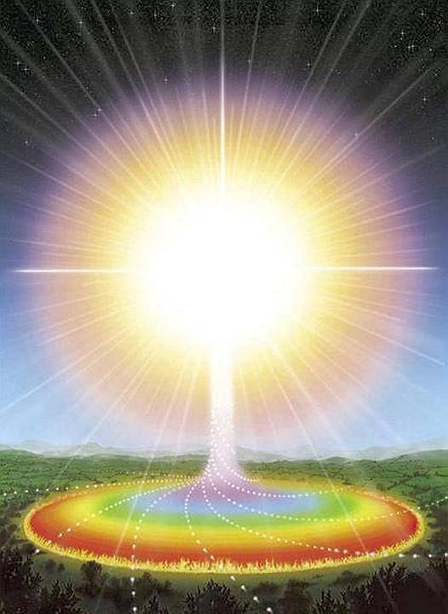
‘When God’s Word,
Love aware of itself
comes pouring
into nothingness,
the
universe happens.
There is something
incarnational
throughout
all of creation.’
Margaret Pirkl osf

Slide 16
‘Every leaf, cloud, fruit, animal and person is
to be seen as an outward expression of the
Word of God in Love!
Thus each creature has its own
identity, integrity and dignity.
Each is sacred because
it holds something
of the Word of God,
Christ in a unique way.’
M Pirkl osf

Slide 17
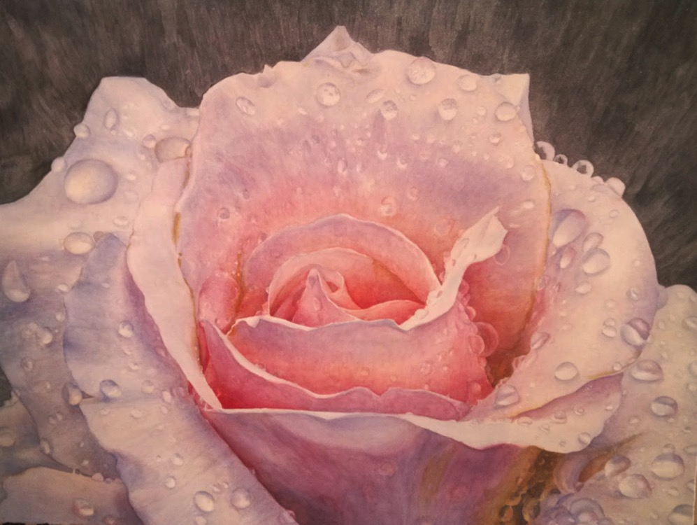
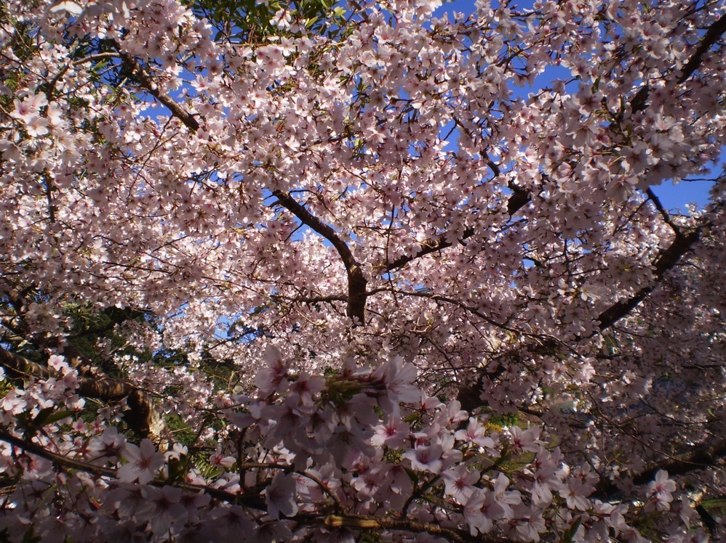
‘There is the dearest freshness deep
down things’
Gerard Manly Hopkins

Slide 18
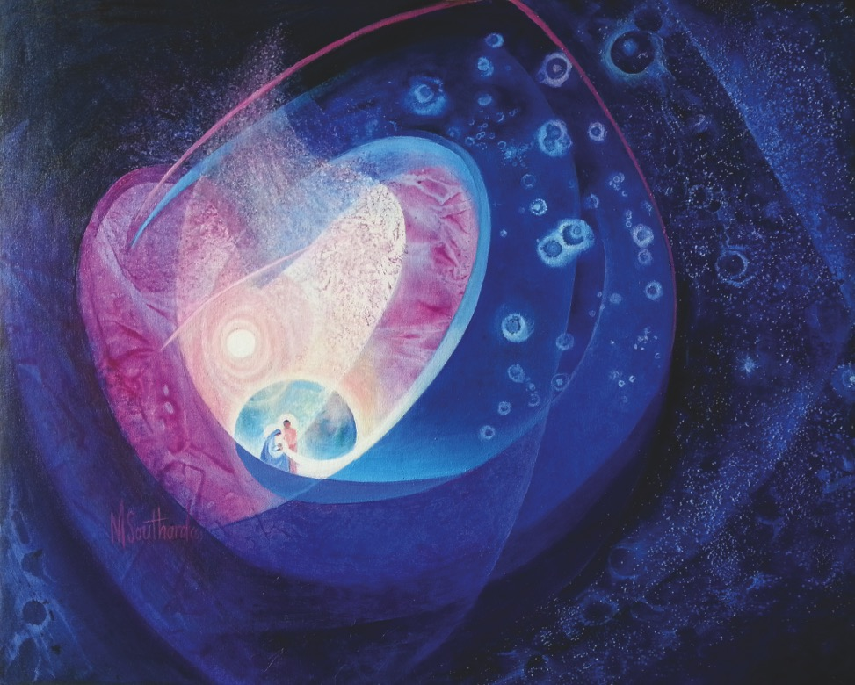
The whole of the cosmic unfolding
is powered by a personalised
Centre of Love
which draws everything towards a greater wholeness…
Teilhard de Chardin
Notes:
“The whole of the cosmic unfolding,” says Teilhard de Chardin, “is powered by a personalised Centre of Love which draws everything towards a greater wholeness.”

Slide 19
“In our time the vitally important question
has become for us to define the
links between Christ and the Universe:
how they stand in relation to one another…
By His incarnation Christ inserted himself
not just into our humanity,
but into the universe
which supports humanity.
The presence of the Incarnate word…
shines at the heart
of all things.” Teilhard de Chardin

Slide 20
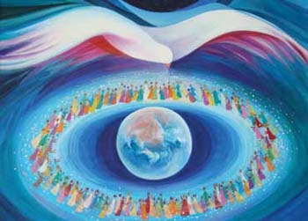
‘The term ‘cosmic Christ’
reminds us that everything
and everyone belongs.
The Mystery of the Incarnation
means the divine
indwelling is in all of us
and in all of creation.
We are indeed the
Body of Christ…
the Universe is the
Body of Christ.’ Richard Rohr

Slide 21
2.The invitation to become
more intentional
about engaging
in individual and
communal contemplation.

Slide 22
‘There where you are
you will find God’
Mary MacKillop

Slide 23
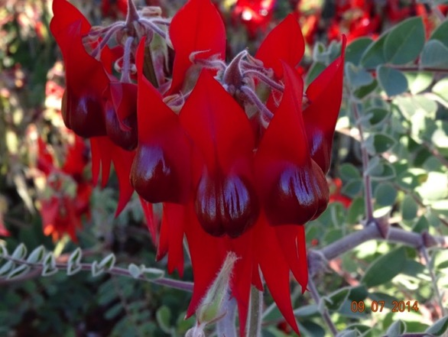
When it is over,
I want to say
All my life
I was married
to amazement.
I was the bridegroom
taking the world
Into my arms.
Mary Oliver

Slide 24
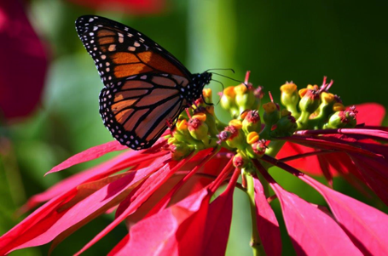
Contemplation
‘Seeing the interconnectedness
and hidden beauty in everything
requires contemplative
awareness and practice.

Slide 25
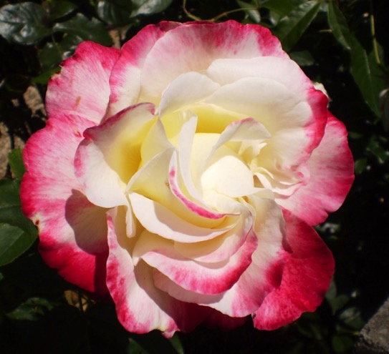
To slow down
and regularly become
aware of the
essential relatedness
of all things
in a single Centre of Love
is a powerful means
of living
Christian Evolutionary
Consciousness.’
Madeleine Duckett rsm

Slide 26
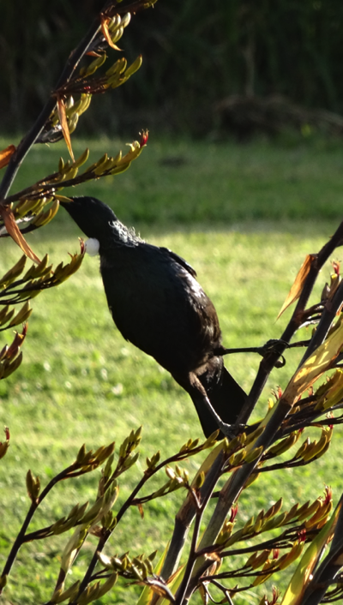
‘… we slowly develop eyes
that can see Christ
‘shining diaphanously through
every creature of the universe’.
This is the seeing of the mystic
and now is the time for
the mystical consciousness
to rise in everyone, as we grow
into living from
the perspective of
the larger whole. Illia Delio osf

Slide 27
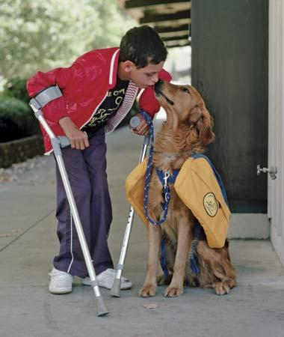
‘When we fail
to acknowledge as
part of reality the
worth of the poor person,
a human embryo,
a person with disabilities
- to offer just a few examples –
it becomes
difficult to hear
the cry of nature itself,
everything is connected.’ Laudato Si

Slide 28
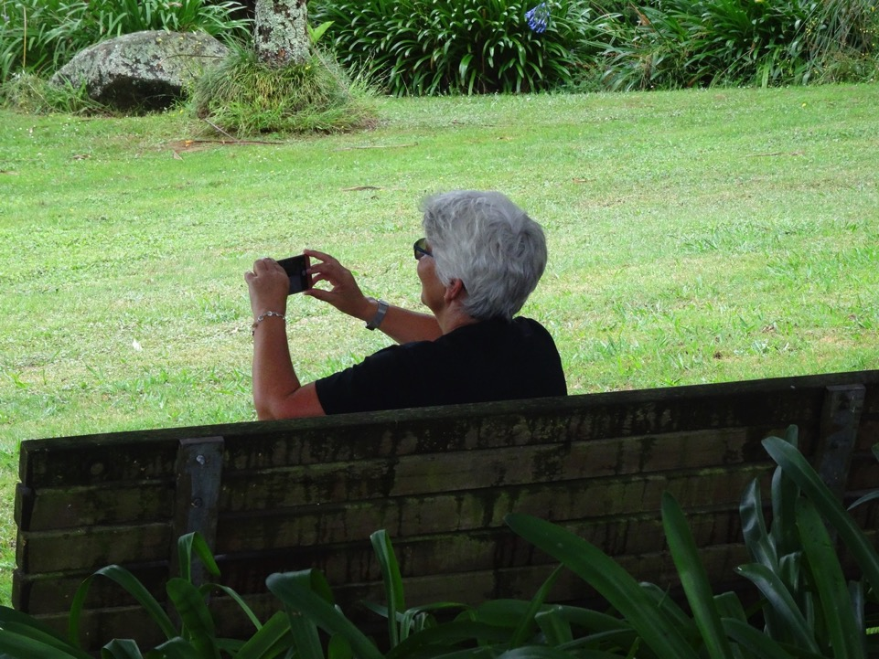
Reflection:
Think of a time… when you were conscious of being in communion with…
We grow in
‘communion consciousness’
recognising
our oneness with all.

Slide 29
3. The invitation to create ways
of coming together
that deepen the
bonds of relationship
among us
and expand our inclusivity
of our love.

Slide 30
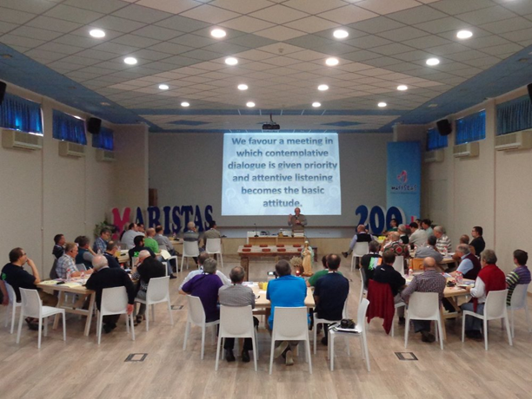
‘The Mystery reveals itself in
and through the collective in ways not possible inside solitary practice.’ Gail Worcello

Slide 31
Since the movement into Integral consciousness is a shift from
I to We,
from individualism to communion
it invites us to discover new ways of being together….
networking with one another in relationship across and beyond our local community and friendship.

Slide 32
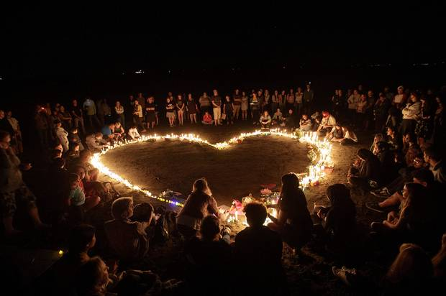
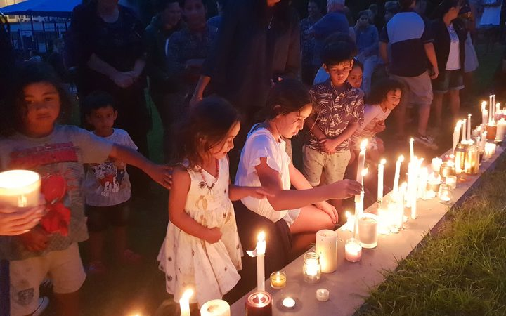
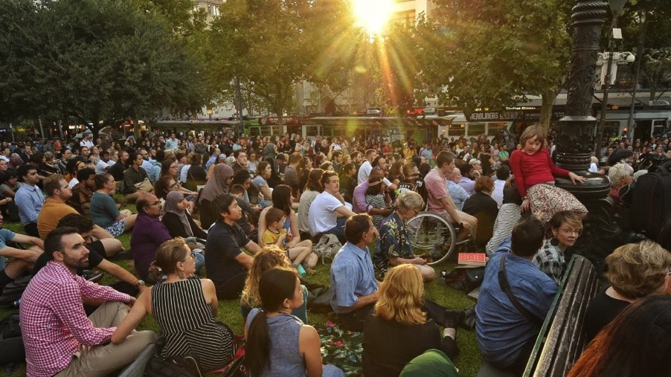

Slide 33
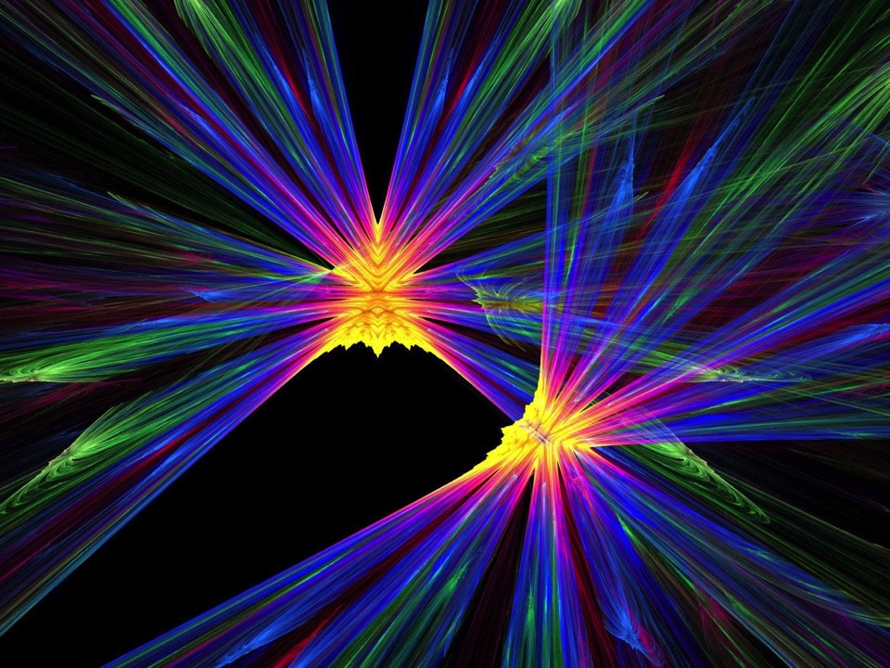
The process of
Contemplative Dialogue
offers wonderful opportunity
to grow in communion,
and to experience
the inbreaking of the Divine.

Slide 34
The Art of Listening
Contemplatively

Slide 35
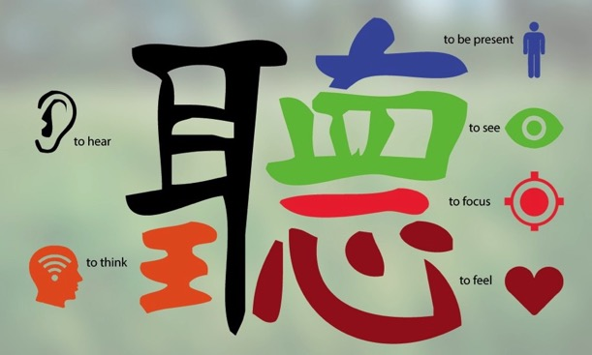

Slide 36
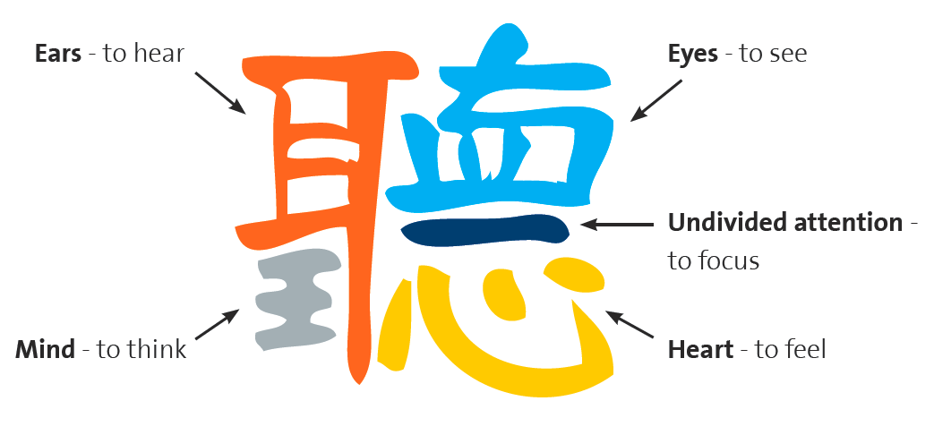

Slide 37
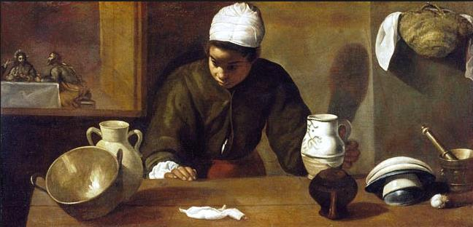
The Supper at Emmaus
Diego Rodriguez de
Silva y Velazquez (1599-1660)

Slide 38
The Servant-Girl at Emmaus
Denise Levertov
She listens, listens, holding
her breath. Surely that voice is his
the one who had looked at her, once,
across the crowd,
as no one ever had looked ?
Had seen her? Had spoken as if to her?
Surely those hands were his,
taking the platter of bread from hers just now?
Hands he’d laid on the dying
and made them well?

Slide 39
Surely that face—?
The man they’d crucified for sedition and blasphemy. The man whose body disappeared from its tomb. The man it was rumoured now some women
had seen this morning, alive?
Those who had brought this stranger home
to their table don’t recognize yet with whom they sit. But she in the kitchen,
absently touching the wine jug she’s to take in, a young Black servant intently listening, swings round and sees the light around him and is sure.

Slide 40
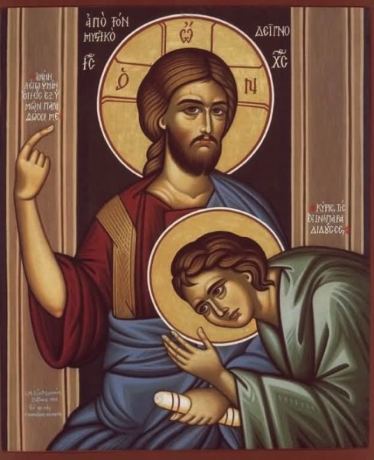
"The Celtic tradition uses the image of listening for the heartbeat of God.
The legend is that John thus heard the heartbeat of God.
He became an image of listening within all things for the One who is the
very beat of life.” —
Echo of the Soul:
The Sacredness of the
Human Body

Slide 41
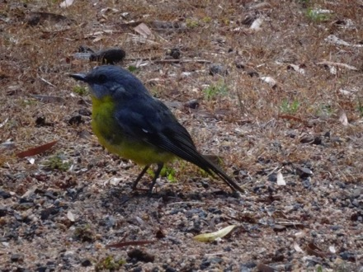
We are being invited instead into a new humility, to serve the holy wisdom that is already stirring in the hearts of people everywhere, the growing awareness of earth’s interrelatedness and sacredness.”

Slide 42
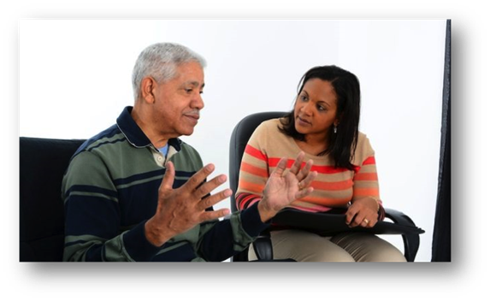
…we need to find ways of sharing our intimate experiences of the Mystery, for we are one.
It is through one another that we will know
more of the Life that flows within us all.
It is through sharing our fragments of insight that we will come to a fuller picture of the
One who is at the heart of each life.”

Slide 43
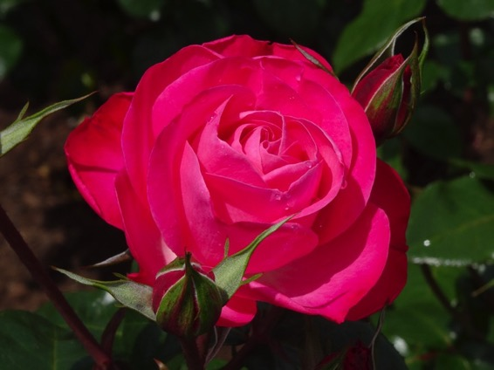
C. Engaging in
Contemplative Dialogue
In Contemplative dialogue together we…
Encourage curiosity
Build on insights
Make connections
Seek Patterns

Slide 44
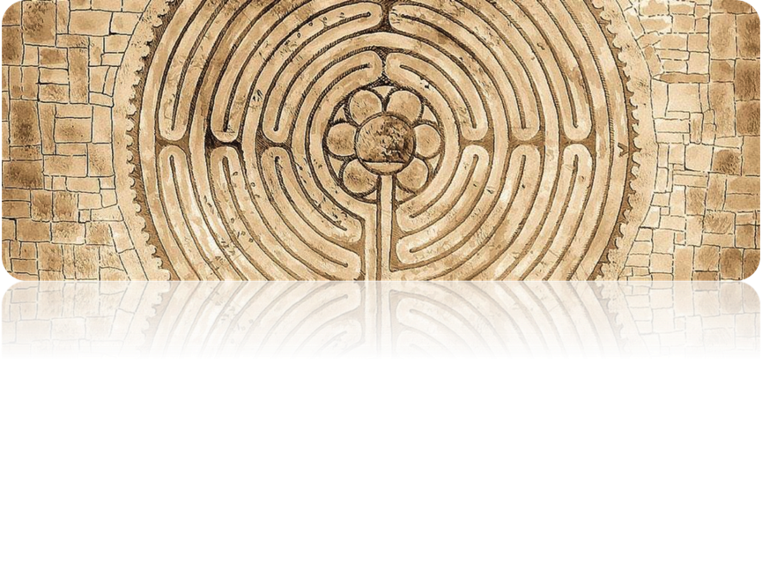
We need to evolve communally at he level of consciousness. It is an invitation to learn to transform the way we are together to evolve in our way of thinking, feeling, and loving when we are in relationship communally.

Slide 45
Inner Dispositions
Open Mind (commitment to truth)
see with fresh eyes
Open Heart (commitment to love)
walk in the shoes of the other
Open Will (commitment to courage)
let go of fear, new will come
Three Voices
Voice of Judgment…stifles creativity
Voice of Cynicism… only my way of thinking and doing
Voice of Fear… cannot let go, so new can come

Slide 46
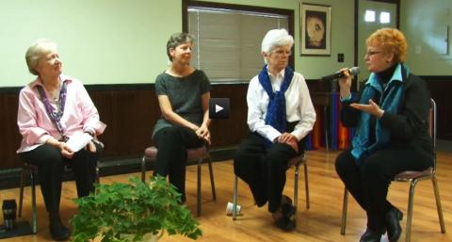
Contemplative Dialogue
What makes this different from other experiences of dialogue?
Suggestions
for the
Practice
of Contemplative Dialogue…

Slide 47
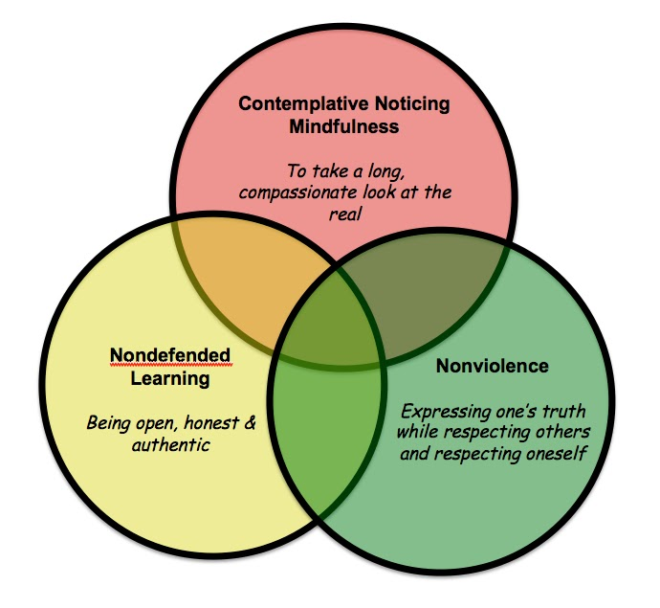

Slide 48
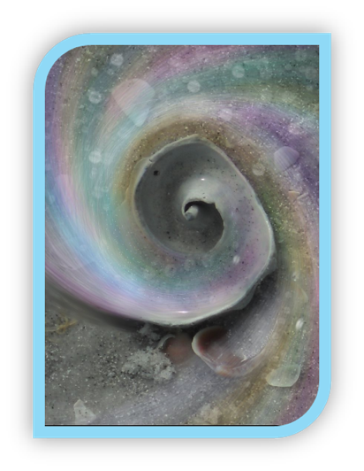
Contemplative Dialogue is a meaningful conversation in a group that is rooted in listening.
We listen deeply to learn what ‘WE’
think and we listen for new possibilities to arise.

Slide 49
We enter the dialogue as a community of equals using three skills…
Contemplatively Listening.
2. Contemplatively Speaking .
3. Intentionally creating a ‘WE’ communal space among us by listening to and building on one another’s wisdom.

Slide 50
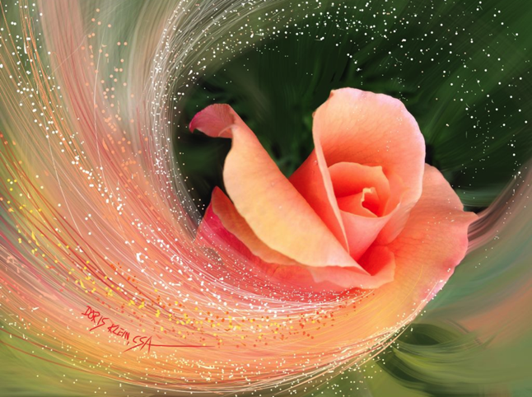
What is Doris Klein
revealing in her art
about Contemplative Dialogue?

Slide 51
During Contemplative Dialogue:
Speak briefly using an economy of words
Share the distilled version of your thoughts
in a few sentences – only what matters
Speak slowly from an inner attitude of quiet contemplation.
Speak to the centre – to the WE
Listen and look at the person who is speaking

Slide 52
Listen without thinking about what we will say. Let your thoughts emerge from the silence.
Avoid sharing past knowledge, quoting something, giving an automatic response or using long and involved patterns of thought.
Keep a spacious hospitality so we can explore differences.

Slide 53
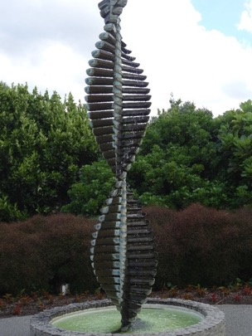
‘Listen, we shape ourselves
to fit the world and
by the world are
shaped again.
The visible and
the Invisible working
together in common
cause to produce
the miraculous.’
David Whyte
How is our
world shaping
us as Christians today?

Slide 54
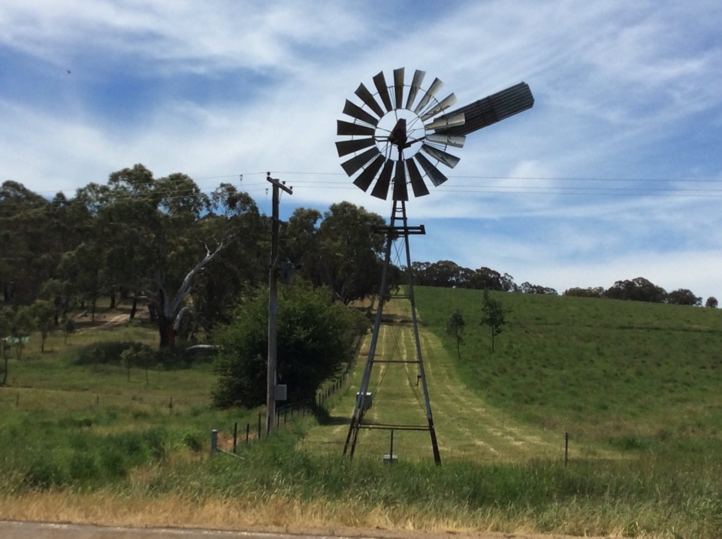
Let Me Hear
© John Philip Newell
2006

Slide 55
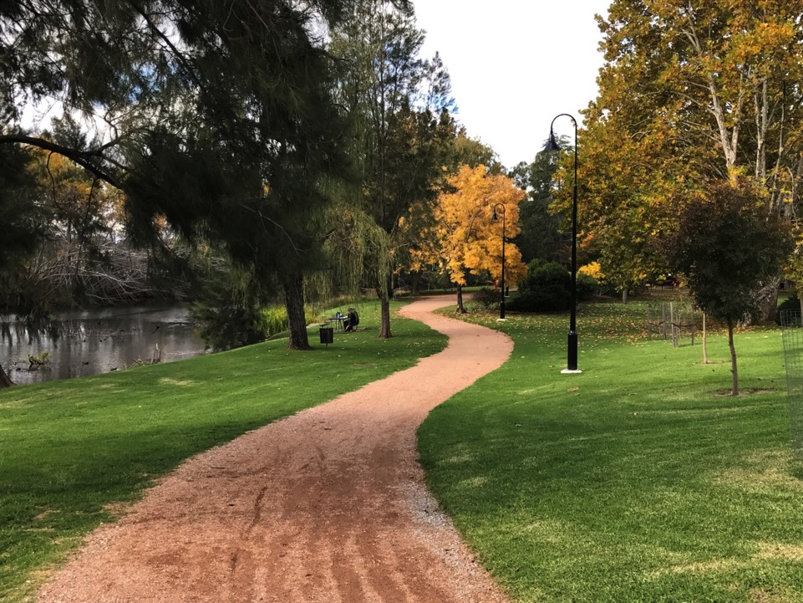
Let me hear
Let me hear
What you will speak
When I turn to You
In my heart.

Slide 56
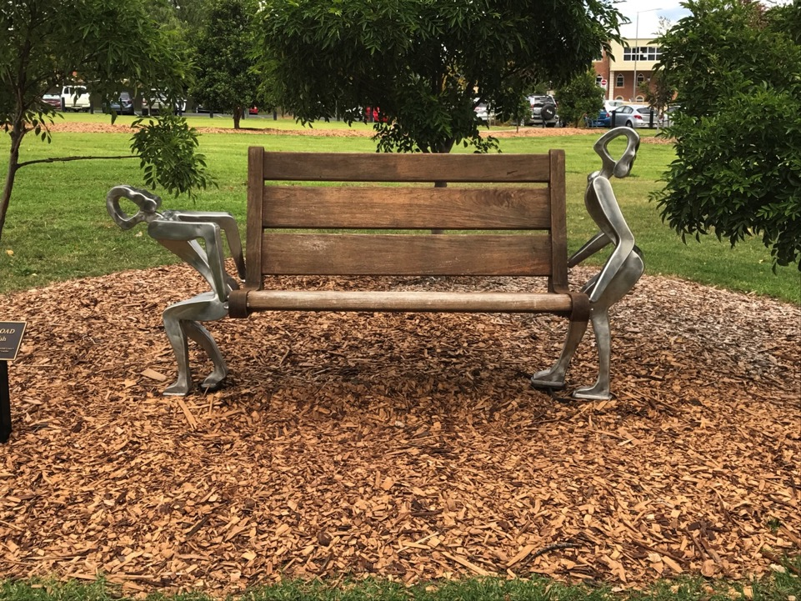
Let me hear
Let me hear
What you will speak
When I turn to You
In my heart.

Slide 57
Let me hear
Let me hear
What you will speak
When I turn to You
In my heart.

Slide 58
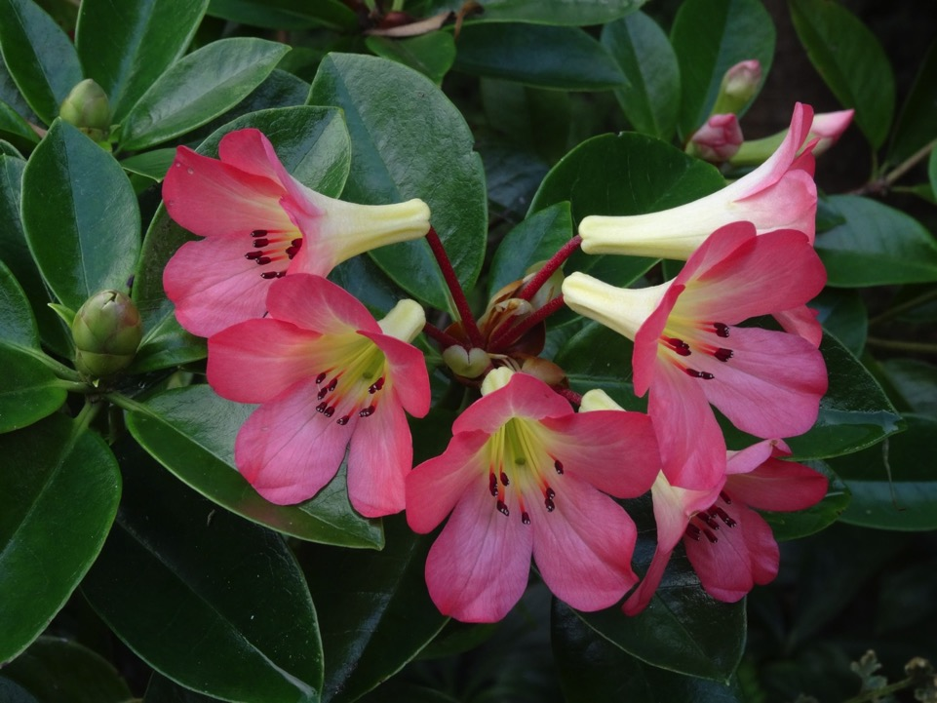

Slide 59
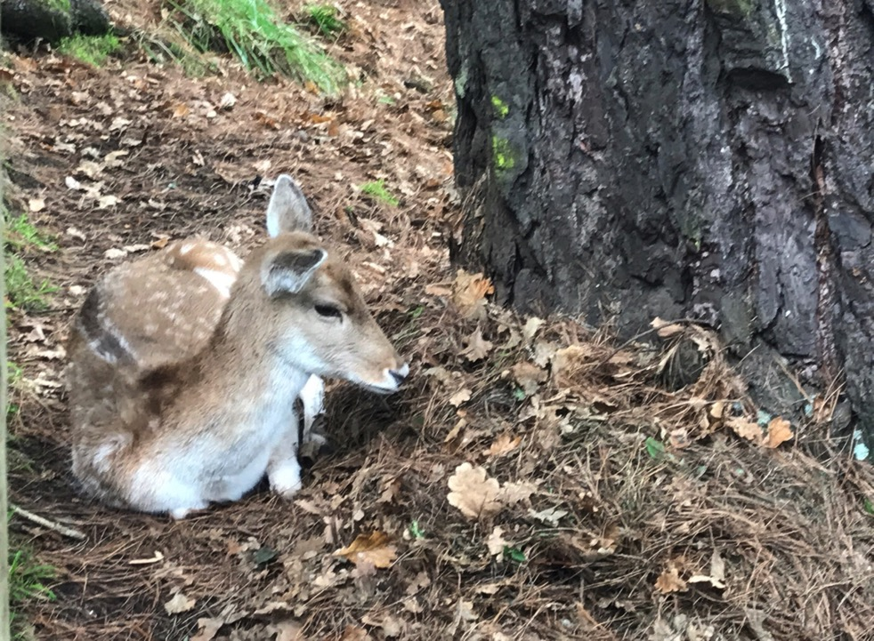
Let me hear
Let me hear
What you will speak
When I turn to You
In my heart.

Slide 60
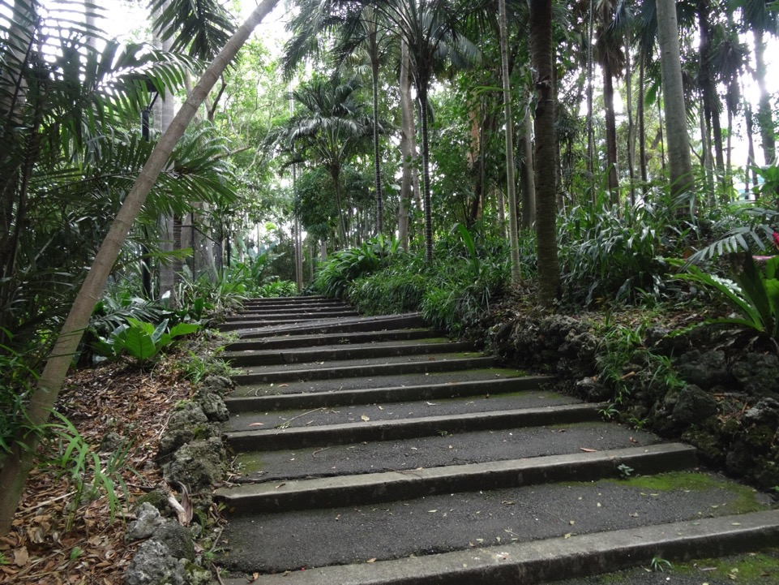

Slide 61
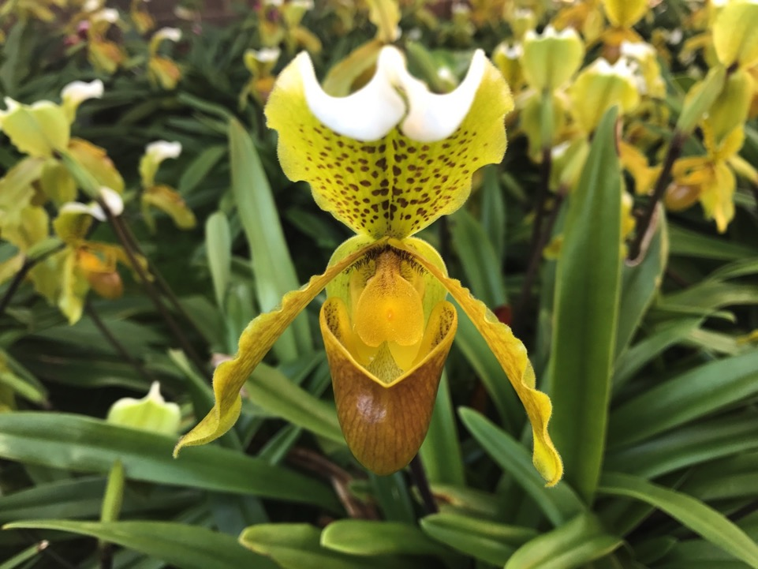
Let me hear
Let me hear
What you will speak
When I turn to You
In my heart.

Slide 62
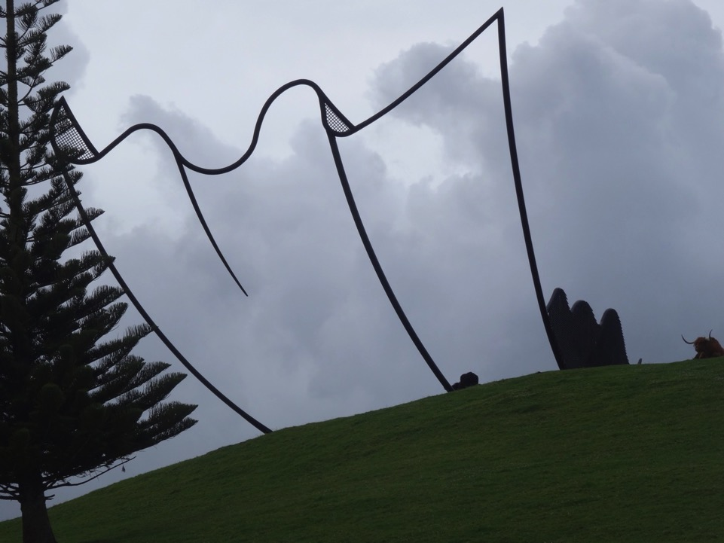
Let me hear
Let me hear
What you will speak
When I turn to You
In my heart.

Slide 63
One Soul
When we sit in a circle and grow still
The energy of the Spirit fills us.
Until we surrender to silence,
We stay on the choppy surface of the mind.
As the breath grows quiet,
we go behind thought, beneath confusion,
fear and doubt.
When we sit here in a circle and share truth,
the mystery of speech and listening
transforms our separate energies into one being –
Present and Fulfilled.

Slide 64
How might you in your Mission
grow in inclusivity in response
to the call of the Gospel?
What are We…
saying, feeling
about inclusivity?

