Slide 1
Key measures
TABLE WITH SECTIONS
MISSION
ONE HEART MANY VOICES SYDNEY – 13-15 MAY 2019
CARROLL & O’DEA SEMINAR PARTICIPATION– ON MONDAY 13 MAY 2019 GOOD GOVERNANCE FOR EFFECTIVE MISSION

Slide 2
Current Trends
Improvement in not for profit sector
Role of regulator
Training

Slide 3
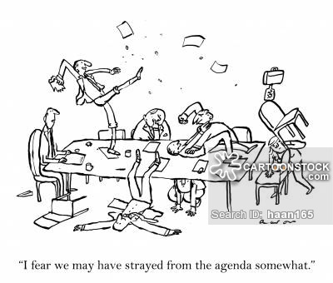
Communication

Slide 4
How important are structures?
Which entity to use?
Companies limited by guarantee
Public juridic persons

Slide 5
Mission ownership

Slide 6
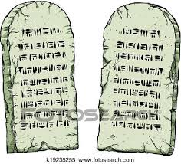
Constitution

Slide 8
Key measures
TABLE WITH SECTIONS

