Slide 1

“Bring in the poor and the crippled”
Spiritual accompaniment among the fringes
Elizabeth Lee
elizabethlee59@gmail.com
Monday 13th May 2019
Mission 2019: One Heart, Many Voices

Slide 2

Acknowledgement of Country

Slide 3
Gathering Blessing
Blessing on us present
May we give with a loving heart this day,
and receive the satisfaction that comes with doing so.
May we receive from others with openness,
and allow them the gift of giving to us.
May you acknowledge our vulnerability,
and have the wisdom to recognize our need.
May we reach out with continual kindness
and do so with a loving and peaceful heart.
Based on a Blessing by Joyce Rupp
https://www.joycerupp.com/a-new-years-prayer/

Slide 4
One sentence to share, say it on a breath…..
Name, Where you are from, Why have you come.
Introductions

Slide 5
The Challenge of Language

Slide 6
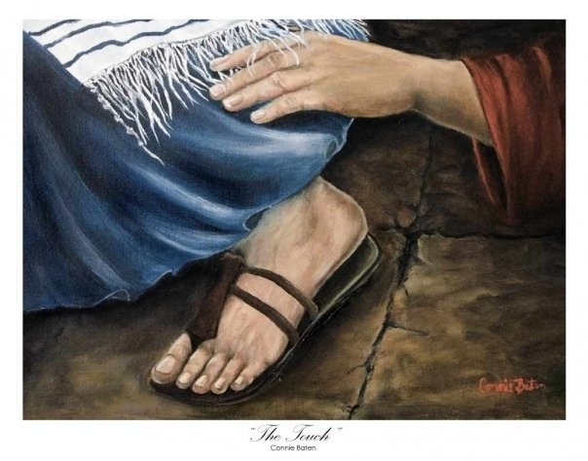

Slide 8


Slide 9
How are you spiritually nourished daily, weekly, monthly and annually?
Now imagine that you are homeless, or escaping domestic violence, just come out of jail, in a drug rehab for 9 months, living with mental health issues, lonely, bereft or dying. Under any one of these circumstances, how would you envisage that you are being nourished spiritually?
What might you be desiring?

Slide 10
Who comes?
Who is not invited?

Slide 11
Spirituality
Spirituality is about what gives us purpose in our lives. It is about our sources of meaning and hope, which in turn is intimately related to our connectedness to ourselves, to others and to the world. (From: National Guidelines for Spiritual Care in Aged Care)

Slide 12
My definition of Spiritual Direction/Accompaniment
Spirituality is about what gives us purpose in our lives. It is about our sources of meaning and hope, which in turn is intimately related to our connectedness to ourselves, to others and to the world. (From: National Guidelines for Spiritual Care in Aged Care)
Spiritual Direction can be seen as a relationship of ‘attentive companionship’ where one person (the Spiritual Director) respectfully and reverently listens to another (the Directee) and helps them notice, name and respond to what is unfolding in their life and explore what gives their life meaning and purpose. A Spiritual Director accompanies a person as they share the stories of their life, their fears and anxieties, their joys and delights, what is life giving and what is life denying. It is ultimately about the life and well-being and the growth of directee’s relationship with self, others and creation, affirming the basic quest for meaning. Regardless of the directee’s relationship with God, as a spiritual director I, through Divine grace, cultivate a space that is holy and fosters spiritual intimacy.

Slide 13
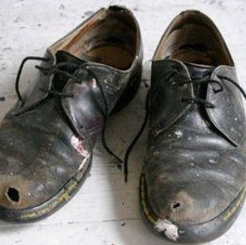
Simon*
* Names have been changed.

Slide 14
Simon* Colin*
* Names have been changed.

Slide 15
Simon* Colin*
Peter*
* Names have been changed.

Slide 16
Something of my recent story
For a long time I had been wondering if I was being called to be a spiritual director
2010 experienced a call to prison ministry
Took leave from teaching, commenced CPE (clinical pastoral education) training
2011-2015 Chaplin at MRRC
October 2015 commenced at Matthew Talbot Hostel
From 2013- 2016 I trained as a Spiritual Direction
Desire to offer Spiritual Direction among those “in the margins”
Too busy to allow this to unfold in any significant way
It was not going to happen while I had so many competing demands at MTH
Decided after 7 years I needed a sabbatical
September to December 2018 14 week sabbatical ~ 6 weeks in USA, 8 in UK for rest, renewal and reorientation

Slide 17


Slide 18


Slide 19
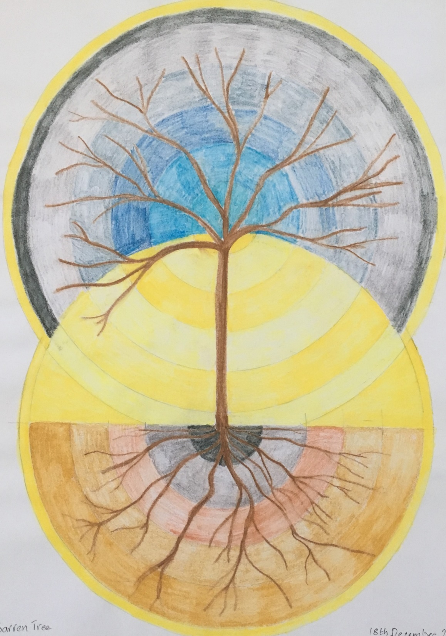

Slide 20
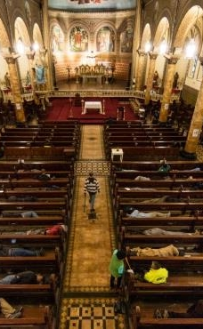
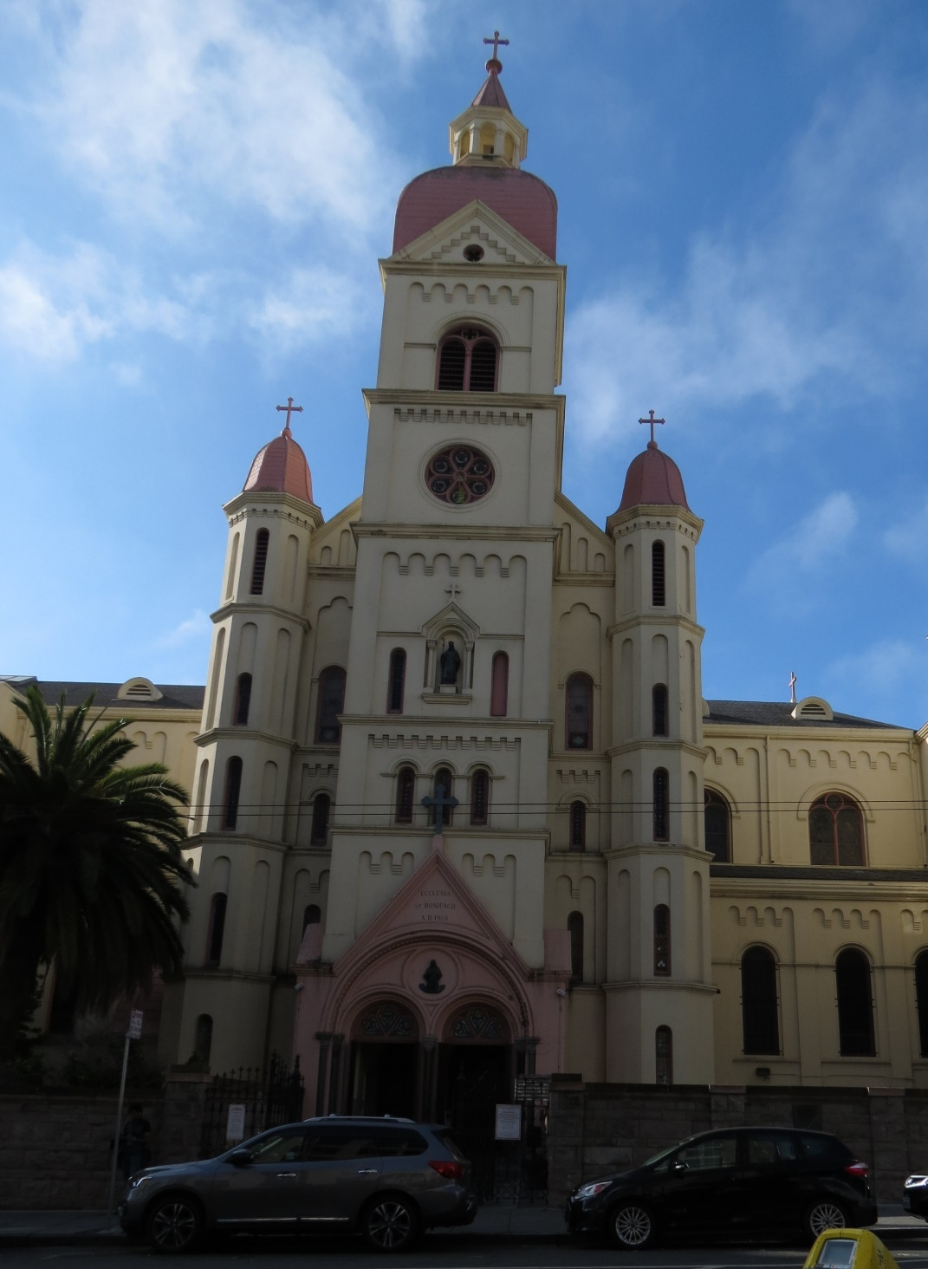
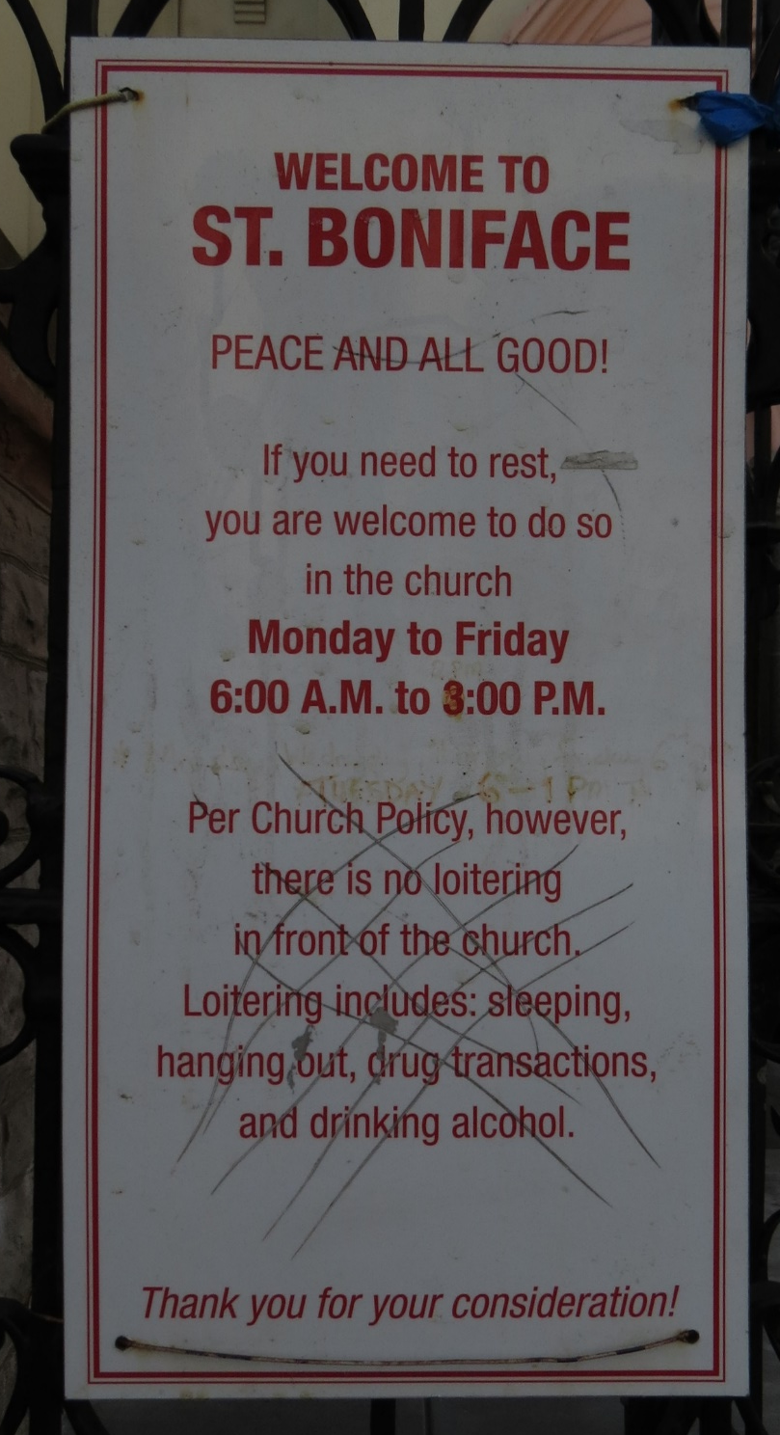

Slide 21
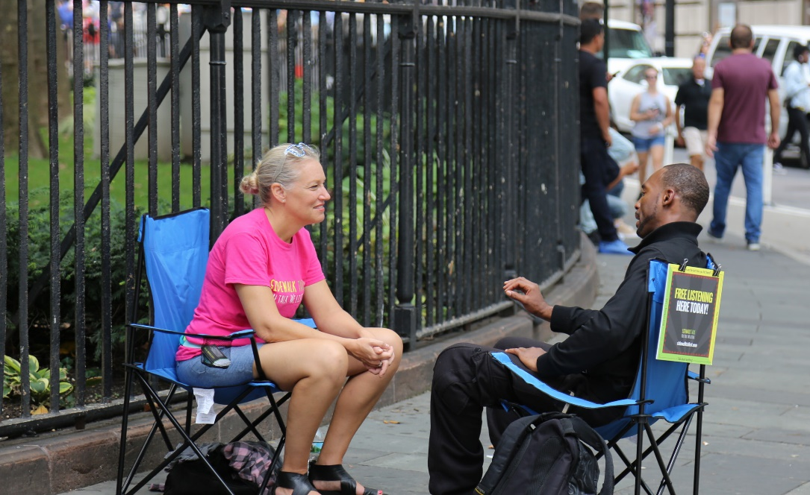

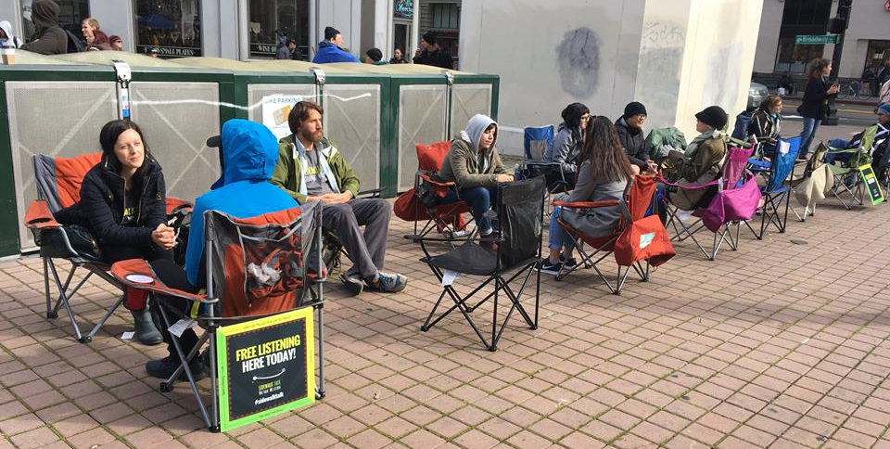

Slide 22
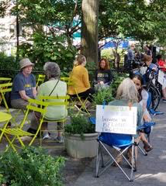
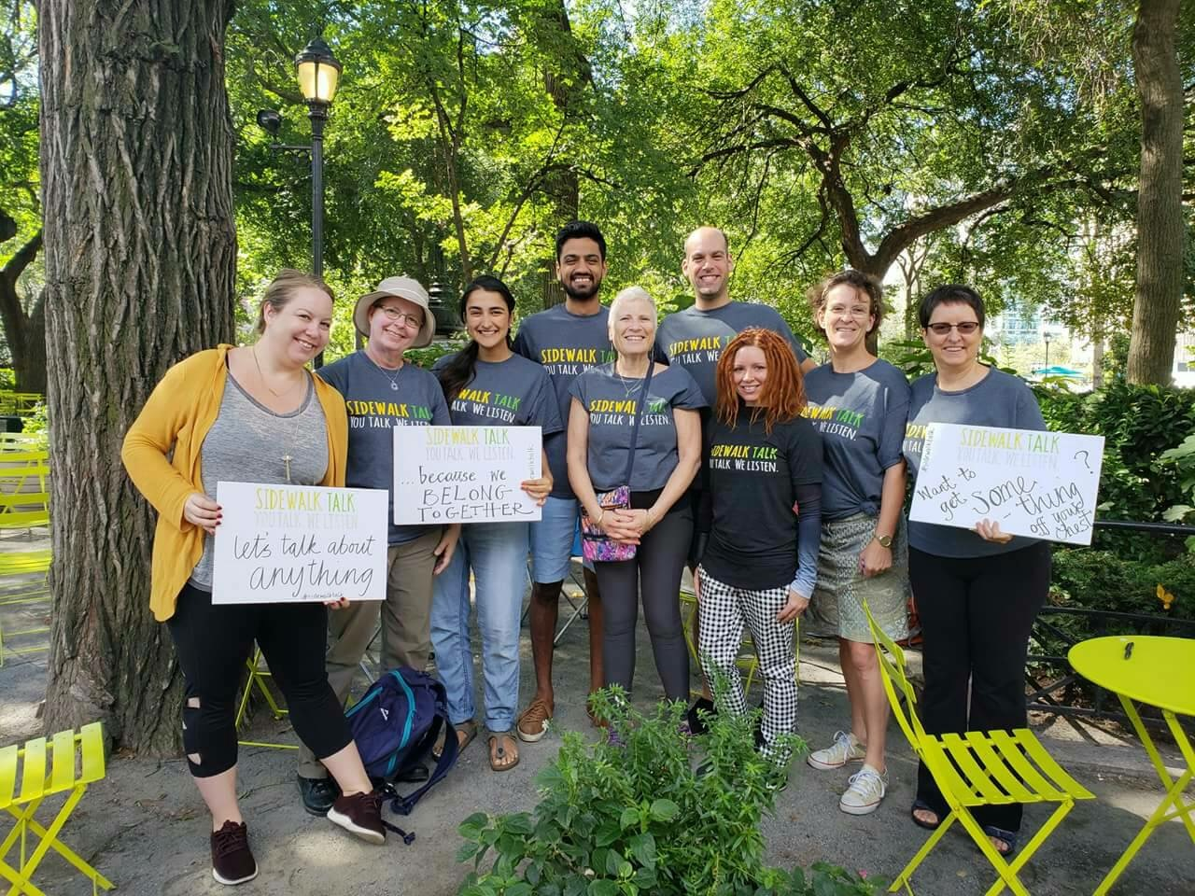

Slide 23

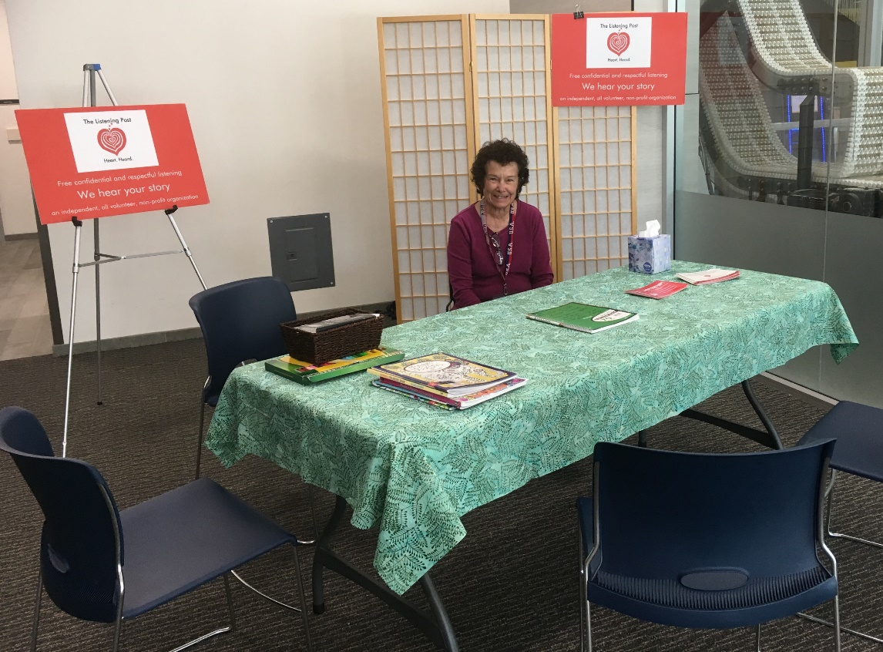

Slide 24


Slide 25
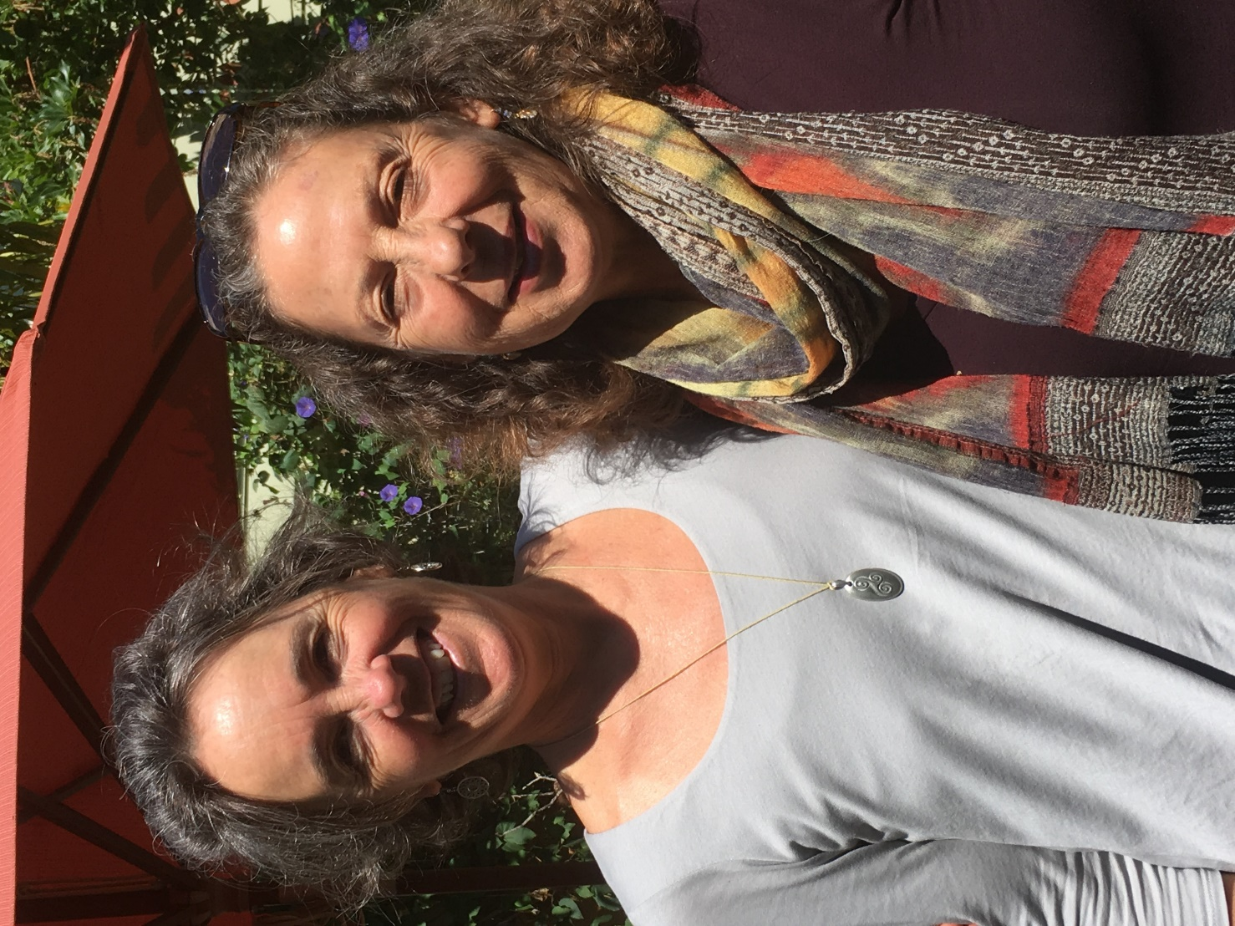

Slide 26
“Not only is there a growing homelessness problem here - and across the world - which is touching more and more people, but there is also a certain homelessness of the soul - of the inner, And so when we offer a place for women to meet and connect at this level, while their outer problems remain, they are able to find peace - home, even if just for an hour. Slowly something comes alive in the women through this process. Not for all, of course, because some wounds are so deep, and their issues can be complex. But there is usually a healing that takes place, even if it is just a felt experience of being welcomed, as they are having their sacredness reflected."
Finding Home: Restoring the Sacred to Life - Stories of Women in Homelessness & Transition, Anne Scott writes;

Slide 27
In everyone’s life, there is great need for am anam ċara, a soul friend. In this love, you are understood as you are without mask or pretension. The superficial and functional lies and half-truths of social acquaintance fall away, you can be as you really are. Love allows understanding to dawn. . . . Where you are understood, you are home. . . . When you really feel understood, you feel free to release yourself into the trust and shelter of the other person’s soul. . . . This art of love discloses the special and sacred identity of the other person. . . .
Richard Rohr
https://cac.org/trinity-part-1-weekly-summary-2019-05-11/

Slide 28
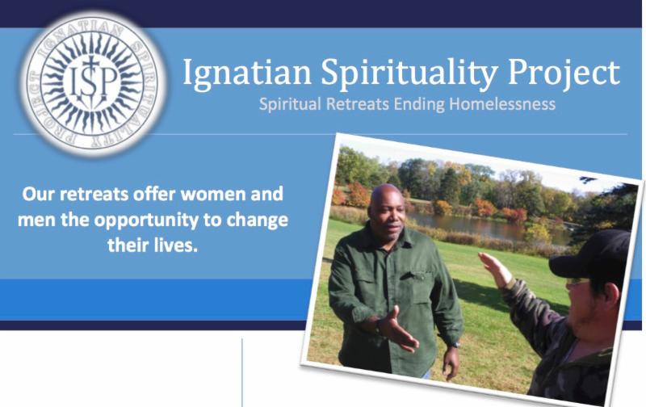

Slide 29
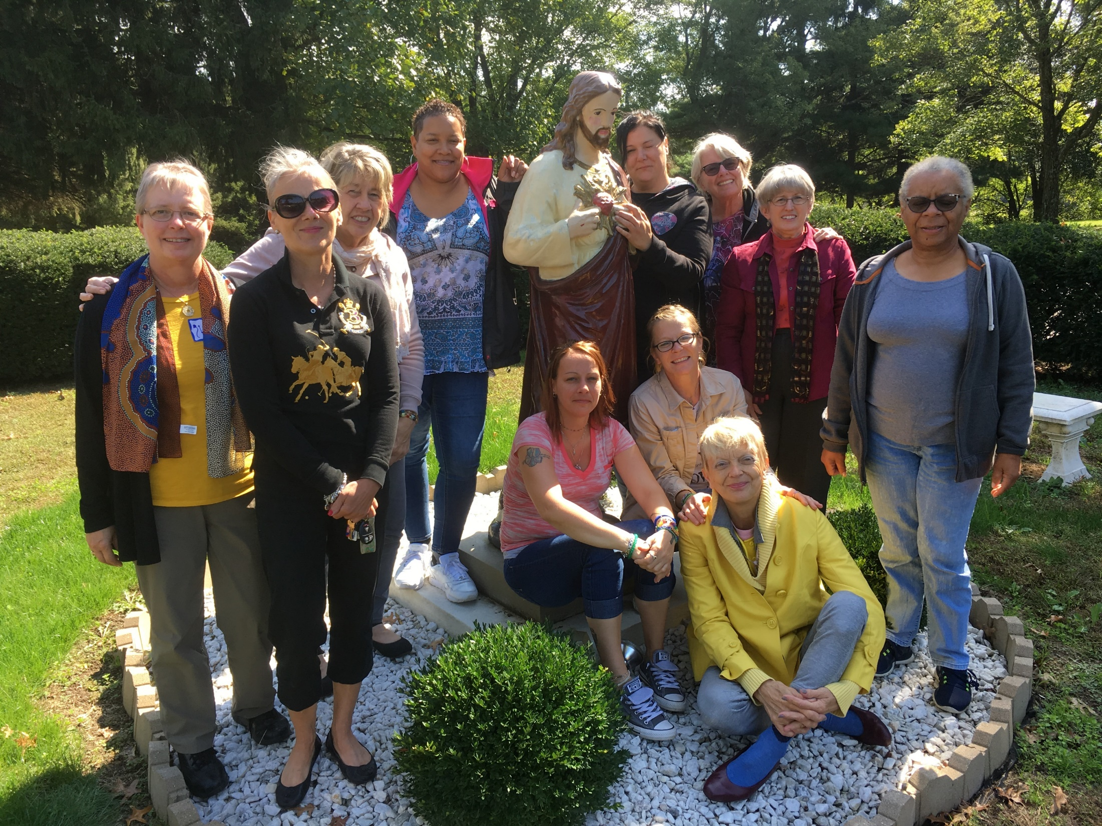

Slide 30
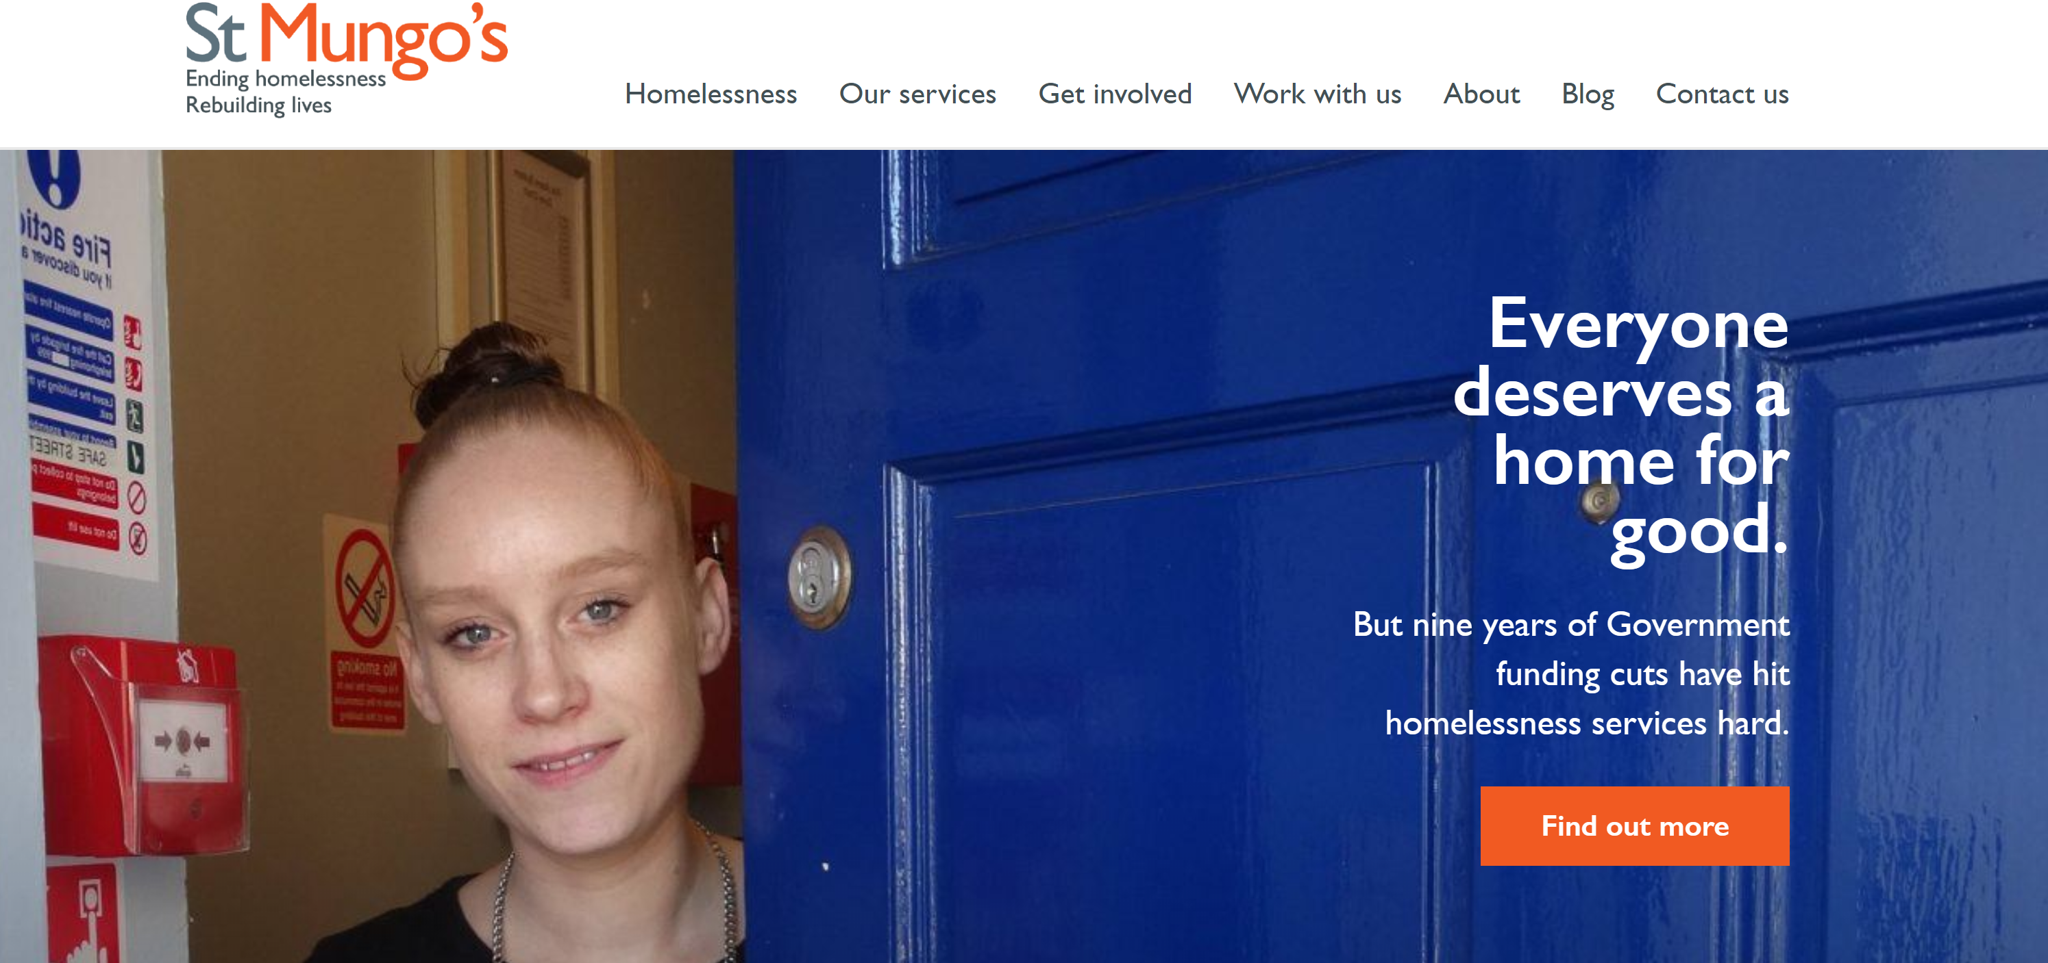

Slide 31
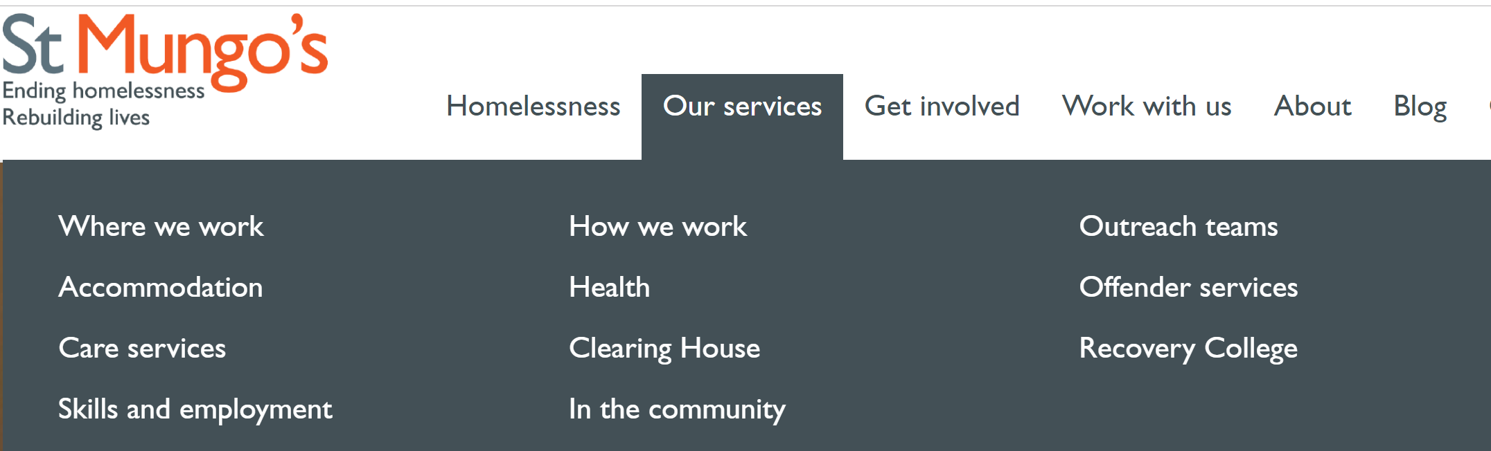

Slide 32
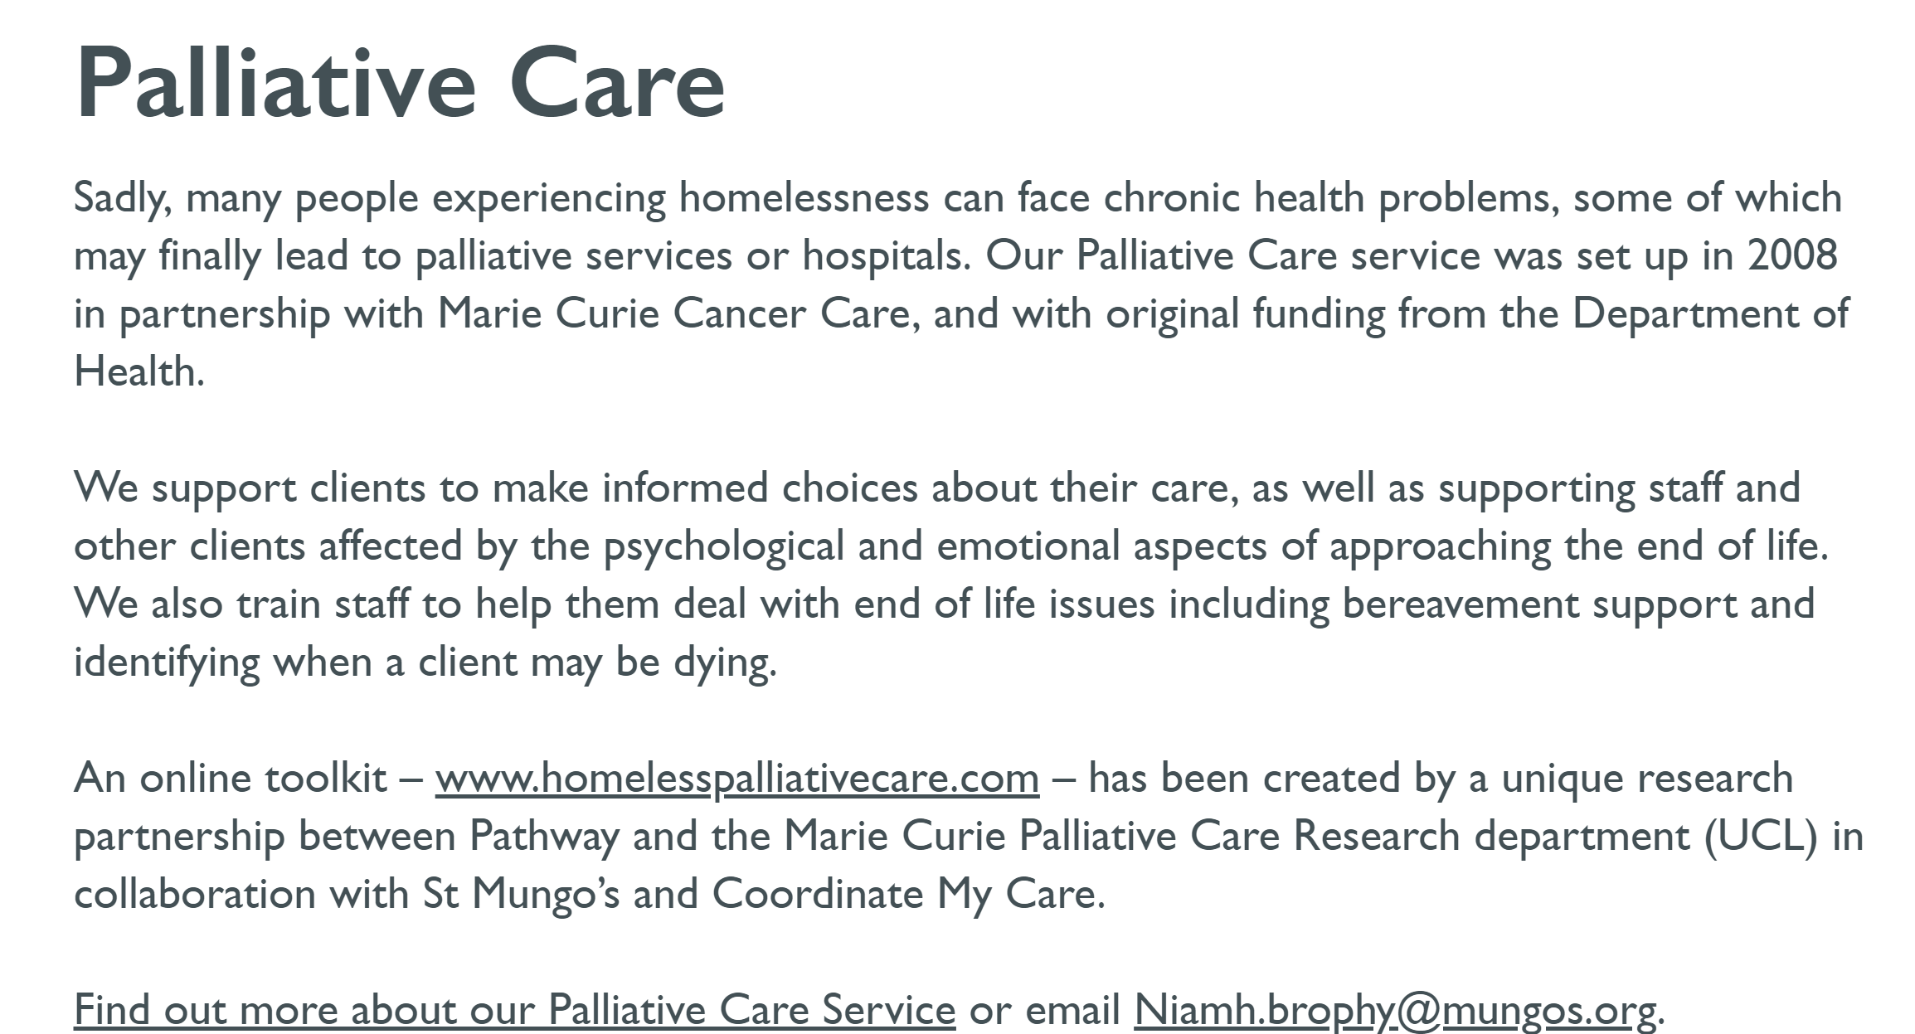

Slide 33


Slide 34
Retreats
Networking
Reflection Days
Facilitation
Ignatian Spirituality Project
End of life care for the homeless
Listening Circles
Formation for those present in the fringes
and supervison
1:1 Listening

Slide 35
“The Church exists to bring about an encounter with the visceral love of God’s mercy. To do this the Church must go outside to look where people live, where they suffer, where they hope. The Christian message is transmitted by embracing those in difficulty, by embracing the outcast, the marginalized.” Pope Francis

Slide 36
“The Church exists to bring about an encounter with the visceral love of God’s mercy. To do this the Church must go outside to look where people live, where they suffer, where they hope. The Christian message is transmitted by embracing those in difficulty, by embracing the outcast, the marginalized.” Pope Francis
I believe many are devoting their time, energy, their lives to feeding the hungry, sheltering the homeless, clothing the naked, visiting the sick and imprisoned.

Slide 37
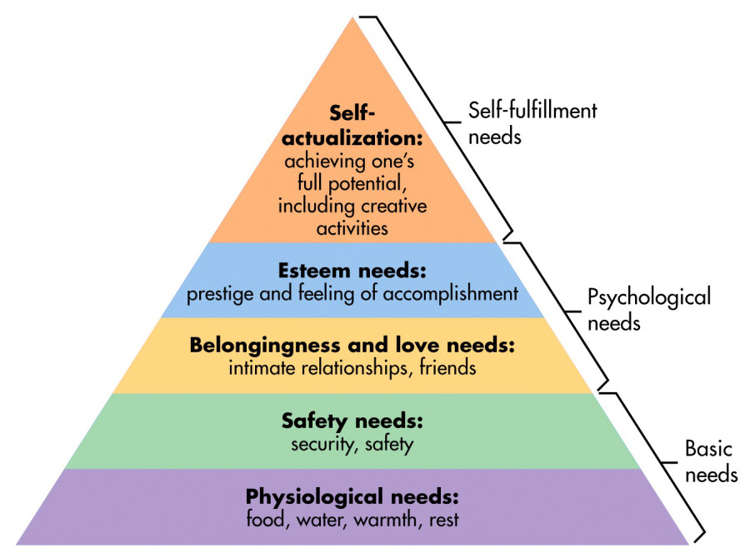

Slide 38
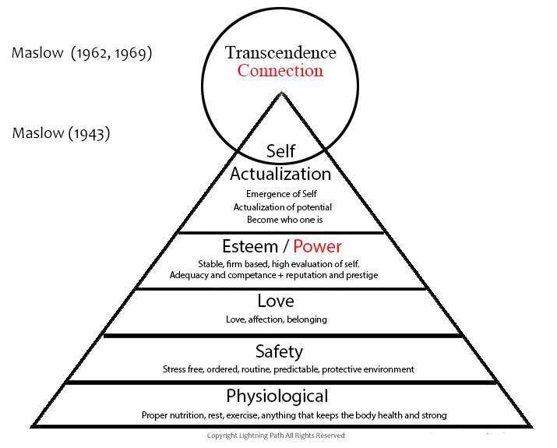

Slide 39
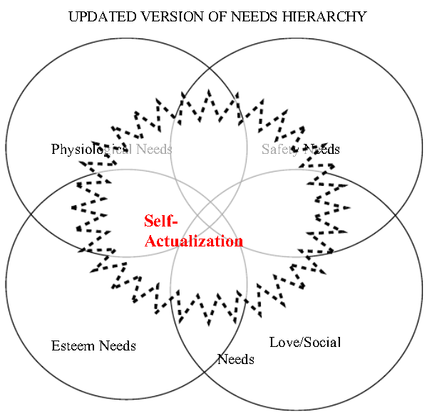

Slide 40
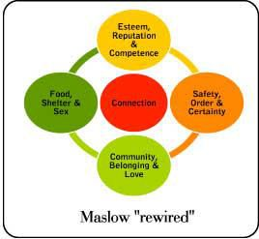

Slide 41
“In our loneliness and isolation, there is a deep longing, a yearning, usually unconscious or ignored, to belong, to be connected to a larger whole, to not be anonymous, to be seen and known. For relationality, exchange, give and take, especially on an emotional plane, is how we are reminded that we have a place in this world, how we know in our hearts that we do belong.”
John Kabat-Zinn. Coming to Our Senses: Healing Ourselves and The World Through Mindfulness. (New York: Hyperion, 2005), 144

Slide 42
“In our loneliness and isolation, there is a deep longing, a yearning, usually unconscious or ignored, to belong, to be connected to a larger whole, to not be anonymous, to be seen and known. For relationality, exchange, give and take, especially on an emotional plane, is how we are reminded that we have a place in this world, how we know in our hearts that we do belong.”
John Kabat-Zinn. Coming to Our Senses: Healing Ourselves and The World Through Mindfulness. (New York: Hyperion, 2005), 144
“…many individuals, I think, are driven to talking to themselves and to the mannequins of their lives, because no one around them listens to them or cares about them. They are not mentally ill, they are just lonely. Some folk connect more with cockroaches, mice, cats dogs, birds and plants in their SRO (single room occupancy hotels) rooms than they do with other human beings. This is not so much by choice, as it is as a result of the poison of human disregard.”
Gary Smith. Radical Compassion: Finding Christ in the Heart of the Poor. (Chicago: Loyola Press, 2002), 28

Slide 43
Banquets are not just about the food

Slide 44
What possible spiritual banquets can we invite people to?

Slide 45
What possible spiritual banquets can we invite people to? (Think, pair, share)
What spiritual accompaniment do you/could you, and those with whom you work, offer those among the fringes?
Who else, particularly those among the fringes, could be included in what you already offer and how?

Slide 46
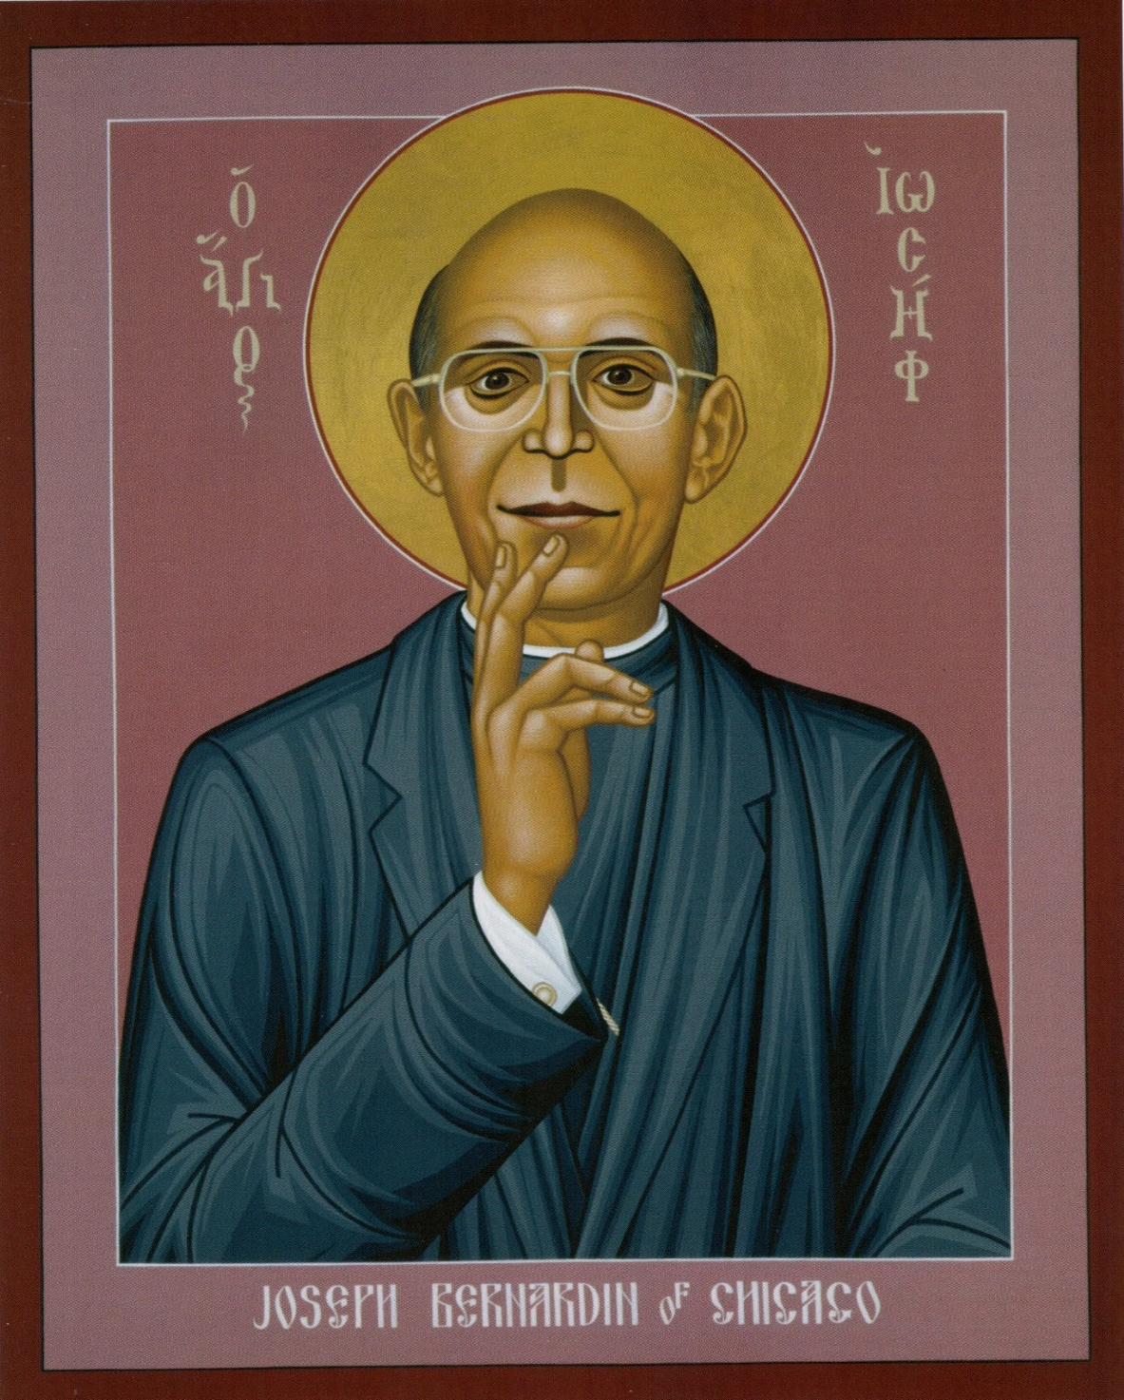
Robert Lentz says of his icon of
Cardinal Bernardin of Chicago:
“Cardinal Bernardin gazes out at us as he did so often in his life, in the pose of one who listens- and one who listens well. It is not always easy to hear what the marginalized have to tell us. Their truth may be blurred by anger, slurred by pain, or whispered from insecurity or fear. When a person at the centre, like Joseph Bernardin, makes the effort to listen to those at the margins, however, miracles happen and God’s kingdom reappears.”
Robert Lentz and Edwina Gately. Christ in the Margins (New York: Orbis Books Maryknoll 2003), 68-69

Slide 47
Three R’s
Where has there been resonance for you today?
Where has there been resistance for you today?
Where has there been realignment for you today?
To remain in contact and explore further
possibilities please put your contact details
and ideas on the blue paper

Slide 48
Gratitude
What are you grateful for from today?

Slide 49
Gratitude
What are you grateful for from today?
“If the only prayer you ever say
in your entire life is thank you,
it will be enough. “
Meister Eckhart

