Slide 1
MISSION 2019: ONE HEART MANY VOICES
LEADERSHIP FOR MISSION
13-15 MAY 2019
SYDNEY, AUSTRALIA

Slide 2
CONTEXT

Slide 3
CONTEXT

Slide 4
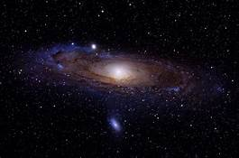
CONTEXT

Slide 5
CONTEXT

Slide 6
CONTEXT

Slide 7
CONTEXT

Slide 8
CONTEXT

Slide 9
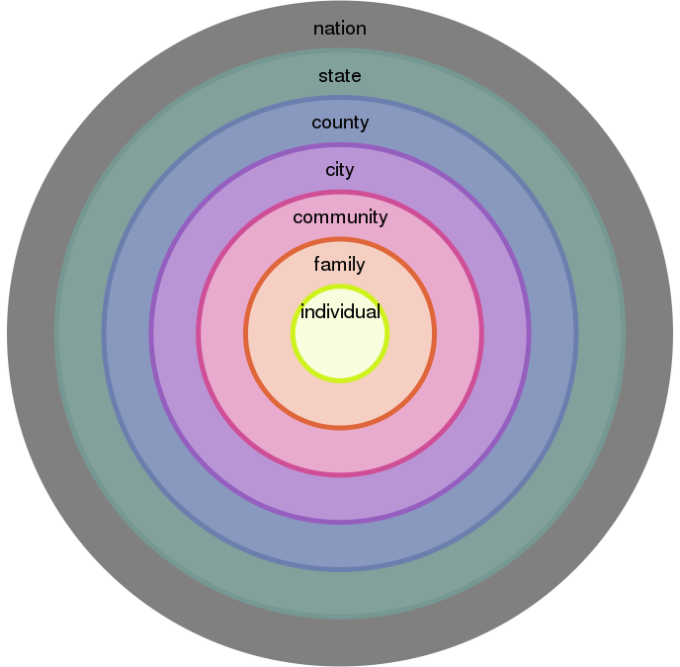
CONTEXT

Slide 10
context
HOLON: PARTS AND WHOLES
LETTER
LETTER WITHIN A WORD
WORD WITHIN A SENTENCE
SENTENCE WITHIN A PARAGRAPH
PARAGRAPH WITHIN A PAGE
PAGE WITHIN A CHAPTER
CHAPTER WITHIN A BOOK
BOOK WITHIN A LIBRARY
LIBRARY WITHIN LIBRARIES
LIBRARIES WITHIN LIBRARIES…

Slide 11
CONTEXT

Slide 12
CONTEXT

Slide 13
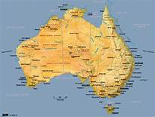
CONTEXT

Slide 14
CONTEXT

Slide 15
CONTEXT

Slide 16
CONTEXT

Slide 17
CONTEXT

Slide 18
CONTEXT
SCRIPTURE
OUTER WORLD
INNER WORLD
BEAUTY (MUSIC/ART…)

Slide 19
Becoming a church beyond 2020
THE CHURCH IS THE PEOPLE OF GOD---ALL OF THEM, ALL THE TIME
OUR BAPTISM MAKES US MEMBERS—ONLY/ALWAYS
THE CHURCH ENGAGES THE WORLD THE SAME WAY THAT JESUS ENGAGED THE WORLD

Slide 20
BECOMING A CHURCH BEYOND 2020
PEOPLE OF GOD:
WELCOME
HOSPITALITY
RESPECT
MUTUALITY
VULNERABILITY
DIVERSITY IS KEY TO UNITY
INCLUSIVITY

Slide 21
BECOMING A CHURCH BEYOND 2020
INCLUSIVITY:
RACE
GENDER
CULTURE
ETHNICITY
AGE
POWER AND CONTROL
DOMINATION AND ELITISM
DENIAL OF REALITY

Slide 22
BECOMING A CHURCH BEYOND 2020
WHAT ATTITUDE OF MIND, HEART AND WILL IS NEEDED IN ORDER FOR THE CHURCH (YOU/ME/US) TO BECOME AN INCLUSIVE CHURCH?

Slide 23
BECOMING A CHURCH BEYOND 2020
OUR BAPTISM MAKES US MEMBERS:
IDENTITY
BELONGING
COMMUNITY OF EQUALS
ECCLESIAL COMMUNION
DIALOGUE---THROUGH WORDS WE CREATE MEANING

Slide 24
BECOMING A CHURCH BEYOND 2020
DIALOGUE:
DESIRE TO LISTEN
LEARN TO LISTEN
LISTEN WITHOUT AN AGENDA/OUTCOME
LISTEN UNDER THE WORDS
LISTEN TO HEAR THE HEART
LISTEN FOR THE PRESENCE/WORD OF GOD

Slide 25
BECOMING A CHURCH BEYOND 2020
WHAT ATTITUDE OF MIND, HEART AND WILL IS NEEDED IN ORDER FOR THE CHURCH (YOU/ME/US) TO BECOME A CHURCH WHERE DIALOGUE IS THE NORM?

Slide 26
BECOMING A CHURCH BEYOND 2020
THE CHURCH ENGAGES THE WORLD:
WIDEN THE CIRCLE
INCREASE THE SCOPE OF COMMUNITY
ENTER NEW PLACES OF THOUGHT AND AWARENESS
ENCOUNTER EACH PERSON IN THE WAY YOU WOULD ENCOUNTER GOD/JESUS

Slide 27
BECOMING A CHURCH BEYOND 2020
ENCOUNTER:
WILLINGNESS TO FULLY MEET THE OTHER
ABILITY TO BOTH MEET AND BE IMPACTED BY THE OTHER
INTENTIONAL COMMTIMENT TO TRANSFORMATION
READINESS TO EXPERIENCE THE MYSTERY OF GOD IN OUR LIVES/PRESENCE

Slide 28
BECOMING A CHURCH BEYOND 2020
WHAT ATTITUDE OF MIND, HEART AND WILL IS NEEDED IN ORDER FOR THE CHURCH (YOU/ME/US) TO BECOME A CHURCH OF ENCOUNTER?

Slide 29
BECOMING A CHURCH BEYOND 2020
OUR CHURCH IS EITHER INCLUSIVE OR NOT (EXCLUSIVE)
OUR CHURCH IS ONE OF DIALOGUE OR NOT (DIDACTIC)
OUR CHURCH IS ONE OF ENCOUNTER OR NOT (AVOID)

Slide 30
BECOMING A CHURCH BEYOND 2020
INCLUSIVITY, DIALOGUE AND ENCOUNTER NEED TO BECOME A WAY OF LIFE FOR YOU/ME/US
INCLUSIVITY, DIALOGUE AND ENCOUNTER WILL CONTINUE TO CALL US TO TRANSFORMATION

Slide 31
BECOMING A CHURCH BEYOND 2020
INCLUSIVITY, DIALOGUE AND ENCOUNTER ARE THE CHURCH BEYOND 2020
INCLUSIVITY, DIALOGUE AND ENCOUNTER ARE WHO WE NEED TO BECOME

Slide 32
BECOMING A CHURCH BEYOND 2020
WHAT MIGHT THE WORLD LOOK LIKE IF THE CHURCH BECAME A LIVING EXPRESSION OF THE LIFE, DEATH AND RESURRECTION OF JESUS CHRIST?

Slide 33
CONTEXT
LEADERSHIP …MISSION
JOY OF THE GOSPEL
PRACTICING THE GOSPEL
ENCOUNTER AS PASCHAL MYSTERY

Slide 34
JOY OF THE GOSPEL

Slide 35
JOY OF THE GOSPEL
CHOOSING HOW WE WILL BE…
CHOOSING HOW WE WILL NOT BE…
CHOOSING THE DIFFERENCE…

Slide 36
JOY OF THE GOSPEL
LOVE OVER FEAR:
FEAR FUNCTIONS AS CERTITUDE
FEAR MASKS AS CONTROL
FEAR HIDES VULNERABILITY

Slide 37
JOY OF THE GOSPEL
F (ALSE)
E (VIDENCE)
A (PPEARING)
R (EAL)

Slide 38
JOY OF THE GOSPEL
LOVE OVER FEAR:
LOVE WELCOMES ALL
LOVE ENGAGES ALL
LOVE FORGIVES ALL

Slide 39
JOY OF THE GOSPEL
L (OOKING AT)
O (THERS) with the
V (ERY)
E (YES) of God

Slide 40
JOY OF THE GOSPEL
MERCY OVER JUDGMENT
JUDGMENT LIVES WITHIN
JUDGMENT LOOKS OUT FOR EGO
JUDGMENT LEANS TOWARDS SUPERIORITY

Slide 41
JOY OF THE GOSPEL
MERCY OVER JUDGMENT
MERCY IS GOD’S NAME
MERCY IS UNEARNED
MERCY IS OUR NAME

Slide 42
JOY OF THE GOSPEL
INCLUSION OVER EXCLUSION
NEED TO DOMINATE
NEED TO LEGISLATE
NEED TO ESCALATE

Slide 43
JOY OF THE GOSPEL
INCLUSION OVER EXCLUSION
CIRCLES NOT WALLS
WIDE NOT NARROW
POROUS NOT RIGID

Slide 44
REFLECTION
WHAT ARE YOU HEARING?
WHAT ARE YOU FEELING?
WHAT DIFFERENCE DOES IT MAKE?

Slide 45
PRACTICING THE GOSPEL

Slide 46
PRACTICING THE GOSPEL
NAMING GLOBAL REALITY (WE ARE)
CLAIMING CHURCH REALITY (WE ARE)
TAMING RELATIONAL REALITY (WE ARE)

Slide 47
PRACTICING THE GOSPEL
PROPHETIC RESPONSE
NEED TO LISTEN TO GOSPEL
NEED TO SPEAK THE GOSPEL
NEED TO WITNESS FOR GOSPEL
YDITM

Slide 48
PRACTICING THE GOSPEL
DISCIPLESHIP RESPONSE
MISSIONARY STANCE
CONTEMPLATIVE STANCE
FAITHFUL STANCE
WYAL?

Slide 49
PRACTICING THE GOSPEL
MUTUALITY RESPONSE
SENSE OF COMMON GOOD
SENSE OF INTERDEPENDENCE
SENSE OF HUMILITY AND CURIOSITY
URI

Slide 50
REFLECTION
WHAT ARE YOU HEARING?
WHAT ARE YOU FEELING?
WHAT DIFFERENCE DOES IT MAKE?

Slide 51
ENCOUNTER AS PASCHAL MYSTERY

Slide 52
ENCOUNTER AS PASCHAL MYSTERY
YES TO A WAY OF LIFE
YES TO A WAY OF RELATING
YES TO A WAY OF THE HEART

Slide 53
ENCOUNTER AS PASCHAL MYSTERY
COMMITTING TO AN ENGAGING WAY OF BEING
INVOLVED WITH/IN
OCCUPY SOMEONE’S ATTENTION
PLEDGE/ENTER INTO A CONTRACT

Slide 54
ENCOUNTER AS PASCHAL MYSTERY
COMMITTING TO AN EMERGING WAY OF LIVING
COMING FORTH
BECOMING KNOWN
COMING TO LIGHT

Slide 55
ENCOUNTER AS PASCHAL MYSTERY
COMMITTING TO AN EVOLVING WAY OF LOVING
DEVELOP GRADUALLY
MAKE MORE COMPLEX
UNFOLDING/ROLLING OUT

Slide 56
REFLECTION
WHAT ARE YOU HEARING?
WHAT ARE YOU FEELING?
WHAT DIFFERENCE DOES IT MAKE?

Slide 57
LEADERSHIP FOR MISSION

Slide 58
LEADERSHIP FOR MISSION

Slide 59
LEADERSHIP FOR MISSION
I HAVE MADE YOU A LIGHT…
HAVE LIFE AND HAVE IT MORE ABUNDANTLY…
I CHOOSE YOU TO GO AND BEAR FRUIT…
SET APART FOR ME…
THE WORK TO WHICH I CALLED YOU…
LOVE ONE ANOTHER…

